Slide 1
NEXT GENERATION WARNING SYSTEM
GRANT PROGRAM
Faisal Khan, Executive Director, NGWS
Kyle Cromer, Kevin Maloof,
Meirah Shedlo Eidelman
www.cpb.org
Next Generation Warning System Grant Program

Slide 2
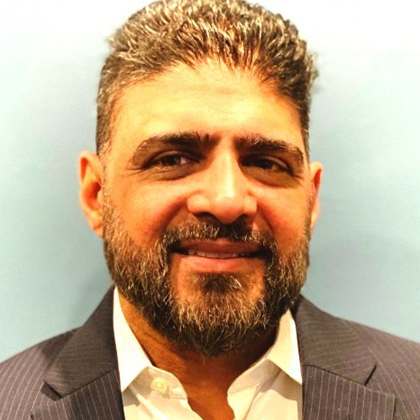
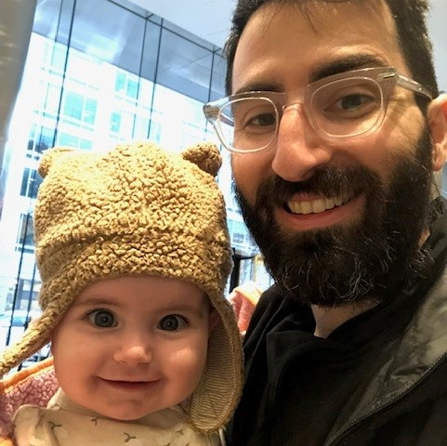
The Team
Faisal Khan
Kyle Cromer
Kevin Maloof
Meirah Shedlo Eidelman
Executive Director
Director, Budget and Compliance
Project Manager
Project Manager
www.cpb.org
Next Generation Warning System Grant Program

Slide 3
Objectives
of the grant program
The program advances DHS/FEMA’s goal to promote “an effective system for warning and informing the American public of impending natural and man-made disasters is an essential part of America's emergency preparedness.”
www.cpb.org
Next Generation Warning System Grant Program

Slide 4
Objectives
of the grant program
Enhance stations’ capacity
Upgrade to digital radio and ATSC 3.0
CPB will award subgrants to eligible, high priority stations to fund equipment purchases, installation, and training that advance the mission of the NGWSGP.
Improve technology infrastructure
Expand emergency alerting
www.cpb.org
Next Generation Warning System Grant Program

Slide 5
Priority 1
Prioritization Criteria
Tribal, minority, and/or rural stations serving underserved communities
Priority 2
Small stations
Priority 3
Other television and radio stations - All public broadcasting entities as defined in 47 U.S.C. §397(11) are eligible to apply. Eligibility is not contingent upon whether a public broadcasting entity qualifies for CPB’s Community Service Grant (CSG) program.
www.cpb.org
Next Generation Warning System Grant Program

Slide 6
Prioritization Criteria
Station characteristics
Project proposal
Uniqueness of coverage
Geographic special risk factors
Public safety/alerting impact
Nature of the equipment request
Project management capability
Partnerships with local/regional/state emergency management officials
www.cpb.org
Next Generation Warning System Grant Program

Slide 7
Project Funding Overview
Funding
$34 million
Contracting
Environmental and Historic Preservation Review (EHP)
CPB is administering; recipients are FEMA subrecipients and subject to federal grant requirements
Applicants must submit a FEMA Environmental and Historic Preservation Review questionnaire
No funding match or cost share is required.
Funds will be granted as reimbursements.
www.cpb.org
Next Generation Warning System Grant Program

Slide 8
Eligible equipment scope/allowable costs can include:
Project Scope and Eligible Equipment
Advanced technology to enable IPAWS alerting capability
Generally, applications should focus on transmission equipment that would improve a station’s airchain infrastructure or improve the resiliency of the airchain in establishing or enhancing emergency alerting.
Common Alert Protocol (CAP) compliant
EAS boxes
Generators and other equipment enabling operation during disasters
www.cpb.org
Next Generation Warning System Grant Program

Slide 9
Non-allowable costs will include, but are not limited to:
Project Scope and Eligible Equipment
Vehicles
Funding of staff positions
Generally, applications should focus on transmission equipment that would improve a station’s airchain infrastructure or improve the resiliency of the airchain in establishing or enhancing emergency alerting.
General cosmetic and structural station upgrades and maintenance
Any cost incurred prior to award, and prior to CPB approval
Covered equipment
www.cpb.org
Next Generation Warning System Grant Program

Slide 10
1
Application Instructions
Go to the Next Generation Warning System Grant Program Request for Applications at CPB.org:
https://cpb.org/grants/Next-Generation-Warning-System-Grant-Program
Deadline: 5PM ET on Wednesday, November 8
Grants are approved on a rolling basis.
2
Read the Request for Applications, which provides an overview of the program.
3
5
Check the CPB NGWS page, which will be updated with webinar announcements and Frequently Asked Questions.
Download the Grant Application and related documents, available under Related Documents.
4
Email ngws@cpb.org to request access to CPB’s Grants Management System.
www.cpb.org
Next Generation Warning System Grant Program

Slide 11
Application Document Checklist
You can download these documents from our grant webpage.
Application form
Equipment form
Proof of pricing
Risk assessment documents
Environment and Historic Preservation Form
Compliance and Exemption Form
Current coverage map(s) (optional)
Conflict of Interest Form*
*Not needed for the initial application

Slide 12
Q&A (and Helpful Links)
Contact us for more information!
ngws@cpb.org
Info + Helpful Links:
https://www.cpb.org/Next-Generation-Warning-System-Grant-Program
RFA and Application:
https://cpb.org/grants/Next-Generation-Warning-System-Grant-Program
Next Generation Warning System Grant Program

