Slide 1





Welcome
WELCOME
Next Generation Warning System Grant Program Training
Faisal Khan, Executive Director, NGWS
Wade Witmer, Deputy Director, FEMA IPAWS
Steve Calzone, FEMA IPAWS Contractor
www.cpb.org
Next Generation Warning System Grant Program

Slide 2
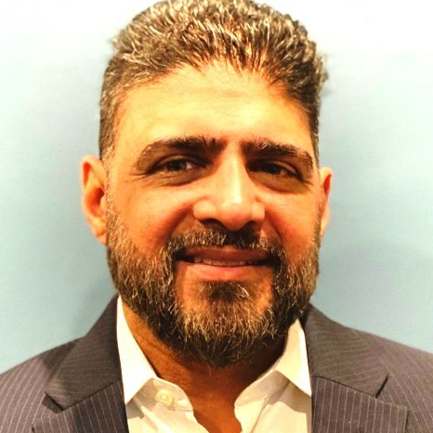






The CPB NGWS Team
Maciej Ochman
Director, Media Technology and Service Strategies
Faisal Khan
Kyle Cromer
Executive Director
Director, Budget and Compliance
Kevin Maloof
Meirah Shedlo Eidelman
Kamanzi Kalisa
Alexandra Dade
Project Manager
Project Manager
Project Manager
Project Manager
www.cpb.org
Next Generation Warning System Grant Program

Slide 3
Mandate
Implementing ATSC 3.0 (TV) and digital broadcast (radio) technology to deliver alerts
of the Notice of Funding Opportunity (NOFO)
CPB will award subgrants to eligible, high priority stations to fund equipment purchases, installation, and training that advance the mission of the NGWSGP.
Training for technology and resilience
Supporting the acquisition of
resilience-related equipment
www.cpb.org
Next Generation Warning System Grant Program

Slide 4
Training objectives
Provide working knowledge of ATSC 3.0 (commercially known as NextGen TV) and HD Radio
Explore the cost/benefits and value of upgrading to ATSC 3.0 and HD radio technology for consumers and emergency alerting
Technology transition and implementation
www.cpb.org
Next Generation Warning System Grant Program

Slide 5

Today’s training agenda
  Module 1: Introduction to FEMA’s Integrated Public Alert and Warning System
  Module 2: Introduction to the Next Generation Warning System Grant Program (NGWSGP)
  Module 3: Understanding AM/FM/HD Radio Technologies
  Module 4: Strategies for Managing Signal Coverage and Addressing Reception Challenges
  Module 5: Best Practices for EAS Integration for Radio Stations
  Module 6: Transitioning to Digital Radio – Pros and Cons
  Module 7: Fiscal Responsibility
  Q&A and Next Steps
www.cpb.org
Next Generation Warning System Grant Program

Slide 6
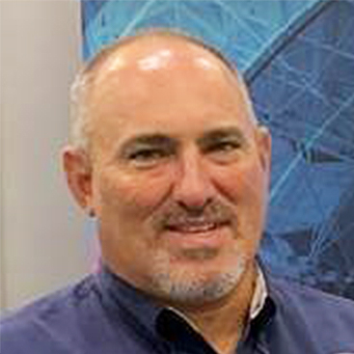
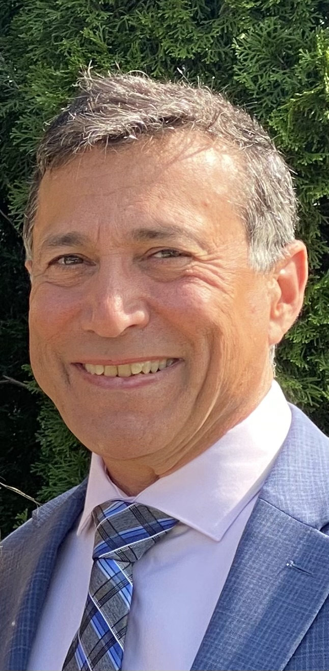
The FEMA IPAWS Team
Wade Witmer
Deputy Director, FEMA IPAWS
Steve Calzone
FEMA IPAWS Contractor Broadcast Engineer
Notes:
Wade: Thank you very much and hello to everyone that joined. I appreciate everyone’s attention and taking the time to listen to this presentation because this grant program is very important to FEMA and to the nation. We think this grant will really improve the general safety of the public across the country. I will explain a short overview of IPAWS, why the grant program is important to IPAWS, how we see you, radio broadcasters, fitting in, and how we are really looking to use this grant program to support your stations, your infrastructure, and your partnerships.

Slide 7
Introduction to FEMA’s Integrated Public Alert and Warning System (IPAWS)
Module 1: Introduction to IPAWS
Agenda:
What is IPAWS
IPAWS Architecture
Emergency Alert System (EAS)
Alerting Authorities
Continuity of Broadcast Operations
Relationship between Alerting Authorities and Broadcasters
Consider:
What are your policies and procedures for redistributing emergency alerts sent by local public safety officials in your community?
Notes:
Quick subjects we will cover: IPAWS, which might be an introduction for many of you and our architecture. We will talk a little bit about EAS and the alerting authorities who we collaborate with and view as our customer to use the system to get alerts to the people. Then, we will discuss the importance of having a continuity plan and being resilient in your station’s operations. We will also discuss relationships and how those relationships can be improved and play a key role in making our communities safer.

Slide 8
What is IPAWS?
Module 1: Introduction to IPAWS
IPAWS is a program and system built to ensure that the President, Federal, State, Tribal, Territorial, and Local authorities can alert and warn the civilian population in areas endangered by natural and man-made threats to public safety
IPAWS enables public safety officials to send emergency alerts, warnings and information to the public through:
  Radio and Television as Emergency Alert System (EAS) broadcasts
  Cellular phones as Wireless Emergency Alerts (WEA)
  NOAA Weather Radio (NWR)
  Other private sector systems
Mission: Provide integrated services and capabilities to Federal, State, Local, Tribal, and Territorial authorities that enable them to effectively alert and warn their respective communities via multiple communications methods.
Vision: To provide trusted timely alert and warning to people affected by threats to public safety in the preservation of life and property.
Notes:
So, what is IPAWS? IPAWS is not just a collection of systems, even though the S in IPAWS stands for “systems”. We are truly a program. We have the responsibility not only to maintain those systems, but truly end-to-end work. One of our key FEMA responsibilities is ensuring that authorities across the country are able to provide warning to the public and the civilian population in their respective areas.
Your partnership and participation within IPAWS to help us provide better public safety across the country is key. Through this grant program, we look to increase that integration and provide better service to the community to get warnings out.

Slide 9
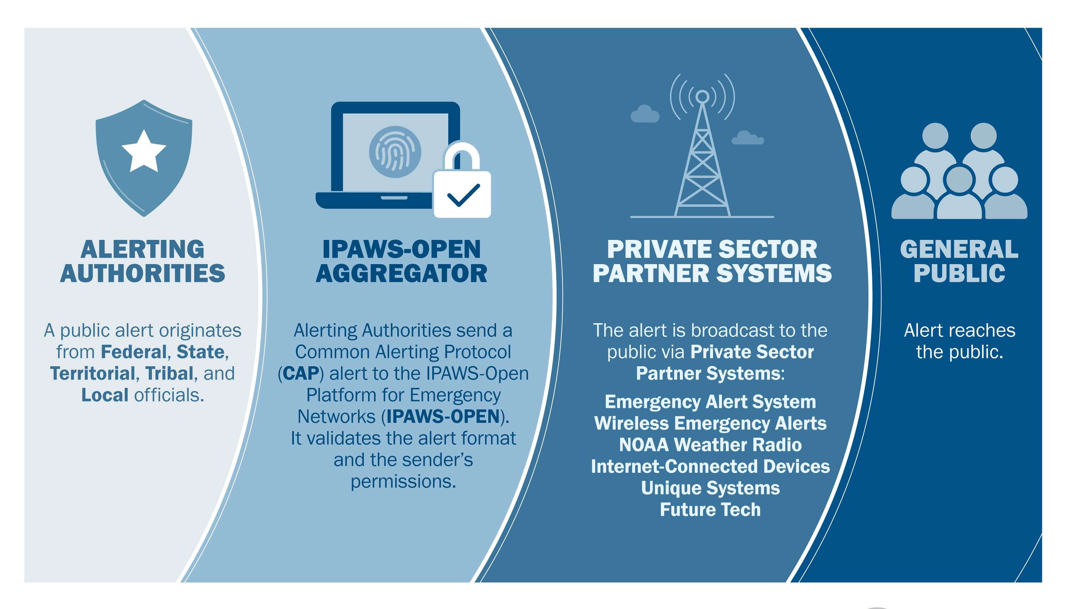
IPAWS Architecture
Module 1: Introduction to IPAWS
Notes:
Here is an overview of our architecture, showing how we accomplish our mission. On the left side, we have Alerting Authorities and on the far-right side we have the public. And when we talk about alerting authorities, we are talking about public safety agencies across the country at all levels of governments. This includes the local level, state level, territorial, tribal nations, as well as federal and ultimately the President. In the middle are the system pieces: we have interfaces and private-sector systems that are key for us to accomplish this mission.

Slide 10

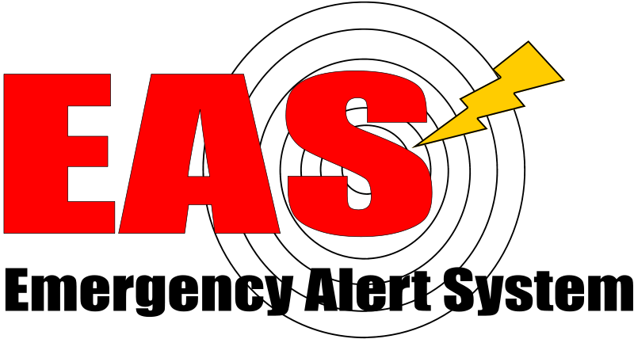

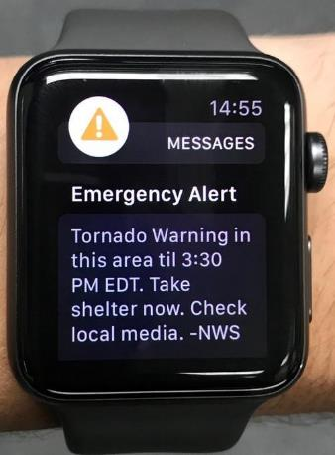





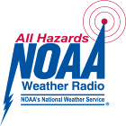

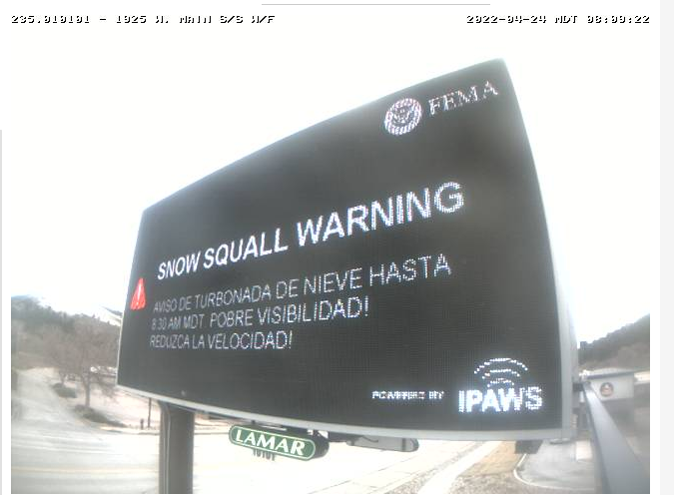
IPAWS Architecture
Module 1: Introduction to IPAWS
Alerting Authorities IPAWS Gateways Private Sector Systems People
Emergency Alert System
FCC 47 C.F.R. Part 11
Radio and TV stations, cable & wireline providers
Emergency
Wireless Emergency Alerts
FCC 47 C.F.R. Part 10
Wireless Providers participate in accordance with regulations
Local authorities
IPAWS OPEN
NOAA Weather Radio Network
1,800 public safety agencies use IPAWS compatible alert origination tools to send alerts
NOAA Weather Radio transmitters
Internet Applications
apps, websites, messaging services, voluntarily participating in distributing alerts
Notes:
The key systems on the private sector side today are the Emergency Alert Systems (EAS), which you are already a part of, and the Wireless Emergency Alerts (WEAs), which is the newest kid on the block. That is alerts to cellular phones. Wireless Emergency Alerts and The Emergency Alert Systems are private sector regulated by the Federal Communications Commission (FCC). So, there are rules for participation for wireless providers and of course, there are FCC regulations that govern how the Emergency Alert System (all radio, TV, satellite, etc.) connect with IPAWS and ultimately provide safety messages from authorities to the public.

Slide 11
Emergency Alert System (EAS)
Module 1: Introduction to IPAWS
FCC rules require all radio, television, cable, wireline, and satellite providers to participate in the EAS. Participants must maintain EAS equipment able to receive and re-transmit a national alert. Participants are encouraged to support broadcast of emergency information sent from state and local authorities.
EAS participants must monitor the FEMA IPAWS EAS Feed and other audio sources in accordance with State EAS Plans
  State Emergency Communications Committees (SECCs) develop the State EAS Plans that describe state and local EAS operations and contain guidelines that define local alerting authorities and EAS participants roles and responsibilities for use and activation of the EAS
All EAS participants must:
  Immediately broadcast a national emergency message
  Receive and broadcast state initiated monthly EAS tests
  Initiate EAS Required Weekly Test
Notes:
Today, you are already a part of the Emergency Alert System. All radio and TV must participate and must have a device typically called an encoder/decoder or an EAS device that is able to receive authorized alerts.
All EAS participants are required to have their device monitor the IPAWS EAS feed, which is available via an internet feed, for alerts that are validated from authorized alerting authorities. The minimum requirement for EAS participation is that you must be able to receive alerts and broadcast a national emergency message. In addition, you must be able to receive required monthly test messages typically initiated by a state authority. You also must be able to initiate a required weekly test, which is an encoded noise that goes out through your station and allows other stations to recognize that your station is on the air and a participant of the EAS. The minimum requirement is to carry a national message. We have never had a national emergency in our country since the beginning of EAS or the prior systems of EAS in which a national authority has sent a message. We have been in the practice since about 2011 of doing national test messages; there was one conducted on October 4. 2023. A key for making our country a safer place to live is for those local authorities that face incidents and emergencies to send alerts to people and mitigating the impacts of those emergencies.

Slide 12
Emergency Alert System (EAS)
Module 1: Introduction to IPAWS
EAS participants must monitor IPAWS and other sources in accordance with State EAS Plans for emergency alert messages applicable to their audience.
State Emergency Communications Committees (SECCs) develop the State EAS Plans that describe state and local EAS operations and contain guidelines that define local alerting authorities and EAS participants roles and responsibilities for use and activation of the EAS
State plans identify monitoring assignments for each EAS participant in a state
State plans identify how a national emergency message will be disseminated to all stations if the IPAWS is not available to disseminate emergency alerts
FEMA maintains the National Public Warning System (NPWS) – a network of selected radio stations that also perform as Primary Entry Point (PEP) Stations for dissemination of a national emergency message.
PEP station transmitter facilities are enhanced to be highly resilient in all hazard scenarios and expected to be on the air ready to broadcast a national emergency message at all times
In the event of disruption to the IPAWS, the NPWS serves as an independent and resilient source to initiate broadcast of a national warning or emergency message
77 PEP stations provide direct coverage for 90% of the US population
Notes:
You will find that there is a document that is typically written by a State-level group called an Emergency Communications Committee, or an equivalent at the level. They write a document called the State EAS plan, and that plan should list all of stations within that state, usually the Broadcast President of State is the key person in the development of that document, in cooperation with some key personnel at the government level and other communication entities. That document defines how the system will be used, who it will be used by, and it highlights monitoring assignments. In addition to being able to receive the IPAWS feed, neighboring stations can monitor via a State relay network or by listening to or hearing the broadcast of neighboring stations. That is a critical document for laying out where you fit within your state organization for the emergency alert system. It also defines how you could receive a national message if it doesn’t come through the IPAWS feed such as if it is coming down through relay of neighboring stations.

Slide 13
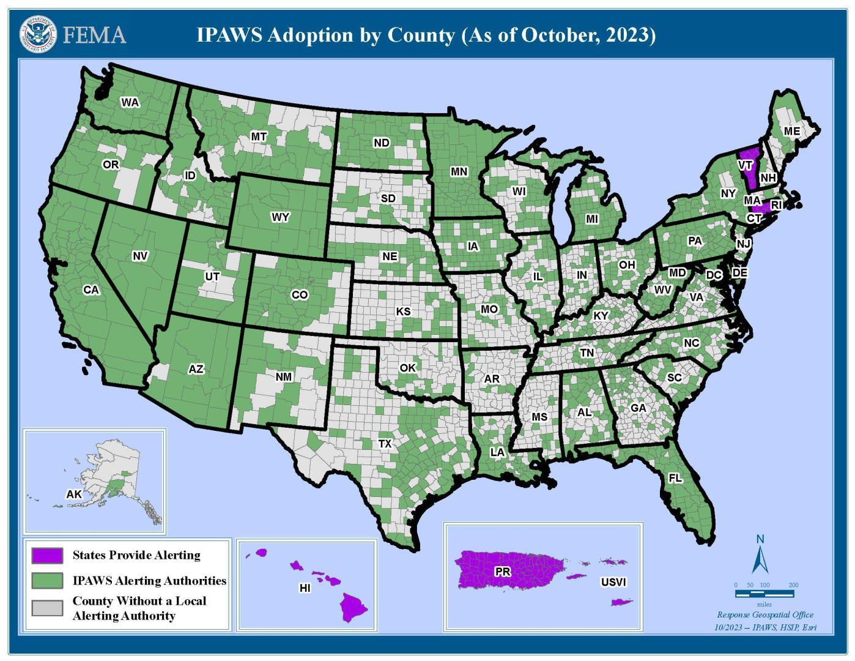
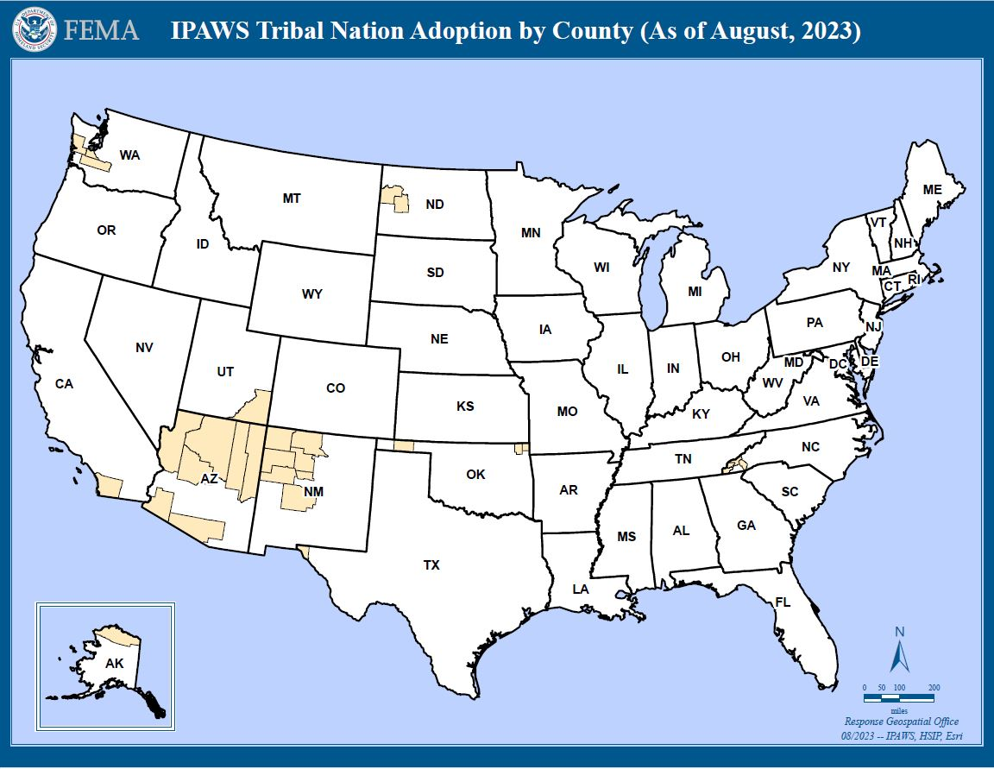
IPAWS Alerting Authorities
Module 1: Introduction to IPAWS
1,836 Total IPAWS Alerting Authorities sending an average of 21,965 per month
1,712 Local
86 State-wide
21 Military
4 Territory
11 Tribal
3 Federal
*All 50 States, Washington DC, Puerto Rico, and the U.S. Virgin Islands have a State level (or equivalent) authorized Alerting Authority.
Notes:
Our key customers are Alerting Authorities. The public safety is not impacted unless that alerting authority is sending information to the public in an emergency about what to do and what that emergency is. Today, we have over 1,800 agencies that are registered and authorized to use IPAWS.
The map on the left side with the green is showing a county with at least one local Alerting Authority. The majority of the 1,800 are local agencies that are able to use IPAWS to distribute an emergency message for broadcast over EAS, or cellphones. In addition, we have 11 tribal nations across the U.S. that are using IPAWS to distribute emergency messages to people in their communities. The three federal alerting authorities include first, the National Weather Service, and they distribute severe weather alerts. Second, the Department of Justice who does Amber Alerts at the request of states. They generate the Amber Alerts that come into those EAS devices if the state is not doing it for themselves or need assistance. The third is the United States Geological Survey, which on the West Coast, uses IPAWS to issue early earthquake warnings or shake alerts that can reach people seconds before the ground starts moving. We continue to expand our work with alerting authorities in ensuring that they are able to accurately know when to use and how to use the systems to get those alerts through to our private sector partners.

Slide 14
Continuity of Broadcast Operations
Module 1: Introduction to IPAWS
Though each situation is unique, any station can be better prepared if it plans carefully, puts emergency procedures in place, and practices for all kinds of emergencies.
Broadcast stations can provide a resilient and reliable source for emergency information to their community before, during, and after emergencies.
Stations should plan to continue broadcast operations through out the wide spectrum of disaster threat scenarios.
Develop a Continuity of Broadcast Operations (COBO) Plan to be prepared for major disasters
Risk Assessments provide valuable information needed to craft plans to harden physical plants and operations for broadcast continuity
Consider:
What emergency policies and procedures does your station have in place?
Notes:
Another key piece to keeping those communities safe is the resilient communications of stations and broadcasters. Part of the grant program is integrating the EAS better, especially the public sector communications, with IPAWS to be able to receive those alerts. The second piece is resiliency and making sure the alerts get to the public. Besides just having good equipment, or your equipment in order, we also encourage and can provide some help in developing a plan for how to keep your station on the air through all contingencies. We call this the Continuity of Broadcast Operations.
Broadcasters should be able to receive alerts and deliver them to your communities and we want your station to be on the air through all hazards.

Slide 15
Public Broadcasters Collaboration with Alerting Authorities
Module 1: Introduction to IPAWS
The relationship between Public Broadcasters and Alerting Authorities is essential to effectively communicating alert, warning, and emergency information to the people in your community.
Radio and television stations provide a resilient capability for local alerting authorities to disseminate emergency alerts, warnings and information to the public before, during and after disasters.
EAS equipment properly configured to retrieve emergency messages from the IPAWS is critical for supporting local alerting authorities.
Tips
Know Your Alerting Authorities and emergency managers
Be familiar with the State EAS Plans
Review you EAS device settings to ensure readiness to retrieve and broadcast emergency messages from local alerting authorities
Encourage local emergency managers in your area to use IPAWS for emergency alerting
Consider:
Do you know your State and Local Alerting Authorities?
Notes:
The relationship between broadcasters and FEMA, IPAWS, the FCC, and Alerting Authorities is essential. We are 100% dependent on private sector infrastructure to get public safety messages to the public. You are a key partner; broadcast has been a key partner in alert and warning since 1934, since the beginning of the FCC. We want to continue that, and we are looking for this grant program to provide a more resilient and more integrated public broadcasting aspect that is specially targeted at increasing the abilities of communities in rural and underserved areas to get alerts through all phases of emergencies. This includes local, state, regional, or national emergency, should there be one.

Slide 16
Introduction to IPAWS Key Takeaways
Module 1: Introduction to IPAWS
IPAWS is the program responsible for ensuring government authorities can effectively warn the public
IPAWS enables Federal, State, Local, Tribal, and Territorial officials to send geo-targeted emergency messages and lifesaving information to the public through IPAWS connections
  EAS = radio and television broadcasts
  WEA = alerts and warnings sent to cell phones
Local alerts and warnings cannot reach the public without active participation from radio and television broadcasters
The relationship between Public Broadcasters and Local Alerting Authorities is essential to effective emergency alerting
Discussion Questions:
Do you know your State and Local Emergency Managers?
What are your public broadcast entities’ policies and procedures for redistributing emergency alerts?
ASK: Share your EAS success stories with the Corporation for Public Broadcasting!
Notes:
That was a quick overview of what we do at IPAWS and how important we find public broadcasting to accomplishing our mission and ensuring that people get warnings.
Key Takeaways:
We are responsible end-to-end: From FEMA’s perspective, we are responsible for ensuring that alerting authorities have the ability and access to send alert to ensure that people in communities get warnings for emergencies happening in their area.
We work across all level of government. Our alerting authority customers span across all levels of government.
Two key systems that we are connected to in the private sector are the Emergency Alert System (EAS) and Wireless Emergency Alert (WEA). We really see broadcast as the most resilient across all disaster scenarios for ultimately getting information to the public when other infrastructures fail. Our local public safety officials can’t get information to their communities without active participation and support from their local radio and television stations. It is essential to accomplishing our mission
One last ask: we would love to hear about success stories or use of how broadcast delivered emergency information within your area. In the press, we mostly have articles about receiving alerts using cell phone, but there is more out there about EAS since there are a lot of people who are dependent upon radio or television. Please share those stories with CPB.

Slide 17

Next Generation Warning System Grant Program Training
Module 2: Introduction to NGWSGP
Faisal Khan, Executive Director, NGWS
www.cpb.org
Next Generation Warning System Grant Program

Slide 18
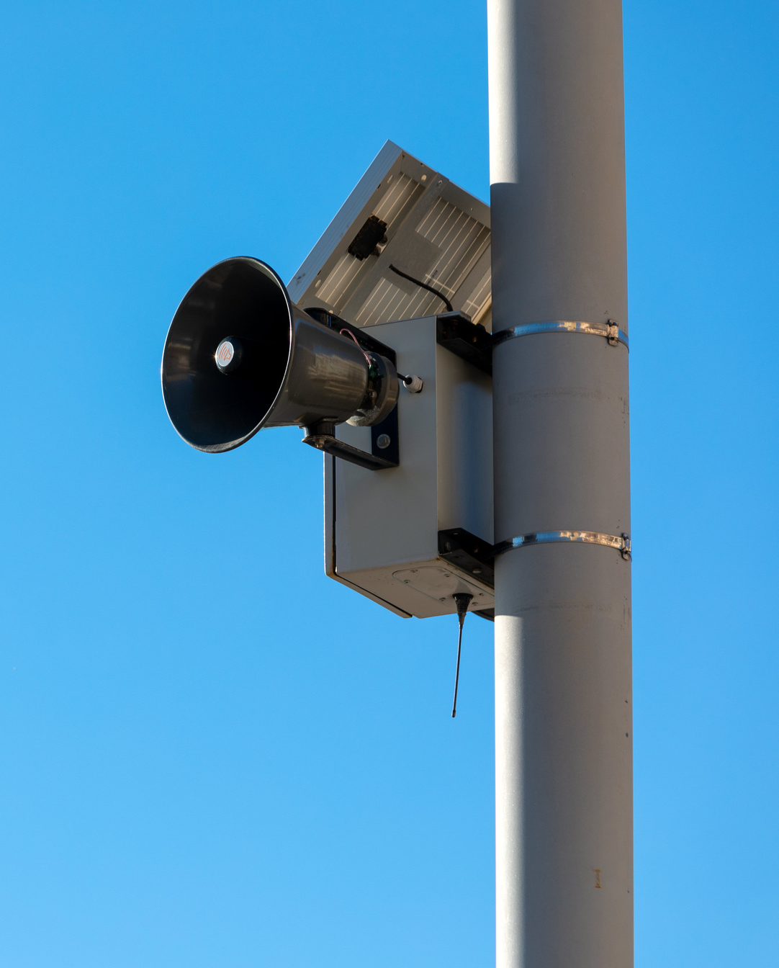

Objectives
Module 2: Introduction to NGWSGP
of the grant program
The program advances FEMA’s goal to promote “an effective system for warning and informing the American public of impending natural and man-made disasters is an essential part of America's emergency preparedness.”
www.cpb.org
Next Generation Warning System Grant Program

Slide 19
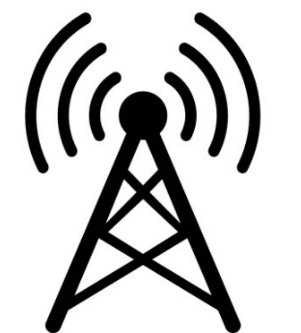



Objectives
Module 2: Introduction to NGWSGP
of the grant program
Enhance stations’ capacity
Upgrade to digital radio and ATSC 3.0
CPB will award subgrants to eligible, high priority stations to fund equipment purchases, installation, and training that advance the mission of the NGWSGP.
Improve technology infrastructure
Expand emergency alerting
www.cpb.org
Next Generation Warning System Grant Program

Slide 20
Prioritization Criteria
Module 2: Introduction to NGWSGP
Priority 1
Tribal, minority, and/or rural stations serving underserved communities
Priority 2
Small stations
Priority 3
Other television and radio stations - All public broadcasting entities as defined in 47 U.S.C. §397(11) are eligible to apply. Eligibility is not contingent upon whether a public broadcasting entity qualifies for CPB’s Community Service Grant (CSG) program.
www.cpb.org
Next Generation Warning System Grant Program

Slide 21
Prioritization Criteria
Module 2: Introduction to NGWSGP
Station characteristics
Project proposal
  Uniqueness of coverage
  Geographic special risk factors
  Public safety/alerting impact
  Nature of the equipment request
  Project management capability
  Partnerships with local/regional/state emergency management officials
www.cpb.org
Next Generation Warning System Grant Program

Slide 22
Project Funding Overview
Module 2: Introduction to NGWSGP
Funding
The FY22 funding round has closed, but there will be an additional round for FY23.
Contracting
Environmental and Historic Preservation Review (EHP)
CPB is administering; recipients are FEMA subrecipients and subject to
federal grant requirements
Applicants must submit a FEMA Environmental and Historic Preservation Review questionnaire
No funding match or cost share is required.
Funds will be granted as reimbursements.
www.cpb.org
Next Generation Warning System Grant Program

Slide 23
Understanding AM/FM/HD Radio Technologies
Agenda:
Differentiate between AM, FM, and HD Radio technologies
Understand the advantages and limitations of each radio platform
Consider strategies for leveraging RDS (Radio Data System) for public messaging and enhanced user experience
Share HD Radio's potential for improving audio quality and offering additional content, including richer emergency alerts
Review use cases for upgrading
Notes:
This is Steve Calzone, your technical trainer on radio technologies. I am a Senior Consultant with FEMA IPAWS, working with CPB to develop this training program.
I am a founder of Shift 2 Stream, and DTV Consulting, and the Chair of the Advanced Television Systems Committee, ATSC, Technical Group 3, Specialist Group 37, on the Conversion and Redistribution of ATSC 3.0 Services, also known as TG3-S37. This specialist group works on specifications, such as standards and recommended practices, for redistributing ATSC 3.0 services. Broadcasters and multi-channel video programming distributors, or MVPDs, use them as a blueprint for delivering NextGen TV services to consumers.
This webinar will help you gain knowledge and insight for your radio stations to enable HD Radio with superb quality audio, along with radio data delivery services, such as geolocation mapping, and enhanced emergency alerting. The addition of HD Radio helps provide important public services for your communities.
Although some of the material in this webinar may be repetitive for those in the audience who are experienced in radio, HD Radio and emergency alerting, this information is important, and will provide benefits for all participants working through the grant programs on radio station technologies, and upgrades.
In this module, we will cover some basics of AM, FM and HD Radio technologies, how they work, their advantages and limitations, and HD Radio’s enhanced public messaging, and user experience.
In the other modules, we will review strategies for managing signal coverage and improving consumer reception, best practices for Emergency Alert Systems integration, and the pros and cons for transitioning to HD Radio, including use cases for stations that have already transitioned.
Links at the end of the presentation provide additional resources for your help in navigating these technical aspects.

Slide 24
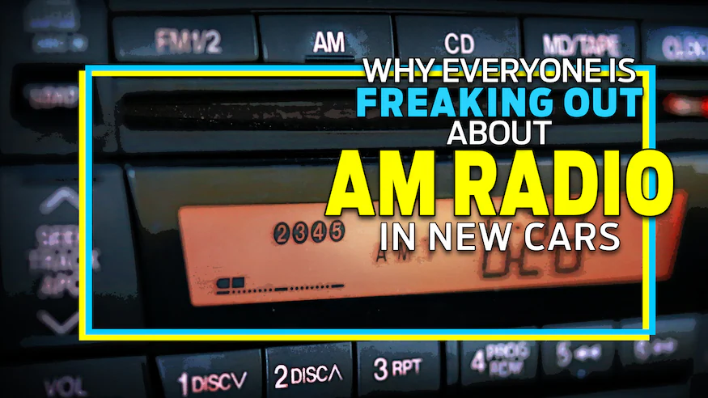
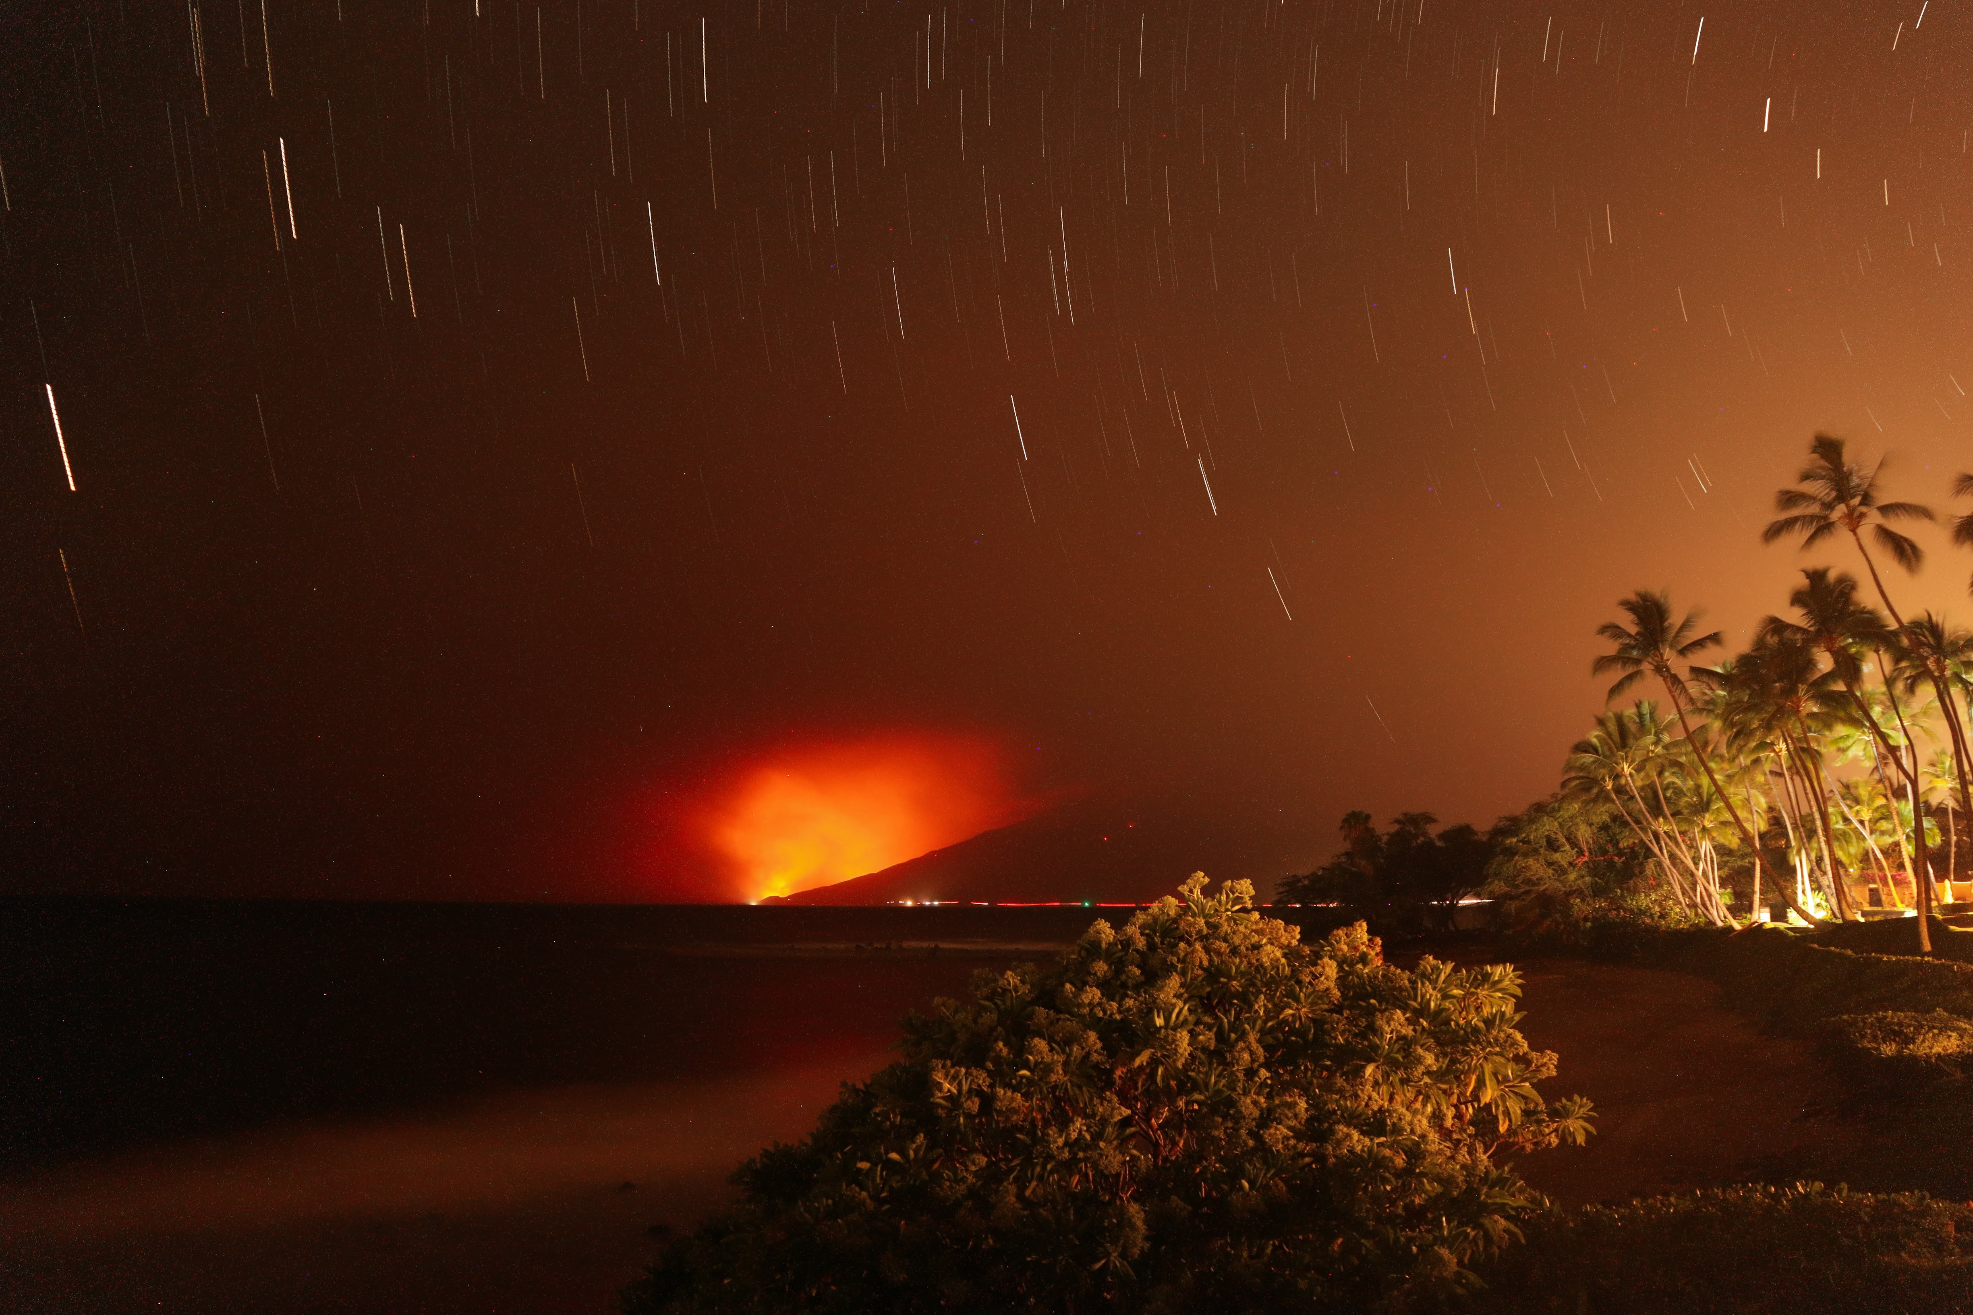
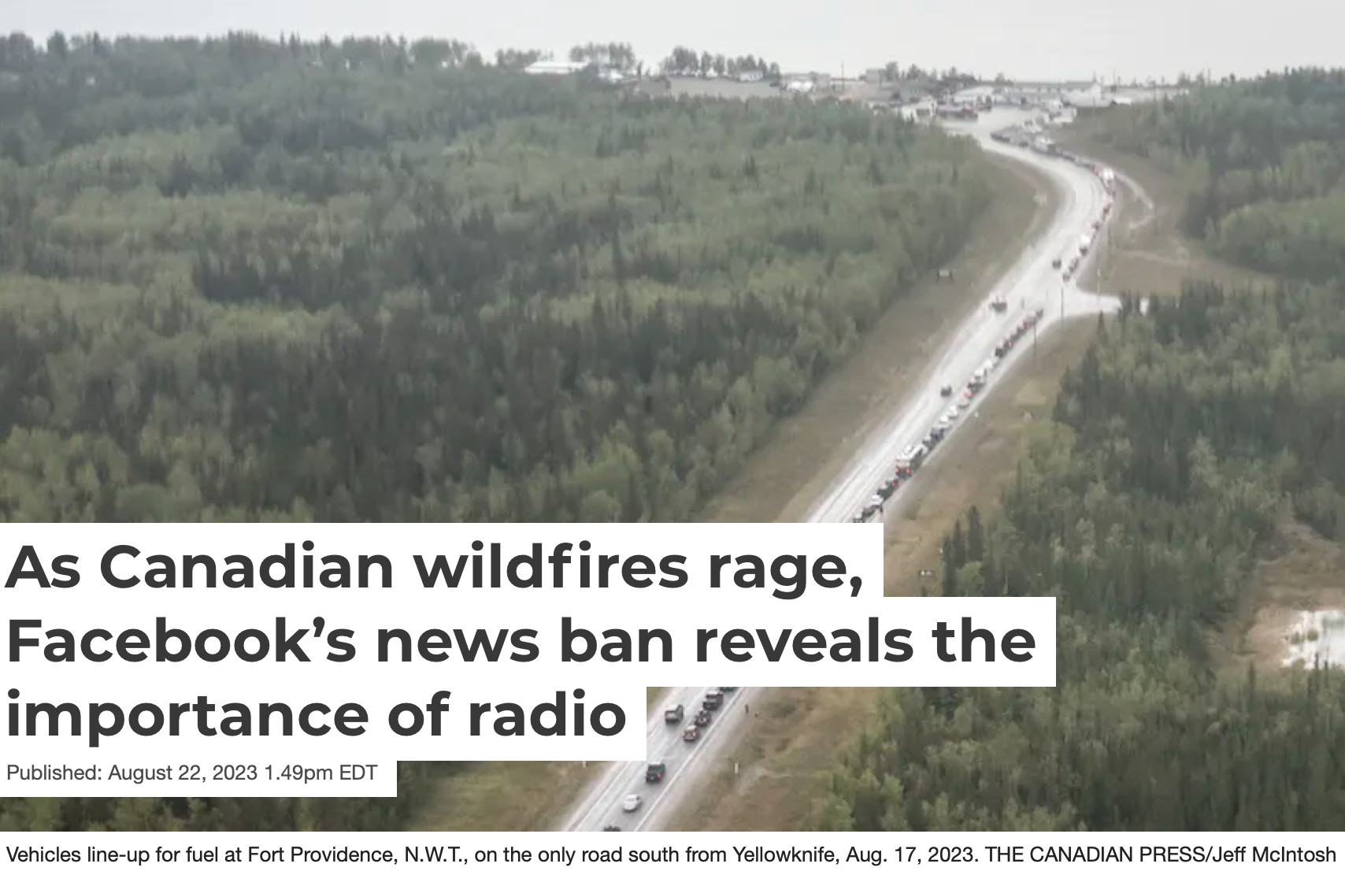











Is Radio Still Relevant? You Betcha!
Notes:
So, is radio still relevant? You Betcha!
https://www.urbandictionary.com/define.php?term=You%20Betcha
“You Betcha”: Minnesotan phrase translating to “Yes” and “If not more”

Slide 25
Is Radio Still Relevant? You Betcha!
Notes:
According to Motortrend, everyone is freaking out about AM Radio in new cars! Something about interference? Why can’t they fix that?
Image references:
https://www.motortrend.com/news/am-radio-new-cars/

Slide 26
Is Radio Still Relevant? You Betcha!
Notes:
Forbes reported that Congress is considering legislation to keep AM Radio in cars, for now.
Image references:
https://www.forbes.com/sites/bradadgate/2023/06/05/congress-looks-to-pass-legislation-keeping-am-radio-in-all-cars/?sh=7d932e4952d2

Slide 27
Is Radio Still Relevant? You Betcha!
Notes:
Inside Radio reports that radio actually helps promote on-line conversations and interactions, driving revenue on web sites, including streaming services, is that well-known?
Image references:
https://www.insideradio.com/free/study-radio-catalyzes-consumer-brand-conversations-and-interactions/article_a5e3f886-5070-11ee-8b59-0fc931711892.html

Slide 28
Is Radio Still Relevant? You Betcha!
Notes:
Variety reports that those streaming services are eating into the revenue provided by radio advertising. Radio is not all about advertising, radio also provides a public service.
Image references:
https://variety.com/2021/music/news/radio-signal-fading-streaming-1234904387/

Slide 29
Is Radio Still Relevant? You Betcha!
Notes:
The FCC reminds radio stations to ensure EAS readiness for the new emergency alerting standards, which were just tested in October.
Image references:
https://www.radioworld.com/news-and-business/headlines/fcc-reminds-stations-to-check-eas-readiness

Slide 30
Is Radio Still Relevant? You Betcha!
Notes:
However, the Consumer Technology Association is clear that they want no mandates.
Image references:
https://www.radioworld.com/news-and-business/cta-campaigns-against-am-mandate-bill

Slide 31
Is Radio Still Relevant? You Betcha!
Notes:
Meanwhile, is Congress getting serious about ensuring AM is in every vehicle? This idea is backed by more than just agricultural groups. The reason?
Image references:
https://www.radioworld.com/news-and-business/business-and-law/am-for-every-vehicle-act-passes-moves-to-the-senate-floor

Slide 32
Is Radio Still Relevant? You Betcha!
Notes:
Radio is sometimes the only way that emergency communications can be realized, look at what happened with the Canadian wildfires…
Image references:
https://theconversation.com/as-canadian-wildfires-rage-facebooks-news-ban-reveals-the-importance-of-radio-211966

Slide 33
Is Radio Still Relevant? You Betcha!
Notes:
…or the Maui wildfires. In times of crisis, radio serves as a lifeline reaching millions of people and providing real-time information, and potentially saving lives.
Radio is an essential tool for emergency alerting.
We can optimize the use of AM, FM, and HD radio technologies for effective emergency communication.
Image references:
https://radioink.com/2023/08/14/radio-has-been-mauis-only-lifeline-as-wildfires-rage/
https://upload.wikimedia.org/wikipedia/commons/4/4c/Lahaina_fire_-_8_august.jpg

Slide 34
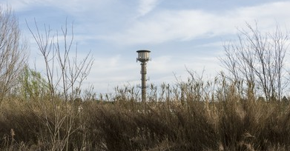
Understanding AM/FM/HD Radio Technologies
Consider:
What are your stations’ goals?
Be Familiar with FCC Radio Broadcasting Regulations and Guidance for your area.
Click the radio dial to view the FCC Broadcast Radio Links web page.
Notes:
So, what are your stations goals when it comes to delivering radio as a public service and emergency alerting?
The FCC provides resources for radio stations that can help shape and realize those goals. These include resources for tribal and rural areas. In 2010, the FCC adopted rules that help Native Nations establish new services specifically designed to offer programming that meets the needs of tribal citizens.
Are you familiar with the FCC Broadcasting Regulations and Guidance? This radio dial has a link to the FCC web page, where resources and detailed guidance can be found for broadcasters delivering AM, FM and HD Radio, including rural and tribal areas.
https://www.fcc.gov/media/radio/broadcast-radio-links#AM
https://www.fcc.gov/general/tribal-and-rural-radio
Image Source: https://www.shutterstock.com/image-photo/communication-radio-antenna-installed-rural-260nw-613507178.jpg

Slide 35
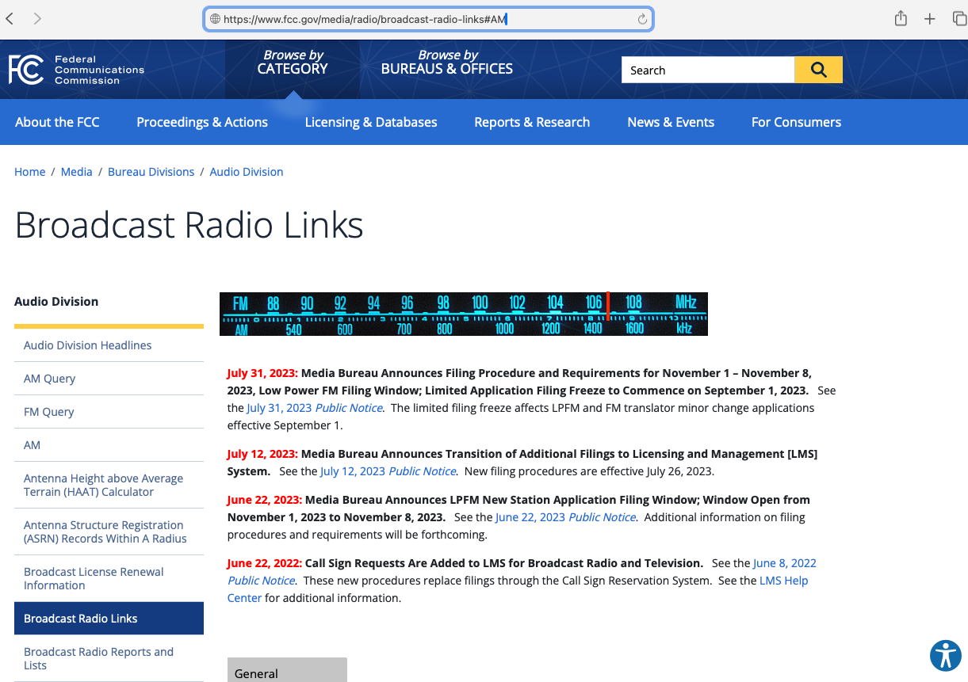
35
Notes:
The FCC Media Bureau Audio Division maintains this Broadcast Radio Links web page to keep owners and operators current with the latest radio station requirements and regulations. This is important, because your station must operate under FCC regulatory approval, within guidelines developed for your area and region. The FCC website delivers news and information on topics such as mandatory licensing and filing, station contours, and transmission antenna characteristics, along with resources for tribal and rural radio stations, such as the 2010 order to promote and streamline native American radio licensing. Keep up-to-date with this information by using the website resources to ensure FCC compliance for your station, and to gain the benefits extended to your station from the FCC.
Compliance is important for your station to maintain a proper signal level in relation to other broadcasters, with minimal interference for your listeners and FCC resources can help you to get on the fast-track to compliance and delivery of your broadcasts, especially for underserved areas.
Image of FCC Broadcast Radio Links web site: https://www.fcc.gov/media/radio/broadcast-radio-links#AM

Slide 36

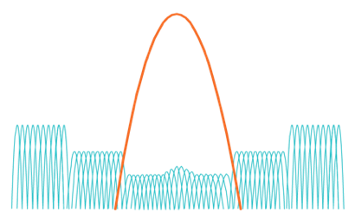
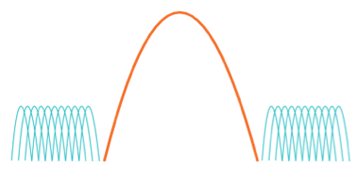

HOW HD RADIO TECHNOLOGY WORKS
AM ANALOG
FM ANALOG
PRONE TO INTERFERENCE:
Multipath distortion
Static
Hiss
Pops
-200 kHz
0 Hz
-14717 kHz
0 Hz
+14717 kHz
+200 kHz
HOW HD RADIO TECHNOLOGY WORKS
AM HYBRID
FM HYBRID
HYBRID MODE:
Enables simultaneous transmission of Analog
and Digital Signals
Analog receivers continue to function normally
-14717 kHz
0 Hz
+14717 kHz
-200 kHz
0 Hz
+200 kHz
Source: Xperi Corporation
Notes:
Analog AM and FM radio frequencies, or RF, are prone to interference with static, hiss, and pops in the received signal. With Hybrid HD Radio, analog-coded digital signals are delivered within the same spectrum, in addition to the analog signal. These digital signals have better quality audio, are not prone to interference, and can deliver data such as enhanced emergency messaging.
HD Radio is the brand name of the digital broadcasting technology owned and licensed by Xperi Corporation. HD Radio was developed by iBiquity Digital Corporation, who created the original “In-Band On-Channel”, or IBOC specifications for digital radio in the US. The term IBOC was coined based on the overlay of the digital signal on top of the existing in-band on-channel radio signal. In 2015, DTS Inc. acquired iBiquity, and in 2016, Xperi acquired DTS. Xperi maintains the licensing for HD Radio technology in the US.
The FCC standardized on HD Radio for digital radio in the US in 2002, based on the testing and reporting delivered by the National Radio Systems Committee (NRSC).
References:
MB Docket No. 19-311: In the Matter of All-Digital AM Broadcasting Revitalization of the AM Radio Service
https://docs.fcc.gov/public/attachments/FCC-20-154A1.pdf
MM Docket No. 99-325: In the Matter of Digital Audio Broadcasting Systems and Their Impact on the Terrestrial Radio Broadcast Service
https://docs.fcc.gov/public/attachments/DA-10-208A1.pdf
Slide Image Courtesy
Ashruf El-Dinary
Xperi Corporation
ashruf.el-dinary@xperi.com

Slide 37
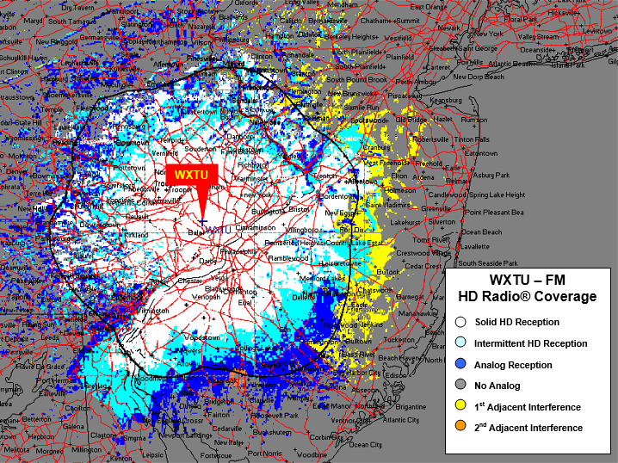
FM BROADCAST COVERAGE
Source: Xperi Corporation
Notes:
Your radio stations RF spectrum contours are managed by FCC regulations on adjacent signal interference. Station contours are preset based on the frequency of the signal, and adjacent or nearby radio or TV stations. The station contours are important to know for your station and area so that, with proper testing and monitoring, you can ensure your transmissions are within regulations and not causing interference with adjacent stations.
This map shows the coverage for WXTU-FM hybrid HD Radio at 92.5 MHz
Note the FCC station contour limits: the black line, and the reach of the HD signal with solid reception: in white, and the intermittent HD reception: in light blue. The analog reception areas: in dark blue, extend out in some places well past the HD reception. This chart shows, in yellow, the areas with 1st adjacent signal interference from 92.3 and 92.7 MHz, and 2nd adjacent interference, in orange, from 92.1 and 92.9.
When you add-in an HD signal to either AM or FM, it provides similar signal coverage, with higher quality digital audio, and little to no audible interference noise.
You will want your station to maximize its reach within FCC requirements.
Slide Image Courtesy
Ashruf El-Dinary
Xperi Corporation
ashruf.el-dinary@xperi.com

Slide 38
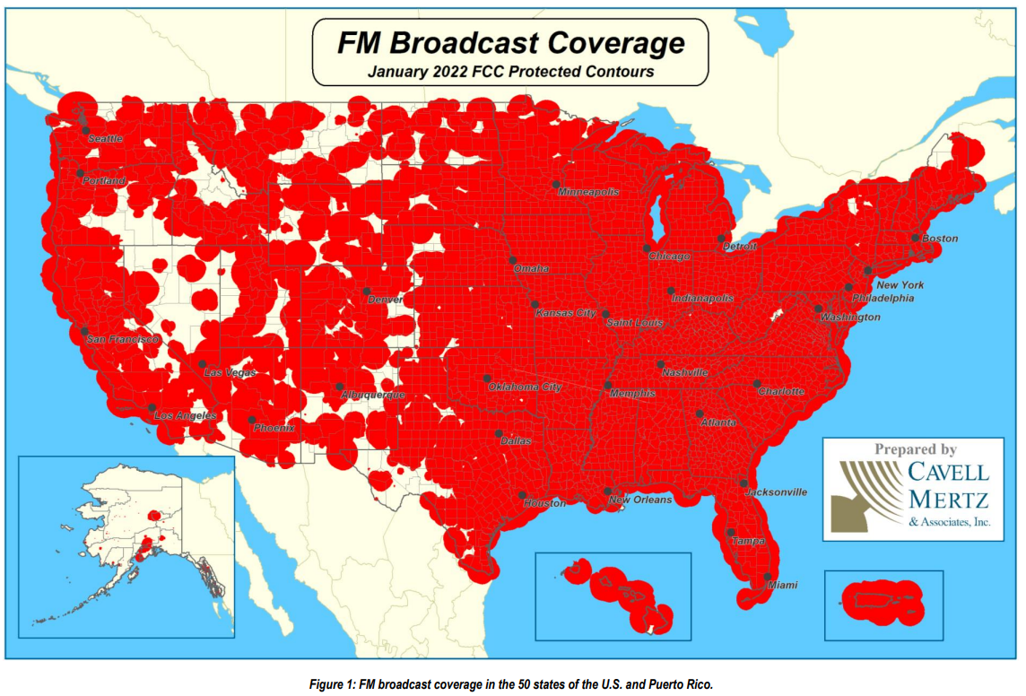
U.S. FM Radio Coverage Map
Notes:
How pervasive is AM, FM, and HD? This map shows the FM coverage over the US, as you can see there are quite a few gaps in more remote areas. We know that AM radio station coverage is much more extensive due to its longer reach and covers more geographic areas than FM in an emergency. This additional coverage is why AM is so important for emergency preparedness, and notifications.
References:
NRSC-G303 Best Practices for Delivering Emergency Alerts and Information for FM Radio Broadcasters April, 2022 2022 pg. 10
https://www.nrscstandards.org/standards-and-guidelines/accept.asp?name=documents/guidelines/nrsc-g303.pdf

Slide 39
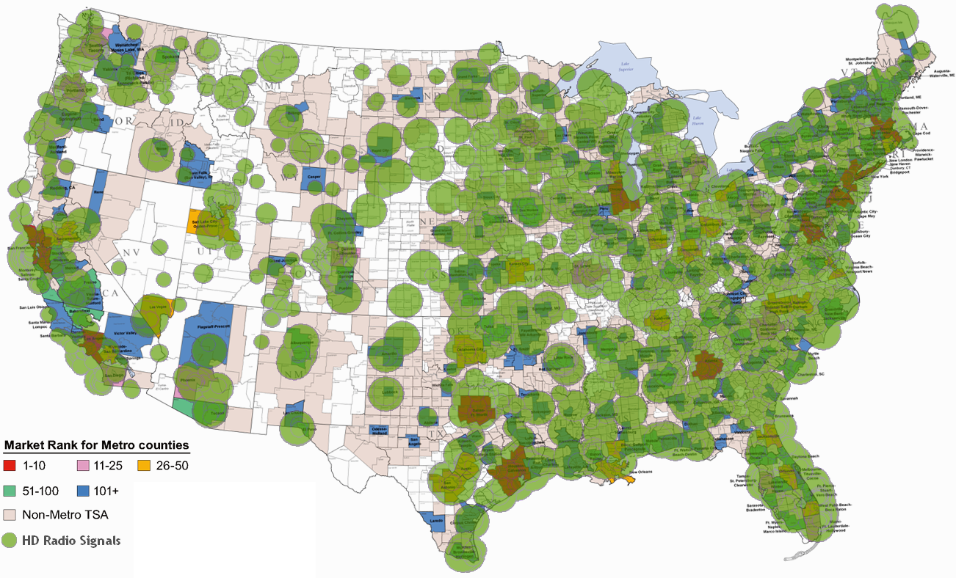


HD RADIO TECHNOLOGY
BY THE NUMBERS
  2500 digital on-air HD broadcasts in U.S.
  100% coverage of the top 100 Nielsen metros
93% of U.S. population live within reception distance of an HD Radio station
Almost 100 million HD Radio-equipped cars on the road
All Major Auto brands offer HD Radio factory-installed
Low pricing for Home Audio and Automotive After-Markets
As of January 2018
Notes:
This map shows HD radio station coverage over the US. As you can see, HD Radio is not as prevalent as FM, but HD Radio broadcasts are accessible to a large percentage of the population,
and HD Radio coverage continues growing. Public Media stations who incorporate and deliver HD Radio, across both FM and AM bands, will help drive the growth in the number of HD Radio station broadcasters, market coverage, and HD Radio consumer adoption. HD Radio broadcasts help public media stations to deliver advanced emergency messaging services, along with better audio. For consumers, HD Radio is available either as stock, or as an option in most automobile makes and models sold today and can be installed as an after-market add-on. HD Radio is not just for cars. HD Radio consumer brands for mobile radios, or radios for in-home use, are also sold online, at pro-audio outlets, and in most big box stores.
Slide Image and Information Courtesy
Ashruf El-Dinary
Xperi Corporation
ashruf.el-dinary@xperi.com

Slide 40
Leveraging Radio Data System (RDS) and HD Radio for
Enhanced Public Messaging and User Experience
Technology | Capabilities and Features
Radio Data System (RDS) | EAS notifications Text-based information Enhanced alerting capabilities Geographically targeted alerts Enhanced public safety communication.
HD Radio | Builds on RDS Features. Stations can provide critical and supplementary details on: Emergency alerts and messages Safety instructions Graphical maps for evacuation routes, or Contact information for emergency services. Stations can transmit other public safety-related information: Traffic updates including road cameras Graphical maps of road conditions AMBER and other SLTT or federal alerts.
Notes:
For radio in the U.S., there are 2 commonly used methods to deliver enhanced public messaging, and a better user experience.
RDS, or Radio Data System, is technology that delivers low-bitrate data streams over the FM radio signal in addition to the FM analog and digital broadcasts. RDS is installed in most consumer brand FM radios as well as in most autos. It is also referred to as RBDS, for Radio Broadcast Data System. RDS delivers text information by modulating the signal in the FM sidebands with the data signal, and can broadcast station name, logo, program name, and song title and artist, along with traffic announcements and traffic data. RDS delivers emergency alerts when properly configured from IPAWS alerts through an EAS decoder. One drawback of RDS is the low bitrate of data delivery, around 100 characters per second.
HD Radio delivers digital data at higher data rates than RDS, including the ability to deliver multiple channels of programming and data services over the same frequency using sub-channels, each capable of thousands of characters per second. Many stations choose to simulcast their analog signal on their main HD Radio program, HD1, and deliver other programming over the remaining digital bandwidth.
Simulcast is where the same signal is broadcast across different stations, or different program streams.
For example, an HD Radio station can be setup to deliver:
one high-quality Music Channel, which is the simulcast of the main analog channel
one News/Talk radio channel; and
one data channel with traffic and other service announcements
These can be delivered along with the main analog audio channel.
RDS Guidelines from the NRSC:
https://www.nrscstandards.org/standards-and-guidelines/documents/guidelines/g300-c.pdf
RDS Standard:
https://www.nrscstandards.org/standards-and-guidelines/documents/archive/nrsc-4-b-standard-2005.pdf
HD Radio Standard from the NRSC:
https://www.nrscstandards.org/standards-and-guidelines/documents/standards/nrsc-5-e/nrsc-5-e.pdf

Slide 41
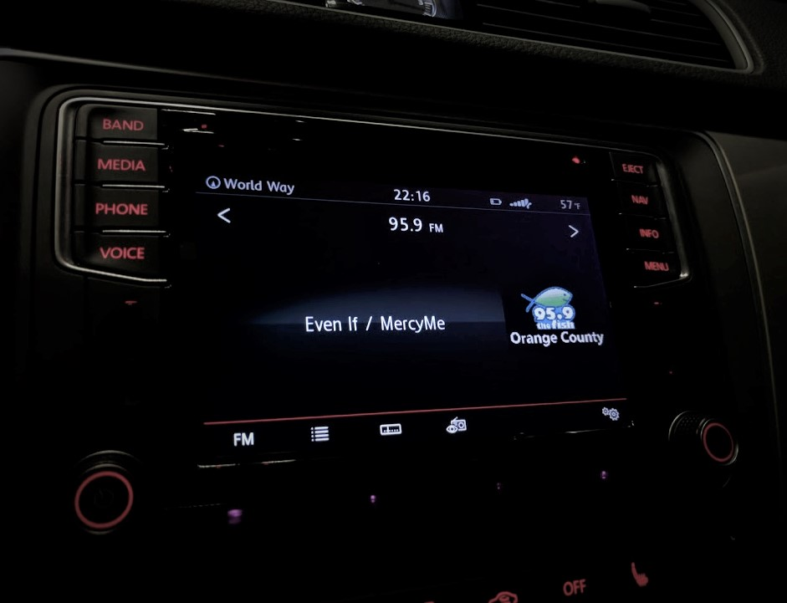

Leveraging Radio Data System (RDS) and HD Radio for
Enhanced Public Messaging and User Experience
Technology | Capabilities and Features
Radio Data System (RDS) | EAS notifications Text-based information Enhanced alerting capabilities Geographically targeted alerts Enhanced public safety communication.
HD Radio | Builds on RDS Features. Stations can provide critical and supplementary details on: Emergency alerts and messages Safety instructions Graphical maps for evacuation routes, or Contact information for emergency services. Stations can transmit other public safety-related information: Traffic updates including road cameras Graphical maps of road conditions AMBER and other SLTT or federal alerts.
Notes:
Here is a view of a receiver showing the RDS data for channel name and logo, along with song title and artist info.
Notice the display includes station logo, artist name/title, Station name/Call letters and FM frequency
Display of RDS:
https://en.wikipedia.org/wiki/Radio_Data_System#/media/File:Radio_Data_System_(RDS)_on_95.9_KFSH_La_Mirada.jpg
https://creativecommons.org/licenses/by-sa/4.0

Slide 42
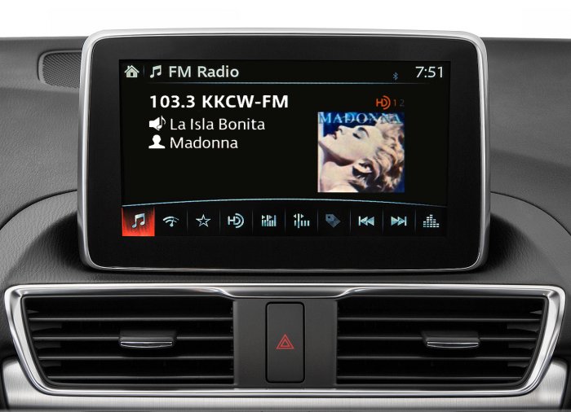

Leveraging Radio Data System (RDS) and HD Radio for
Enhanced Public Messaging and User Experience
Technology | Capabilities and Features
Radio Data System (RDS) | EAS notifications Text-based information Enhanced alerting capabilities Geographically targeted alerts Enhanced public safety communication.
HD Radio | Builds on RDS Features. Stations can provide critical and supplementary details on: Emergency alerts and messages Safety instructions Graphical maps for evacuation routes, or Contact information for emergency services. Stations can transmit other public safety-related information: Traffic updates including road cameras Graphical maps of road conditions AMBER and other SLTT or federal alerts.
Notes:
Here’s an HD Radio receiver displaying channel name, song title and artist with artwork.
HD Radio FM Radio Display:
Source: https://radiomatters.org/index.php/2018/04/30/hd-radio-driving-radios-digital-dash/
Blog by Rick Greenhut (Xperi)

Slide 43
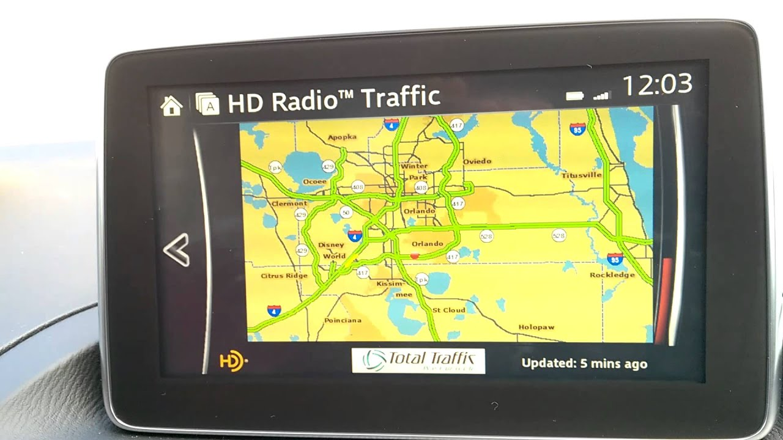
Leveraging Radio Data System (RDS) and HD Radio for
Enhanced Public Messaging and User Experience
Technology | Capabilities and Features
Radio Data System (RDS) | EAS notifications Text-based information Enhanced alerting capabilities Geographically targeted alerts Enhanced public safety communication.
HD Radio | Builds on RDS Features. Stations can provide critical and supplementary details on: Emergency alerts and messages Safety instructions Graphical maps for evacuation routes, or Contact information for emergency services. Stations can transmit other public safety-related information: Traffic updates including road cameras Graphical maps of road conditions AMBER and other SLTT or federal alerts.
Notes:
And here is traffic data on an HD Radio display.
Hmm, strange, I don’t remember ever seeing Route 4 that clear!
HD Traffic Radio Display:
Source: Mazda3 Sport HD radio traffic demo – YouTube
https://www.youtube.com/watch?v=WwwP4jXmBDs
Blog by Rick Greenhut (Xperi)

Slide 44
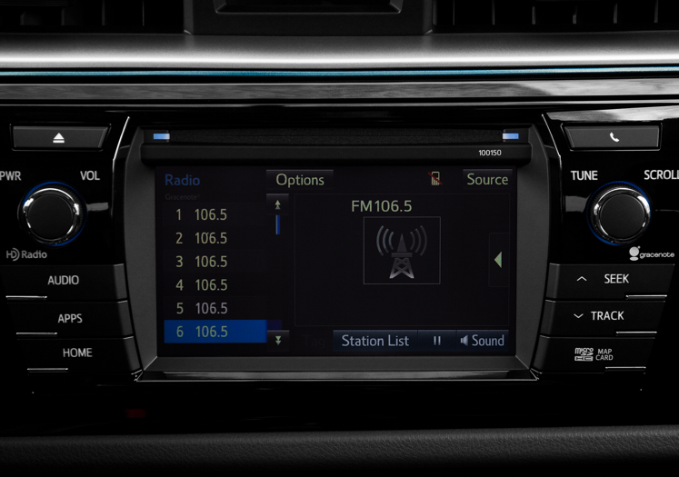
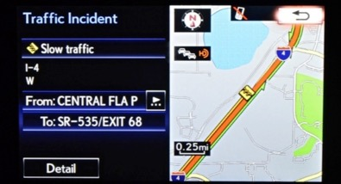
Leveraging Radio Data System (RDS) and HD Radio for
Enhanced Public Messaging and User Experience
Technology | Capabilities and Features
Radio Data System (RDS) | EAS notifications Text-based information Enhanced alerting capabilities Geographically targeted alerts Enhanced public safety communication.
HD Radio | Builds on RDS Features. Stations can provide critical and supplementary details on: Emergency alerts and messages Safety instructions Graphical maps for evacuation routes, or Contact information for emergency services. Stations can transmit other public safety-related information: Traffic updates including road cameras Graphical maps of road conditions AMBER and other SLTT or federal alerts.
Notes:
Ah! There is the Rt. 4 traffic jam!
HD Radio Traffic Incident Display:
Courtesy: Ashruf El-Dinary
Xperi Corporation
ashruf.el-dinary@xperi.com

Slide 45
Leveraging Radio Data System (RDS) and HD Radio for
Enhanced Public Messaging and User Experience
Technology | Capabilities and Features
Radio Data System (RDS) | EAS notifications Text-based information Enhanced alerting capabilities Geographically targeted alerts Enhanced public safety communication.
HD Radio | Builds on RDS Features. Stations can provide critical and supplementary details on: Emergency alerts and messages Safety instructions Graphical maps for evacuation routes, or Contact information for emergency services. Stations can transmit other public safety-related information: Traffic updates including road cameras Graphical maps of road conditions AMBER and other SLTT or federal alerts.
Technology | Capabilities and Features
Radio Data System (RDS) | EAS notifications Text-based information Enhanced alerting capabilities Geographically targeted alerts Enhanced public safety communication.
HD Radio | Builds on RDS Features. Stations can provide critical and supplementary details on: Emergency alerts and messages Safety instructions Graphical maps for evacuation routes, or Contact information for emergency services. Stations can transmit other public safety-related information: Traffic updates including road cameras Graphical maps of road conditions AMBER and other SLTT or federal alerts
Notes:
Using HD Radio, broadcasters can provide valuable real-time information to their listeners, contributing to public safety and community well-being

Slide 46
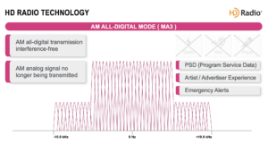
AM/FM/HD Radio Technologies Comparison Summary
Technology | Advantages | Limitations
AM Radio | Long range coverage Better penetration ability Wide range of stations | Interference Lower audio quality Limited bandwidth
FM Radio | Higher audio quality Less interference Better than AM for music Can include RDS for data | Limited range Signal degradation Fewer available stations in rural versus urban areas
HD Radio | Improved audio quality over FM Additional data transmission and multi-channel capabilities AM and FM All-Digital HD Radio delivers best quality, and highest bandwidth | Specialized receivers required Limited availability Potential interference and coverage limitations
Discussion:
How do AM/FM/HD and All-Digital HD Radio technologies fit your station goals?
Notes:
Here is a recap of the difference. So how do AM, FM, and HD technologies fit with your goals?
AM and FM broadcasts are critical for our emergency communications, and HD Radio provides data delivery capabilities that your station should be using to get the most benefit for your listeners.
HD Radio delivers a much better audible experience for listeners, along with better data transmission capabilities.
Stations can choose to go All-Digital, where the analog broadcasts are completely replaced by HD Radio.
Stations must take careful consideration of the costs and regulatory requirements for going All-Digital.
Reference for HD All-Digital Radio Image:
https://hdradio.com/all-digital-am/

Slide 47
AM/FM/HD Radio Capabilities Key Takeaways
AM Radio stations have a farther transmission range compared to FM stations and cover areas where FM stations are not available
AM Radio has lower sound quality and lower digital bandwidth
HD Radio provides better sound quality for both AM and FM digital radio implementations
RDS broadcasts include EAS Integration, text-based messaging, enhanced alerting, geotargeting, and enhanced public safety information
HD Radio improves on RDS ability to enhance public safety by using a separate broadcast channel for data delivery services in addition to the main program audio
HD Radio provides a pathway to next generation radio with All-Digital capabilities including data services and multi-channel programming
Discussion:
How do AM/FM/HD and All-Digital HD Radio technologies fit your station goals?
Notes:
For more information on these capabilities, the FCC and the National Radio Systems Committee (NRSC) have complete details on the requirements and specifications for AM radio transmissions, FM radio transmissions, RBDS, and HD Radio. The hdradio.com website provides a wealth of information for broadcasters to support HD Radio, and All-Digital HD Radio.
Refer to the links in the references for this webinar for additional helpful information.
In your planning for upgrading your station, how does AM, FM, HD Radio, and All-Digital HD Radio fit your station goals?
Analog broadcasts as we know them may not be around forever. Digital broadcast quality is much better, and with better transmission and reception technology, upgrades can fully replace analog AM or FM. One limitation is that there needs to be HD Radio capable consumer devices that receive the superior transmissions.
More references on details for AM, FM and HD Radio technology:
https://www.diffen.com/difference/AM_vs_FM
https://www.nrscstandards.org/standards-and-guidelines/documents/standards/nrsc-5-e/nrsc-5-e.pdf
https://www.nrscstandards.org/standards-and-guidelines/documents/standards/nrsc-5-e/NRSC-5-E_reference_documents.pdf
HD RadioTM Air Interface Design Description Layer 1 AM Rev. G December 14, 2016 Doc. No.: SY_IDD_1012s: https://www.nrscstandards.org/standards-and-guidelines/documents/standards/nrsc-5-d/reference-docs/1012s.pdf
Figure 5-1: AM HD Radio Hybrid Waveform Spectrum (5 kHz Audio Configuration): https://www.nrscstandards.org/standards-and-guidelines/documents/archive/nrsc-5-b/1012sE.pdf
Figure 5-2: AM All Digital Waveform Spectrum: https://docs.fcc.gov/public/attachments/FCC-02-286A3.pdf
HD RadioTM Air Interface Design Description Layer 1 FM Version H November 2022 Doc. No.: SY_IDD_1011s: https://www.nrscstandards.org/standards-and-guidelines/documents/standards/nrsc-5-e/NRSC-5-E_reference_documents.pdf
Figure 5-6: Spectrum of the Extended Hybrid Waveform – Service Modes MP2, MP3, MP11, MP5, MP6, MP1X, DSB1, MP1XOV, MP6OV, and DSB1OV: https://www.nrscstandards.org/standards-and-guidelines/documents/standards/nrsc-5-e/NRSC-5-E_reference_documents.pdf
Figure 5-7: Spectrum of the All Digital Waveform – Service Modes MP5, MP6, DSB1, MP6OV, DSB1OV, and MS5: https://www.nrscstandards.org/standards-and-guidelines/documents/standards/nrsc-5-e/NRSC-5-E_reference_documents.pdf

Slide 48
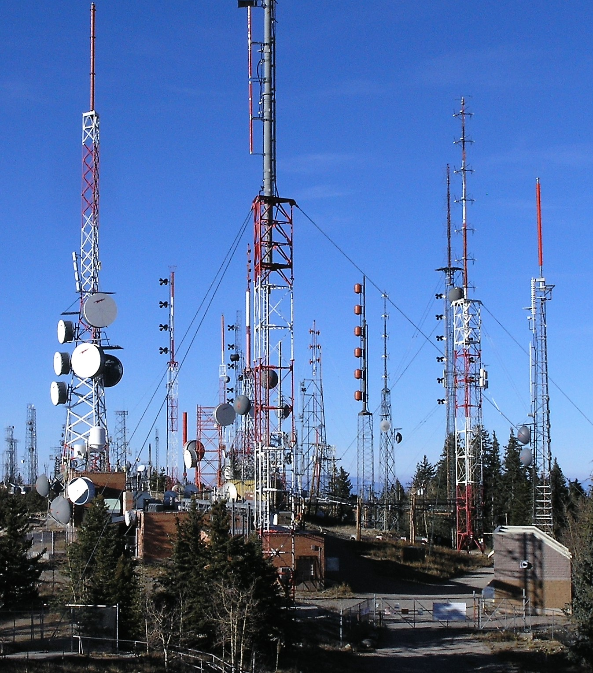
Module 4: Strategies for Managing Signal Coverage and
Addressing Reception Challenges
Notes:
With radio technology, what are the strategies for managing signal coverage and improving consumer reception?
Image references:
https://commons.wikimedia.org/wiki/File:Radio_towers_on_Sandia_Peak.JPG
https://commons.wikimedia.org/wiki/Category:CC-BY-SA-3.0

Slide 49
Module 4: Strategies for Managing Signal Coverage and
Addressing Reception Challenges
Agenda:
Consider improving station coverage:
  Boosters
  Translators
  Single Frequency Networks (SFN)
Understand how partner stations extend reach
Discuss resiliency:
  Station facilities
  Studio Transmitter Link (STL)
  Testing and Maintenance
Booster, Translator and SFN Benefits:
Coverage for hard-to-reach areas
Improves station footprint
Resilient backup facilities
Consider:
What current coverage and reception challenges are your station facing?
How will extended coverage benefit your listenership?
Notes:
With radio technology, what are the strategies for managing signal coverage and improving consumer reception?
In Module 4, we will look at these strategies and reception challenges, along with discussing partner stations, and resiliency. Some things to consider during this module, are the signal coverage challenges you are facing and how extending coverage will benefit your listeners.

Slide 50
Signal Coverage and Reach – Build or Improve
Signal Coverage refers to the geographical area where a radio station’s broadcast signal can reach listeners.
Build America Buy America:
Establishes a domestic content procurement preference for all Federal financial assistance obligated for infrastructure projects.
Factors influencing coverage can include:
Transmission power, regulatory requirements
Antenna height, terrain, orientation
Antenna directionality, gain, radiation patterns
Surrounding structures, urban or rural
For new station builds, careful site selection is crucial for maximizing signal coverage.
Consideration factors include:
Terrain analysis to identify potential obstacles and signal blockages
Placement away from electromagnetic interference sources
Compliance with local regulations and zoning restrictions
The John McCain Act:
Prohibits the purchasing of telecommunications equipment from specific vendors and manufacturers due to privacy and security concerns.
Notes:
Review these facts that influence signal coverage. Take into consideration the factors that affect your station. When looking at upgrading, you will need to consider Federal procurement requirements.
For example, you may need to consider U.S. domestic manufacturing preferences, and to verify that equipment is purchased from unprohibited telecommunication vendors.
Be sure to work with the NGWS grant program administrators for guidance and to ensure compliance.
Optimize antenna system design for improved signal coverage:
Proper antenna height and orientation.
Use of directional antennas to focus the signal in desired directions.
Antenna placement for line-of-sight propagation.
Consideration of antenna gain and radiation patterns
Can come up with some pretty wild antenna patterns
Done in design phase of application.
Adjusting transmitter power can enhance signal coverage:
Increase power for wider coverage, especially in rural areas.
Optimize power output for specific coverage areas to avoid signal wastage.
Consider power limitations and regulatory requirements.
BABAA – Build America Buy America Act
https://www.whitehouse.gov/omb/management/made-in-america/build-america-buy-america-act-federal-financial-assistance/
https://www.fema.gov/grants/policy-guidance/buy-america
John McCain Act
https://www.acquisition.gov/far/52.204-25

Slide 51
Signal Coverage and Reach – Build or Improve
Signal Coverage refers to the geographical area where a radio station’s broadcast signal can reach listeners.
Build America Buy America:
Establishes a domestic content procurement preference for all Federal financial assistance obligated for infrastructure projects.
Regular Signal Monitoring and Testing are essential for maintaining optimal signal coverage.
Use professional tools and conduct drive tests.
The John McCain Act:
Prohibits the purchasing of telecommunications equipment from specific vendors and manufacturers due to privacy and security concerns.
Consider: What power limitations, reception challenges, monitoring and regulatory requirements does your station face?
Notes:
Remember, regular maintenance, signal monitoring, and reception testing will keep your station operating at peak. You will need to consider power, reception, monitoring and regulatory challenges for your station.
Regular signal monitoring and testing are essential for maintaining optimal coverage:
Use professional monitoring tools to evaluate signal strength and quality.
Conduct drive tests to assess coverage performance across different areas.
Continuously monitor and address any signal degradation issues promptly
Perform regular maintenance of all equipment

Slide 52
Signal Coverage and Addressing Reception Challenges for Rural and Underserved Areas
Reception Challenge | Cause of Challenge | Strategies to Address Reception Challenge
Dead Zones | Weak or no signal coverage. | Identify dead zones through testing Explore alternatives for transmission sites Collaborate with other local stations Collaborate with local community resources to identify coverage gaps and explore solutions.
Rural Areas | Limited infrastructure and challenging terrain | Optimize antenna height and placement Utilize repeaters or translators. Collaborate with other local stations Collaborate with local communities.
Notes:
Does anyone’s station coverage include dead zones?

Slide 53
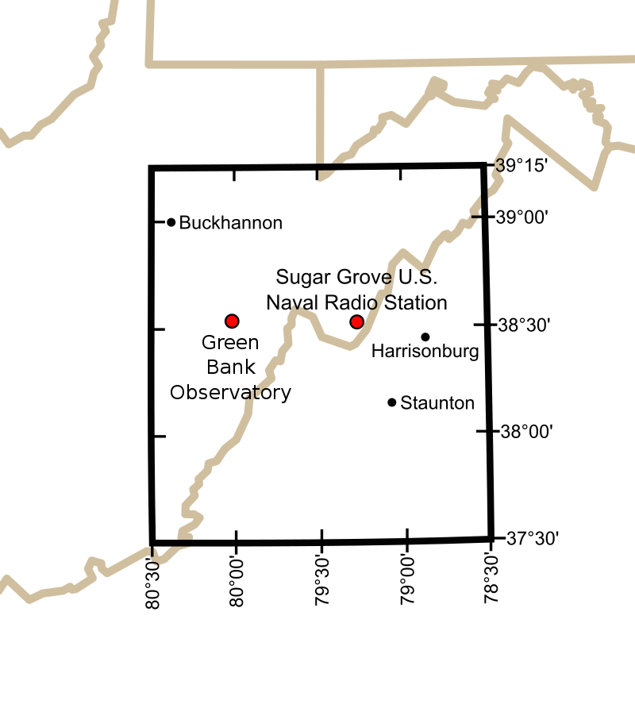
Signal Coverage and Addressing Reception Challenges for Rural and Underserved Areas
Reception Challenge | Cause of Challenge | Strategies to Address Reception Challenge
Dead Zones | Weak or no signal coverage | Identify dead zones through testing Explore alternatives for transmission sites Collaborate with other local stations Collaborate with local community resources to identify coverage gaps and explore solutions.
Rural Areas | Limited infrastructure and challenging terrain | Optimize antenna height and placement Utilize repeaters or translators. Collaborate with other local stations Collaborate with local communities.
Notes:
I’m not talking about the No RF Quiet Zone or NRQZ.
Black/White NRQZ Image By Joel Bradshaw - Derivative of public-domain http://en.wikipedia.org/wiki/File:Map_of_current_Interstates.svgInformation from http://www.gb.nrao.edu/nrqz/nrqz.shtml, CC BY-SA 3.0, https://commons.wikimedia.org/w/index.php?curid=8284049

Slide 54
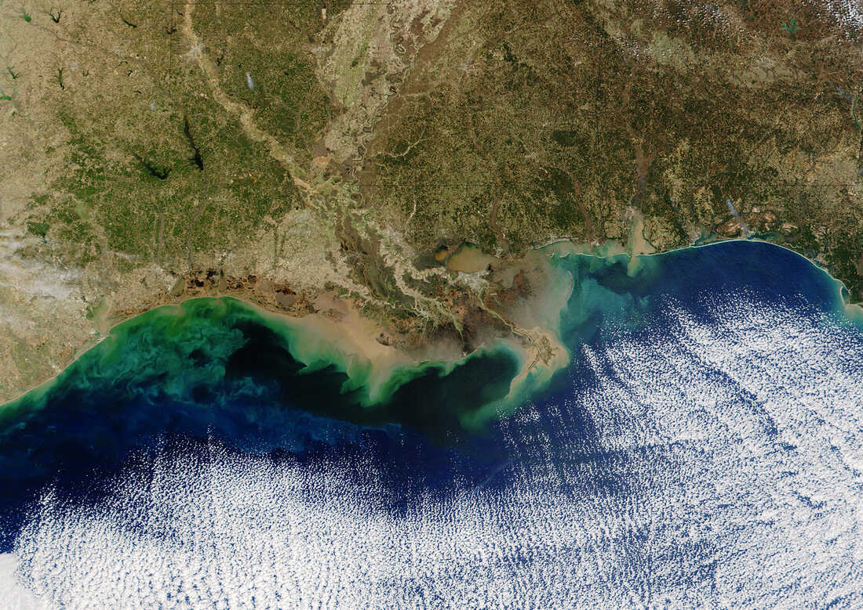
Signal Coverage and Addressing Reception Challenges for Rural and Underserved Areas
Reception Challenge | Cause of Challenge | Strategies to Address Reception Challenge
Dead Zones | Weak or no signal coverage. | Identify dead zones through testing Explore alternatives for transmission sites Collaborate with other local stations Collaborate with local community resources to identify coverage gaps and explore solutions.
Rural Areas | Limited infrastructure and challenging terrain | Optimize antenna height and placement Utilize repeaters or translators. Collaborate with other local stations Collaborate with local communities.
Notes:
And not about where the fish can’t live.
Black/White NRQZ Image By Joel Bradshaw - Derivative of public-domain http://en.wikipedia.org/wiki/File:Map_of_current_Interstates.svgInformation from http://www.gb.nrao.edu/nrqz/nrqz.shtml, CC BY-SA 3.0, https://commons.wikimedia.org/w/index.php?curid=8284049
NASA/Getty Images
https://www.npr.org/sections/thesalt/2017/08/03/541222717/the-gulf-of-mexicos-dead-zone-is-the-biggest-ever-seen

Slide 55
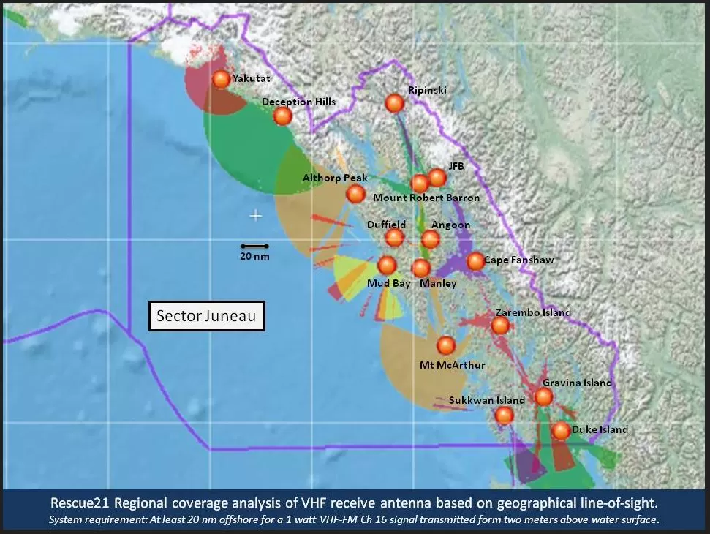
Signal Coverage and Addressing Reception Challenges for Rural and Underserved Areas
Reception Challenge | Cause of Challenge | Strategies to Address Reception Challenge
Dead Zones | Weak or no signal coverage. | Identify dead zones through testing Explore alternatives for transmission sites Collaborate with other local stations Collaborate with local community resources to identify coverage gaps and explore solutions.
Rural Areas | Limited infrastructure and challenging terrain | Optimize antenna height and placement Utilize repeaters or translators. Collaborate with other local stations Collaborate with local communities.
Notes:
Here’s a maritime RF map showing some dead zones.
Black/White NRQZ Image By Joel Bradshaw - Derivative of public-domain http://en.wikipedia.org/wiki/File:Map_of_current_Interstates.svgInformation from http://www.gb.nrao.edu/nrqz/nrqz.shtml, CC BY-SA 3.0, https://commons.wikimedia.org/w/index.php?curid=8284049
NASA/Getty Images
https://www.npr.org/sections/thesalt/2017/08/03/541222717/the-gulf-of-mexicos-dead-zone-is-the-biggest-ever-seen
Radio dead zone from 2020 in Maritime waters off Alaska:
https://www.kfsk.org/2020/01/20/coast-guard-notes-communications-dead-zones-in-southeast/
Rescue21 Regional coverage analysis of VHF receive antenna based on geographical line-of-sight.
System requirement: At least 20 nm offshore for a 1 watt VHF-FM Ch 16 signal transmitted form two meters above water surface.

Slide 56
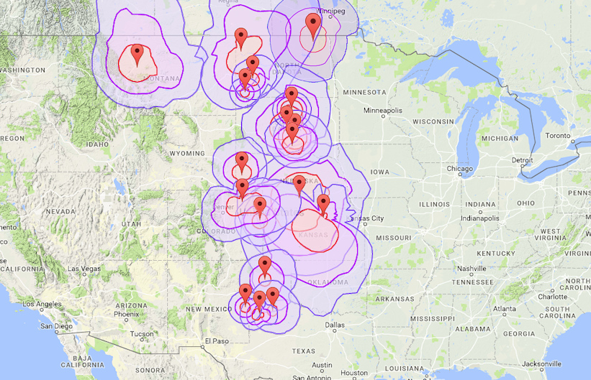
Signal Coverage and Addressing Reception Challenges for Rural and Underserved Areas
Reception Challenge | Cause of Challenge | Strategies to Address Reception Challenge
Dead Zones | Weak or no signal coverage. | Identify dead zones through testing Explore alternatives for transmission sites Collaborate with other local stations Collaborate with local community resources to identify coverage gaps and explore solutions.
Rural Areas | Limited infrastructure and challenging terrain | Optimize antenna height and placement Utilize repeaters or translators. Collaborate with other local stations Collaborate with local communities.
Notes:
Here is a map of agricultural areas showing some dead zones.
Black/White NRQZ Image By Joel Bradshaw - Derivative of public-domain http://en.wikipedia.org/wiki/File:Map_of_current_Interstates.svgInformation from http://www.gb.nrao.edu/nrqz/nrqz.shtml, CC BY-SA 3.0, https://commons.wikimedia.org/w/index.php?curid=8284049
Radio dead zone from 2020 in Maritime waters off Alaska:
https://www.kfsk.org/2020/01/20/coast-guard-notes-communications-dead-zones-in-southeast/
Rescue21 Regional coverage analysis of VHF receive antenna based on geographical line-of-sight.
System requirement: At least 20 nm offshore for a 1 watt VHF-FM Ch 16 signal transmitted form two meters above water surface.
Signal Coverage Map with Dead Zone Identified:
Source: https://agsearch.us/coverage.html

Slide 57
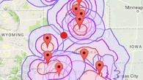
Signal Coverage and Addressing Reception Challenges for Rural and Underserved Areas
Reception Challenge | Cause of Challenge | Strategies to Address Reception Challenge
Dead Zones | Weak or no signal coverage. | Identify dead zones through testing Explore alternatives for transmission sites Collaborate with other local stations Collaborate with local community resources to identify coverage gaps and explore solutions.
Rural Areas | Limited infrastructure and challenging terrain | Optimize antenna height and placement Utilize repeaters or translators. Collaborate with other local stations Collaborate with local communities.
Notes:
In this instance, we see a dead zone in the area between Nebraska and South Dakota, covered by the red dot.
Black/White NRQZ Image By Joel Bradshaw - Derivative of public-domain http://en.wikipedia.org/wiki/File:Map_of_current_Interstates.svgInformation from http://www.gb.nrao.edu/nrqz/nrqz.shtml, CC BY-SA 3.0, https://commons.wikimedia.org/w/index.php?curid=8284049
Signal Coverage Map with Dead Zone Identified:
Source: https://agsearch.us/coverage.html

Slide 58
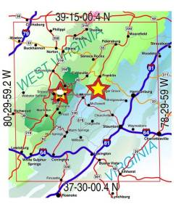
Signal Coverage and Addressing Reception Challenges for Rural and Underserved Areas
Reception Challenge | Cause of Challenge | Strategies to Address Reception Challenge
Dead Zones | Weak or no signal coverage. | Identify dead zones through testing Explore alternatives for transmission sites Collaborate with other local stations Collaborate with local community resources to identify coverage gaps and explore solutions.
Rural Areas | Limited infrastructure and challenging terrain | Optimize antenna height and placement Utilize repeaters or translators. Collaborate with other local stations Collaborate with local communities.
Notes:
There are communications dead zones where radio signals are not being delivered. Although RF can be transmitted anywhere, should it be?
The No RF Quiet Zone is one area where coordination of radio signals with the FCC is required to ensure RF interference cannot affect radio reception and transmission for the National Radio Observatory in Green Bank, West Virginia, and the US Navy facilities in Sugar Grove, West Virginia. Other areas where RF is not received or transmitted includes deserts or mountainous terrain without possible human habitation. Regardless, your reception area should be as fully covered as possible.
Color NRQZ image:
National Radio Quiet Zone – Green Bank Observatory
https://greenbankobservatory.org/about/national-radio-quiet-zone/
Signal Coverage Map with Dead Zone Identified:
Source: https://agsearch.us/coverage.html

Slide 59
Signal Coverage and Addressing Reception Challenges for Rural and Underserved Areas
Reception Challenge | Cause of Challenge | Strategies to Address Reception Challenge
Dead Zones | Weak or no signal coverage. | Identify dead zones through testing Explore alternatives for transmission sites Collaborate with other local stations Collaborate with local community resources to identify coverage gaps and explore solutions
Rural Areas | Limited infrastructure and challenging terrain | Optimize antenna height and placement Utilize repeaters or translators Collaborate with other local stations Collaborate with local communities
Reception Challenge | Cause of Challenge | Strategies to Address Reception Challenge
Dead Zones | Weak or no signal coverage. | Identify dead zones through testing Explore alternatives for transmission sites Collaborate with other local stations Collaborate with local community resources to identify coverage gaps and explore solutions.
Rural Areas | Limited infrastructure and challenging terrain | Optimize antenna height and placement Utilize repeaters or translators. Collaborate with other local stations Collaborate with local communities.
Notes:
Testing will identify areas in your station reception contours with dead zones, along with an understanding of where coverage extends.
Urban and rural environments each have unique reception challenges. For example, urban areas are more likely to have interference from buildings and other man-made structures, whereas rural areas more likely suffer from challenging terrain, and limited resources.
Wherever your station is located, it is always good practice to collaborate with local communities and resources. It can be important to partner with other local stations for things like shared antenna placement, and alternative transmission sites.
Urban environments present unique reception challenges due to signal interference from buildings and other structures.
Use signal boosters or repeaters to enhance coverage within buildings.
Consider distributed antenna systems (DAS) for improved indoor coverage. DAS is available from many common manufacturers… e.g. Internet browser search on “Distributed antenna systems for radio”
Collaborate with building owners for antenna placement or signal distribution
Synchronous boosters can offer gap filling in difficult areas that are not served well by single-point transmissions or repeaters. On-frequency repeaters/boosters can create issues with audio distortion and interference on the main signal in certain circumstances, such as when proximity to the main antenna creates overlapping signals. Commonly, repeaters are high tower height, and only a single booster site. Synchronous boosters use multiple low-power, precisely-synchronized transmitters on lower-height, highly-directional antennas, placed strategically for the regions contour coverage gaps.
Reference: https://www.gatesair.com/documents/slides/2015-08-Anderson-Synchronous-Boosters-for-Single-Frequency-Networking-and-MaxxCasting.pdf
Gap filling is not specific to HD Radio, this also impacts AM/FM and TV broadcasts.
Does HD Radio have different strategies for mitigation of transmission/reception issues for urban, rural landscapes and dead zones?
No, but it is not affected by multipath interference.
Low power FM stations in some cases may be getting interference from HD Radio stations.
www.radioworld.com/tech-and-gear/digital-radio/an-unintended-consequence-of-digital-radio
RF Engineering will help to resolve these types of problems.
Utilize HD Radio digital broadcasting technology for better resistance to interference.
Go All-Digital with your station for higher quality audio regardless of band (AM/FM)

Slide 60
Objectives and Equipment for Managing Radio Station
Signal Coverage and Reception Challenges
Objectives | Components
Resiliency | Power Backup Generator Backup Transmitter
Studio-Transmitter Links (STL) | Microwave Network / Antenna Fiber Network Ethernet WiFi Cellular
Security | Maintain all employee and station computer equipment for latest cyber-security patches Verify and maintain station premises with appropriate controlled access rights
Objectives | Components
Monitoring and Testing | Local Station Receiver EAS Monitor Receiver Field Testing and Monitoring Receivers
Equipment Maintenance | Antennas Transmitters Power Generators Cooling Systems STLs EAS Receivers Security Updates Monitoring Facilities
Notes:
Once you have maximized your stations coverage to minimize dead zones and poor reception areas, your objectives for managing operational signal coverage and reception should focus on the core technologies:
Power resilience: You can’t run the station without power.
Studio-Transmitter-Links: This is where all the source broadcast content is transported from the studio to the transmitter for broadcast.
Security for Systems and Facilities: Security applies across all facets of the radio stations communications capabilities, including STL, Computers, Internet, as well as access to station facilities.
And Monitoring, Testing, and Maintenance
All are important not just to keep the lights on, but to deliver the best broadcast signals, and community services for your station.

Slide 61
Use Cases for Upgrading Your Station
Discussion Questions:
1. What current coverage and reception challenges are your station facing?
2. How will expanded signal coverage fulfill your stations’ missions?
3. Can you identify strategies that were discussed that could benefit your listenership?
Use Case | Components
Non-digital, Outdated or Malfunctioning Air-Chain Equipment | Transmitters with Higher Power Output FM Exciters HD Importer / Exporter Audio Processing, Digital Upgrades Monitoring and Testing
Tower Maintenance, Disrepair or Degradation | Invest in Inspections, Structural Fixes Improved Channel Reach Antenna Modifications and Upgrades Boosters, Translators, SFNs
EAS Equipment Updates to Support FCC Requirements | Firmware upgrades for capable equipment Replacement EAS equipment/monitoring
Streaming and IP Conversion | Internet Access and Redundancy Systems and Cloud Services Content Delivery Networks Security
Notes:
Here are some of the use cases you can use to consider for station upgrades.
Review your air-chain equipment. Any outdated or malfunctioning components? Hire tower inspectors, and make sure you address any irregularities. RF Engineering is required to understand how best to update your antenna systems to improve your station reach.
Keep your EAS gear up-to-date, and make sure to replace all outdated equipment.
If you are considering virtualization of your station broadcast data, virtualization requires high-speed Internet connectivity, and although radio is in general low bit rate, streaming requires real-time responsiveness and delivery, over sometimes clogged Internet pipes.
Regardless, you will want to contract for the most reliable Internet service for your area, with business-level service and redundancy.
Be aware of costs for streaming, where each stream being delivered is charged by the bit from cloud providers. Ingest is more or less, free, but egress is not.
Content Delivery Networks remove the burden of streaming from the broadcaster, but they can be costly, dependent on your station reach and how many simultaneous streams are supported. Streaming costs can be offset with audience engagement across both radio and streaming services.
Finally, make sure you keep up-to-date with computer systems security, especially when it comes to delivering streams over the Internet. You do not want your station streams to get hi-jacked!
Here are some questions for discussion for your station:
What coverage and reception challenges are you facing?
What will expanding signal coverage do for your station?
What strategies can benefit your listeners?
Review use cases for upgrading a station that radio station leaders can use for justification of funding and technology purchases.
Improving station coverage, boosters, translators, and Single Frequency Networks (SFN)
Requires FCC approval for changes to reach for antennas and transmitters
Partner stations for extending reach
Work with other community radio station broadcasters on Tower sharing for resources, configuration, and monitoring/testing.
Resiliency of station facilities, studio to transmitter link (STL), and testing and maintenance
Rulemaking and requirements went into effect in December 2023 that require devices to poll IPAWS to see if there are any additional updates. Virtualization makes it easy to stay upgraded, but Internet access is required for virtualization.

Slide 62
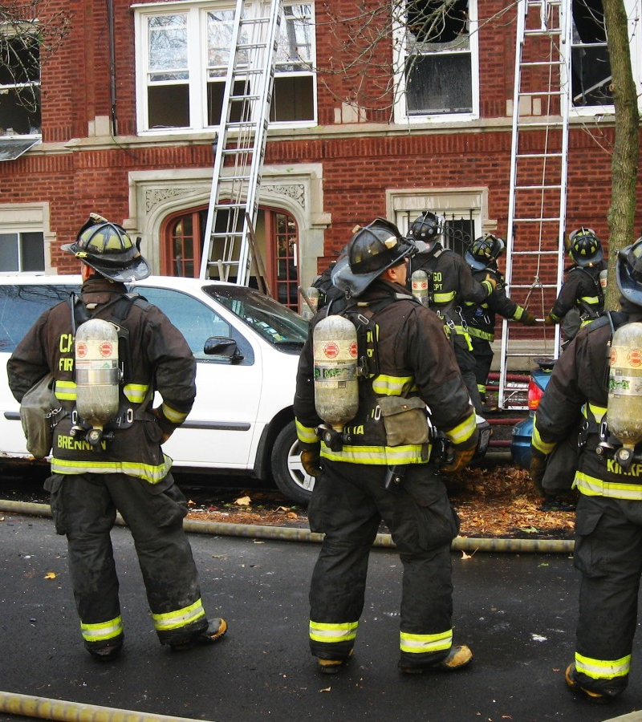
Best Practices for EAS Integration for Radio Stations
EAS is a system for broadcasting emergency alerts to the public
Integration enables seamless transmission of emergency messages during regular programming
Best practices ensure compliance, hardware, and software optimization, and effective message delivery
Notes:
In the IPAWS module, we reviewed that EAS broadcasts alerts to the public through radio and TV. Emergency messages require an effective delivery infrastructure, or else messages won’t be delivered. Broadcasting has the unique ability to deliver messaging across a wide area with no need for an Internet return path. This is extremely effective for emergency messaging.

Slide 63
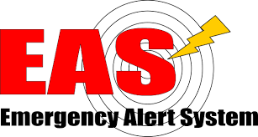
Best Practices for EAS Integration for Radio Stations
Agenda:
Provide an overview of the EAS, regulatory requirements, hardware and software
Discuss strategies for seamless integration of EAS alerts within regular programming
Consider leveraging RDS and HD Radio for EAS messaging and advanced emergency alerting
Understand new FCC regulations, such as higher power for transmission and CAP messaging
Consider:
How will enhanced emergency information alerting benefit your listenership?
Notes:
In this module, we will review some best practices for EAS integration with Radio Stations, with a look at the latest EAS regulations and gear, station operations, and HD Radio enhancements for emergency messaging. Let’s see how enhanced emergency messaging can benefit your listeners.

Slide 64
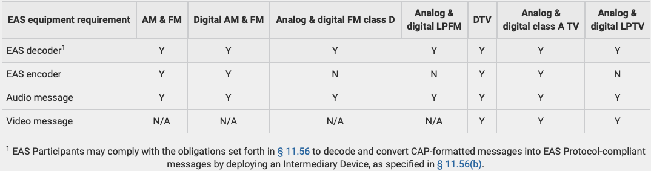
Regulatory Requirements for EAS
Analog and Digital Broadcast Station EAS Equipment Deployment Requirements
Note: An Intermediary Device refers to a receiver that can take CAP EAS messages and construct a visual message for the consumer.​
Notes:
Your station requires certain Emergency Alert System equipment to receive and send alerts, depending on your stations class of operation. This table shows the required EAS gear for various station types including low power, and digital TV. All stations are required to receive the EAS and transmit it on their broadcast. However, low power and class D stations are not required to encode an EAS message for redistribution to other stations. All stations are required to transmit the accompanied audio tones and message.
Table Reference:
https://www.ecfr.gov/current/title-47/chapter-I/subchapter-A/part-11
Table 1—Analog and Digital Broadcast Station Equipment Deployment Requirements

Slide 65
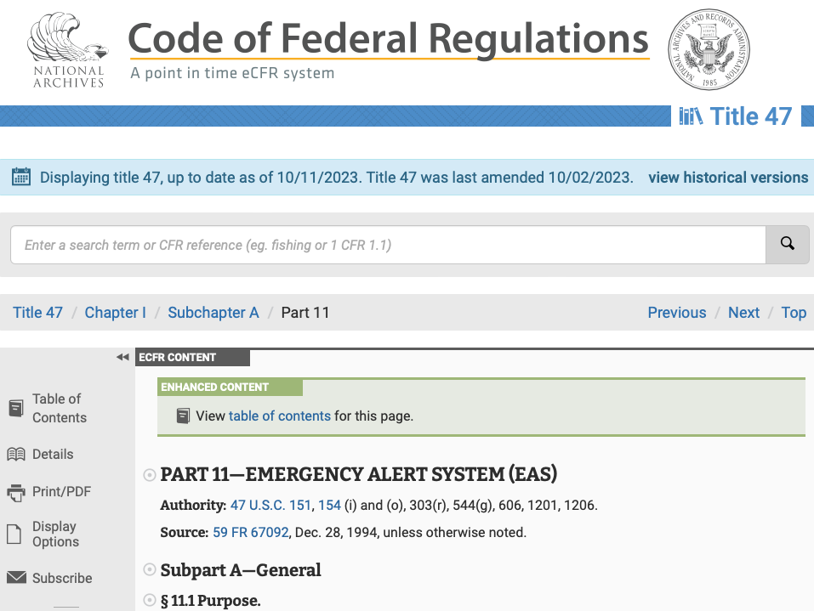
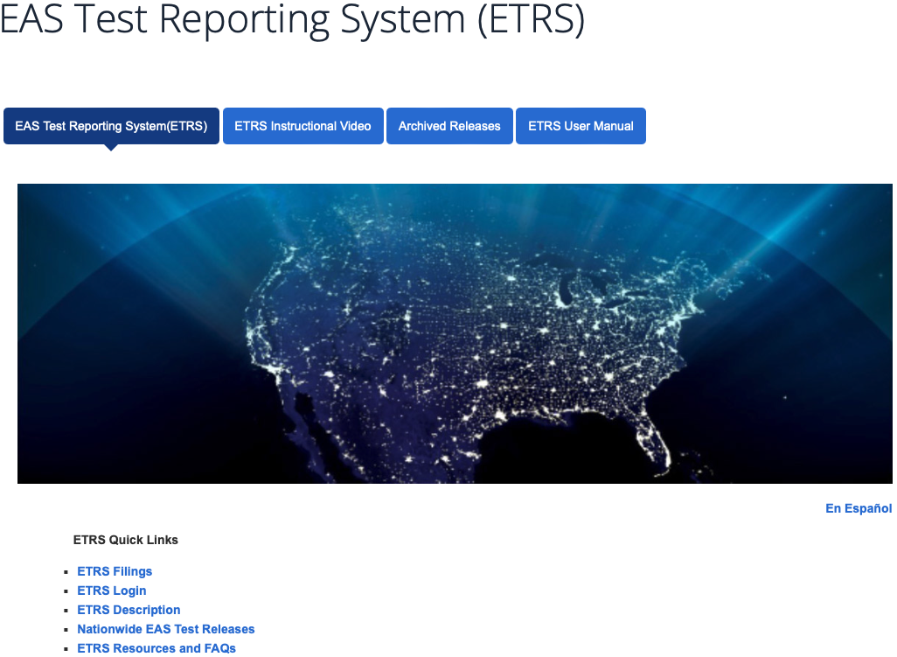
Regulatory Requirements for EAS
Regulatory Requirements:
CAP Messaging
State and Regional EAS Plans;
Alert origination, duration, and prioritization
Testing:
  RWT = Required Weekly Testing
  RMT = Required Monthly Testing
  NPT = National Periodic Testing
Reporting and Maintaining Records
Notes:
The FCC regulations include requirements for EAS encoders and decoders to use CAP Messaging. This is a new requirement. Your state and region have EAS plans.
References:
https://www.ecfr.gov/current/title-47/chapter-I/subchapter-A/part-11
https://www.fcc.gov/general/eas-test-reporting-system

Slide 66
Regulatory Requirements for EAS
Regulatory Requirements:
CAP Messaging
State and Regional EAS Plans;
Alert origination, duration, and prioritization
Testing:
  RWT = Required Weekly Testing
  RMT = Required Monthly Testing
  NPT = National Periodic Testing
Reporting and Maintaining Records
Notes:
All stations are required to participate in the EAS testing, along with maintaining records, and reporting of test results.
References:
https://www.fcc.gov/general/eas-test-reporting-system

Slide 67
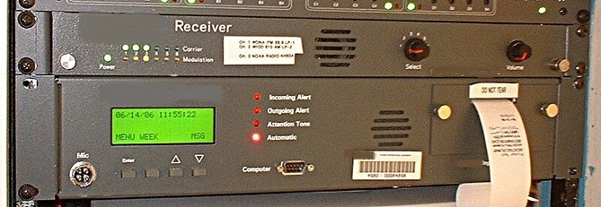
EAS Integration for Radio Stations
Hardware and Software Considerations
Invest in Reliable EAS Hardware and Software
Solutions that are tailored for your station
Certified by regulatory authorities
Regularly maintain and update hardware and software for optimal functionality
Emergency Responders require Mission-Critical communications infrastructure
  Cellular phones
  Satellite phones
  Radio-based walkie-talkies
  Mobile Radio and TV Broadcast Facilities
Consider:
What is your relationship with the Alerting Authorities and Emergency Managers in your SLTT areas?
Notes:
This is an example of EAS equipment that is out of date. If you have one like this, it needs to be replaced
SAGE ENDEC Receiver Image:
https://en.m.wikipedia.org/wiki/File:Sage_EAS_Endec.jpg
https://en.wikipedia.org/wiki/User:VXO
https://commons.wikimedia.org/wiki/Main_Page

Slide 68
EAS Integration for Radio Stations
Hardware and Software Considerations
Invest in Reliable EAS Hardware and Software
Solutions that are tailored for your station
Certified by regulatory authorities
Regularly maintain and update hardware and software for optimal functionality
Emergency Responders require Mission-Critical communications infrastructure
  Cellular phones
  Satellite phones
  Radio-based walkie-talkies
  Mobile Radio and TV Broadcast Facilities
Consider:
What is your relationship with the Alerting Authorities and Emergency Managers in your SLTT areas?
Notes:
Keep your equipment well maintained with patches and upgrades.
FCC Rulemaking that went into effect in December 2023 requires devices to poll IPAWS to see if there are any additional updates before sending out an alert. This will require a firmware upgrade for capable EAS encoders and decoders; and may mean you will have to replace any outdated EAS gear. Some encoders are not yet capable of these mandatory updates, so you may need to ask the FCC for a waiver if your gear cannot become compliant before the deadline, as some stations have already done or you can replace that gear with encoders that do support the new requirements. Remember, in an emergency, your station broadcasts are critical to deliver life-saving information for first responders, and the general public, in your broadcast area.
What is your relationship with your alerting authorities and state emergency managers? Your stations coordination with state emergency managers can provide support when planning for business continuity and disaster recovery activities, in addition to the service that your station provides for alerting authorities and emergency managers, to communicate to the public during crises.
References:
https://www.fcc.gov/emergency-alert-system#block-menu-block-4
- provides a wealth of resources for radio station managers and engineers
– FEMA cannot recommend any specific vendors.
https://www.fcc.gov/SECC-Resources
SLTT – State, Local, Tribal and Territorial

Slide 69
Strategies for Seamless Integration with Regular Programming
Develop Communication protocols for receiving emergency alerts
  Secure communications for emergency responders
  Develop a relationship with your State Emergency Management and Alerting Authorities
Use FEMA’s EAS Manual
Train staff on EAS Operations and Procedures
Implement automated alert monitoring and switching systems for seamless integration
Resources:
IPAWS Best Practices (fema.gov)
PrepTalks: Dr. Dennis Mileti "Modernizing Public Warning Messaging" | FEMA.gov
Home - The Warn Room
The Emergency Alert System (EAS) | Federal Communications Commission (fcc.gov)
Consider:
Who is training the trainer?
Notes:
What are your protocols for communicating with emergency responders during a crisis? FEMA maintains best practices and a very informational website on alerting, and there are other private and educational resources as well.
In your operations, who is training the trainer? Maintain a consistent knowledge of emergency preparedness across your station operations.
Check out:
https://www.fema.gov/sites/default/files/documents/fema_ipaws-best-practices-guide.pdf
https://www.fema.gov/blog/preptalks-dr-dennis-mileti-modernizing-public-warning-messaging
http://www.thewarnroom.com
https://www.fcc.gov/emergency-alert-system#block-menu-block-4
- provides a wealth of resources for radio station managers and engineers
Also:
https://www.fema.gov/emergency-managers/practitioners/integrated-public-alert-warning-system/public-safety-officials/sign-up
https://www.fema.gov/emergency-managers/practitioners/integrated-public-alert-warning-system/public-safety-officials/alerting-authorities
- Link to FCC site for becoming an alerting authority

Slide 70
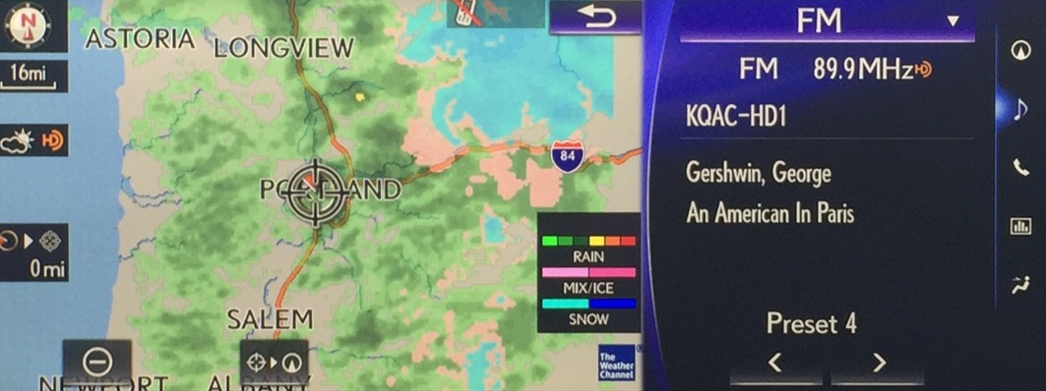
Leveraging RDS and HD Radio for EAS Messaging
RDS | Text-based information Transmission Display detailed emergency information on compatible receivers Include supplementary details, safety instructions, and evacuation routes Targeted Emergency Alerts Geographically targeted alerts using Program Identification (PI) Codes Provide localized information to specific areas or regions
HD Radio | Digital Technology for Enhanced EAS Messaging Improved audio quality and reduced static compared to analog broadcasts More bandwidth to transmit additional data alongside audio, such as emergency details Transmit traffic updates, road conditions, AMBER Alerts, etc. Multi-channel capabilities for additional programming options during emergencies
Example Car Dashboard Doppler Weather Radar using HD Radio Data Services
Notes:
RDS and HD Radio both provide the ability to broadcast text-based information and geo-targeted emergency alerts. HD Radio improves the audio quality, bandwidth, and number of channels being delivered. This multi-channel capability means that you can broadcast large amounts of additional data quickly, such as evacuation routes, using a single channel bandwidth.
Image courtesy of
2022 – 2026 IPAWS Strategic Plan (page 9): https://www.fema.gov/sites/default/files/documents/fema_ipaws-strategic-plan-fy-2022-2026.pdf

Slide 71
Leveraging RDS and HD Radio for EAS Messaging
RDS | Text-based information Transmission Display detailed emergency information on compatible receivers Include supplementary details, safety instructions, and evacuation routes Targeted Emergency Alerts Geographically targeted alerts using Program Identification (PI) Codes Provide localized information to specific areas or regions
HD Radio | Digital Technology for Enhanced EAS Messaging Improved audio quality and reduced static compared to analog broadcasts More bandwidth to transmit additional data alongside audio, such as emergency details Transmit traffic updates, road conditions, AMBER Alerts, etc. Multi-channel capabilities for additional programming options during emergencies
Example Car Dashboard Doppler Weather Radar using HD Radio Data Services
Notes:
Here is a a view of that RDS display
Display of RDS:
https://en.wikipedia.org/wiki/Radio_Data_System#/media/File:Radio_Data_System_(RDS)_on_95.9_KFSH_La_Mirada.jpg
https://creativecommons.org/licenses/by-sa/4.0

Slide 72
Leveraging RDS and HD Radio for EAS Messaging
RDS | Text-based information Transmission Display detailed emergency information on compatible receivers Include supplementary details, safety instructions, and evacuation routes Targeted Emergency Alerts Geographically targeted alerts using Program Identification (PI) Codes Provide localized information to specific areas or regions
HD Radio | Digital Technology for Enhanced EAS Messaging Improved audio quality and reduced static compared to analog broadcasts More bandwidth to transmit additional data alongside audio, such as emergency details Transmit traffic updates, road conditions, AMBER Alerts, etc. Multi-channel capabilities for additional programming options during emergencies
Example Car Dashboard Doppler Weather Radar using HD Radio Data Services
Notes:
And here is an example of an HD Radio car dashboard, with Doppler Weather Radar.
Doppler Radar on HD Radio Image Courtesy
Ashruf El-Dinary
Xperi Corporation
ashruf.el-dinary@xperi.com

Slide 73
Leveraging RDS and HD Radio for EAS Messaging
RDS | Text-based information Transmission Display detailed emergency information on compatible receivers Include supplementary details, safety instructions, and evacuation routes Targeted Emergency Alerts Geographically targeted alerts using Program Identification (PI) Codes Provide localized information to specific areas or regions
HD Radio | Digital Technology for Enhanced EAS Messaging Improved audio quality and reduced static compared to analog broadcasts More bandwidth to transmit additional data alongside audio, such as emergency details Transmit traffic updates, road conditions, AMBER Alerts, etc. Multi-channel capabilities for additional programming options during emergencies
Notes:
With these types of improvements, it makes sense for your station to leverage HD Radio to deliver enhanced EAS messaging for your listeners. Plus, HD Radio is not just an improvement for messaging in automobiles.

Slide 74
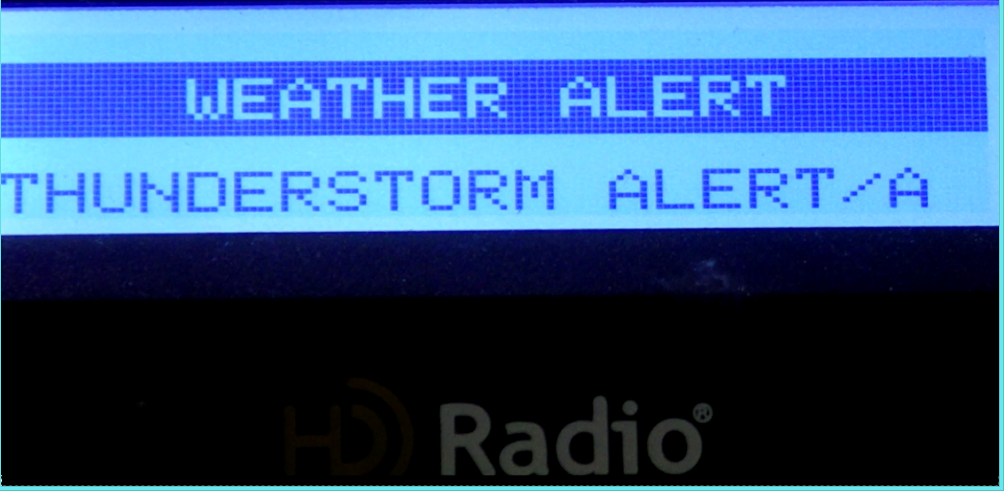
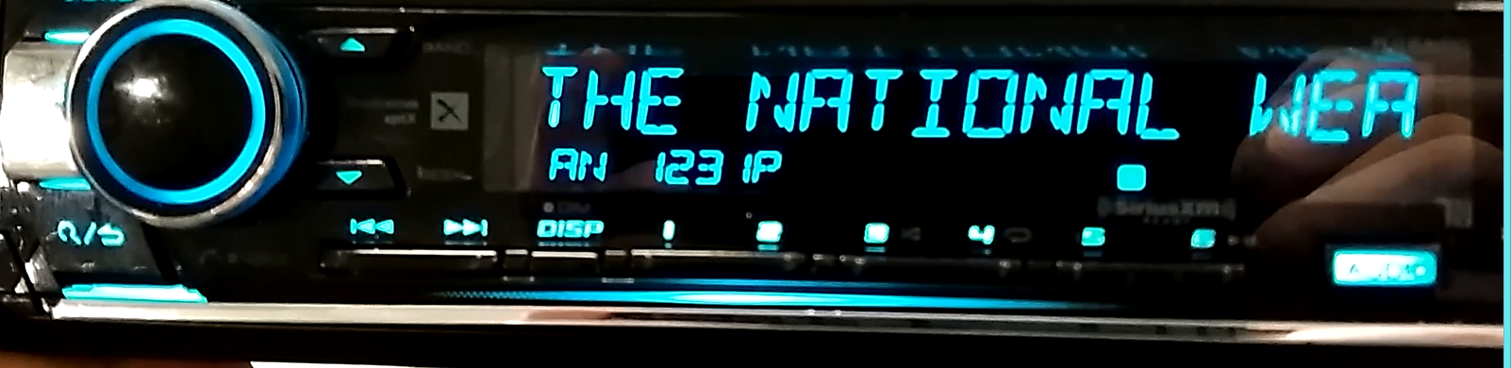
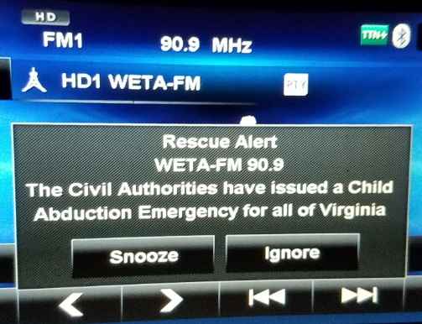
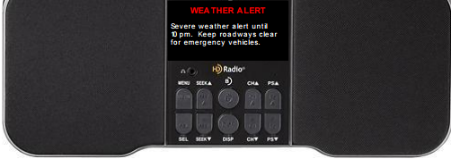
EMERGENCY ALERTS PHASE 1 –
TEXT NOTIFICATION
Notes:
HD Radio is useful for home reception too. HD Radio alerting implementations can deliver real-time text notifications to home and mobile receivers.
Images Courtesy
Ashruf El-Dinary
Xperi Corporation
ashruf.el-dinary@xperi.com

Slide 75
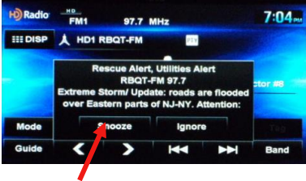
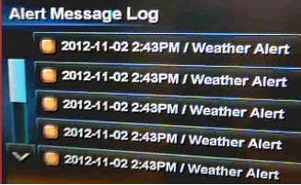
EMERGENCY ALERTS PHASE 1 –
CURRENT USER EXPERIENCE
“Wake-up” receiver
Visual notification
Alert reminders
History log
Pop-up alert message with user action requests
  Receiver wake-up
  Special-needs functionality product
Notes:
HD Radios do allow receivers to wake-up on a notification, and to deliver pop-up alert messages. Some HD Radios support functional access for disabled or special-needs.
Images Courtesy
Ashruf El-Dinary
Xperi Corporation
ashruf.el-dinary@xperi.com

Slide 76
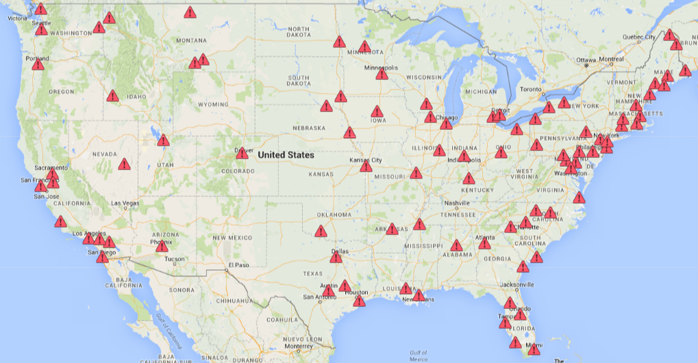
DIGITAL EMERGENCY ALERTS –
LAUNCH STATUS PHASE 1
Currently there are 322 stations in 83 markets transmitting emergency alerts over HD Radio. These are simple text messages.
Notes:
Text message alerting using HD Radio is deployed through most existing HD Radio stations today. If your public station has deployed HD Radio, then you will likely already have text message alerting configured with your EAS gear. If you are deploying HD Radio as part of the grant program, then you will want to make sure to configure text message alerts for your listeners, at a minimum.
Image Courtesy
Ashruf El-Dinary
Xperi Corporation
ashruf.el-dinary@xperi.com

Slide 77
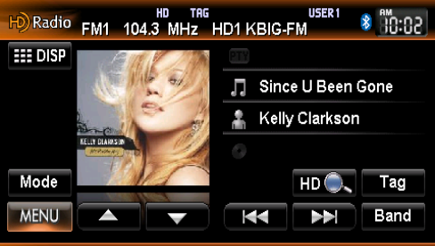



EMERGENCY ALERTS PHASE 2 –
NRT Content
Transmit graphics linked to alerts
Hurricane Warning
Emergency Alert
Evacuation Notice
Emergency Alert
Person of Interest
Emergency Alert
Notes:
HD Radio does support the inclusion of Non-Real-time data that can link graphics to the text alerts, as you can see here supporting various emergency alerting situations such as amber alerts, and weather alerts.
These capabilities can be configured using the HD Importer/Exporter system. Enhanced alerts can be delivered through your EAS gear using IPAWS CAP messaging when extended emergency information is available.
Images Courtesy
Ashruf El-Dinary
Xperi Corporation
ashruf.el-dinary@xperi.com

Slide 78
ALERT DISTRIBUTION COMPARISON
 | Analog Radio EAS | HD Radio Emergency Alerts | Cellular WEA
Alert Method | Audible tones and voice | Radio trigger, audible tones, text and voice | Handset trigger, text
Audio Message | Yes | Yes | No
Text Message | No | Yes | Yes
Language selective | No | Yes | No*
Location-based | Listening area | Broadcast area and ZIP codes | Target location
Message history | No | Yes | Yes
Message Types (NWR-Specific Area Message Encoding) | Presidential Weather Life or Safety Amber Alerts Periodic Tests | Presidential Weather Life or Safety Amber Alerts Periodic Tests | Presidential Weather Life or Safety Amber Alerts
Severity Indication | Only voice | Yes | Yes
Reliability | All technologies complement existing EAS system mandated by FCC and FEMA. No one system is guaranteed 100% at any time or location.
Notes:
Here’s a chart of the distribution of alerting. As you can see, HD Radio emergency alerts provide additional capabilities over AM, FM, and wireless cellular alerts, including distribution through all types of alerting methods, the ability to broadcast different languages, and more targeted area-based alerts.
*Just recently, the FCC has asked cellular providers to support emergency messages in the 13 most commonly spoken languages in the US, as well as English, and American Sign Language, through Wireless Emergency Alerts. Multiple languages for emergency notifications is available today for HD Radio broadcasts.
*Reference for FCC Order:
https://docs.fcc.gov/public/attachments/DOC-397834A1.pdf
Slide table, Courtesy
Ashruf El-Dinary
Xperi Corporation
ashruf.el-dinary@xperi.com

Slide 79
Best Practices for EAS Integration for Radio Stations Key Takeaways
Stay compliant with EAS regulations
Maintain reliable hardware and software
Train staff and develop communication protocols
Utilize HD Radio for advanced emergency messaging
Coordinate with local alerting authorities
Discussion Questions:
How will enhanced emergency information alerting benefit your listenership?
Do you know your State and Local Alerting Authorities?
What are your current EAS protocols?
Has your station gone digital with HD Radio?
Notes:
Please review these key takeaways on the best practices for EAS integration for your stations and answer these discussion questions for your organization.

Slide 80
Transitioning to Digital Radio:
Pros and Cons
Purpose:
Understand how to leverage HD Radio with:
  Higher quality audio
  Public messaging
  Enhanced user experience
Discuss HD Radio transition options
  Review Case Studies
Discuss Public Awareness and Accessibility to AM/FM, and digital HD Radio receivers
Consider costs, challenges and total cost of operations for HD Radio
Review how HD Radio can be a tool to engage your audience
Notes:
Why transition to HD Radio? In this module, we will go more in depth on HD Radio capabilities. We’ll review the pros and cons of transitioning to HD Radio, including cost considerations. We will look briefly at using ATSC 3.0 for radio distribution and review a use case on transitioning. We will conclude with a discussion on how HD Radio helps drive audience engagement and delivers access to additional information in an emergency.
As you can see in the diagram, since analog and digital source signal paths are combined only prior to transmission, your station can deliver multiple independent program streams on separate digital tunable sub-channels, without affecting your analog signal. Also, the digital signal is not affected by multi-path distortion. The resultant user experience for a listener who has HD Radio with graphical displays, includes artist, artwork, song titles and HD Radio channel call letters and main or sub-channel, in this case the HD2 sub-channel.
Diagram and Image Courtesy
Ashruf El-Dinary
Xperi Corporation
ashruf.el-dinary@xperi.com

Slide 81


Transitioning to Digital Radio – Better Audio, New Services
 | Pros | Cons
Transitioning to HD Radio for Better Quality Audio | Improved audio quality with higher fidelity Reduced noise and distortion for enhanced listening experience Increased dynamic range, benefiting music-oriented stations | Upfront investment Limited receiver adoption Potential coverage limitations Potential signal interference
Leveraging HD Radio for Public Messaging and Enhanced User Experience | Ability to transmit supplementary data alongside audio Interactive features and personalized content options Enhanced emergency messaging | Increased complexity Station operators may require additional resources for content creation and management Compatibility challenges for listeners with older receivers
Evacuation Notice
Emergency Alert
Notes:
Along with enhanced data for car dashboards, and consumer home and portable receivers, HD Radio delivers better quality audio, and other new services.
Image: https://hdradio.com/all-digital-am/

Slide 82
Transitioning to Digital Radio – Better Audio, New Services
 | Pros | Cons
Transitioning to HD Radio for Better Quality Audio | Improved audio quality with higher fidelity Reduced noise and distortion for enhanced listening experience Increased dynamic range, benefiting music-oriented stations | Upfront investment Limited receiver adoption Potential coverage limitations Potential signal interference
Leveraging HD Radio for Public Messaging and Enhanced User Experience | Ability to transmit supplementary data alongside audio Interactive features and personalized content options Enhanced emergency messaging | Increased complexity Station operators may require additional resources for content creation and management Compatibility challenges for listeners with older receivers
Evacuation Notice
Emergency Alert
Notes:
These new services include delivering QR-codes for products or events, and public services, as well as enhanced emergency messaging,
Image Courtesy
Ashruf El-Dinary
Xperi Corporation
ashruf.el-dinary@xperi.com

Slide 83
Transitioning to Digital Radio – Better Audio, New Services
 | Pros | Cons
Transitioning to HD Radio for Better Quality Audio | Improved audio quality with higher fidelity Reduced noise and distortion for enhanced listening experience Increased dynamic range, benefiting music-oriented stations | Upfront investment Limited receiver adoption Potential coverage limitations Potential signal interference
Leveraging HD Radio for Public Messaging and Enhanced User Experience | Ability to transmit supplementary data alongside audio Interactive features and personalized content options Enhanced emergency messaging | Increased complexity Station operators may require additional resources for content creation and management Compatibility challenges for listeners with older receivers
Evacuation Notice
Emergency Alert
Notes:
Additional information can also include evacuation routes, and public announcements.
Image Courtesy
Ashruf El-Dinary
Xperi Corporation
ashruf.el-dinary@xperi.com

Slide 84
Transitioning to Digital Radio – Better Audio, New Services
 | Pros | Cons
Transitioning to HD Radio for Better Quality Audio | Improved audio quality with higher fidelity Reduced noise and distortion for enhanced listening experience Increased dynamic range, benefiting music-oriented stations | Upfront investment Limited receiver adoption Potential coverage limitations Potential signal interference
Leveraging HD Radio for Public Messaging and Enhanced User Experience | Ability to transmit supplementary data alongside audio Interactive features and personalized content options Enhanced emergency messaging | Increased complexity Station operators may require additional resources for content creation and management Compatibility challenges for listeners with older receivers
Evacuation Notice
Emergency Alert
Notes:
HD Radio broadcasts require upfront investment, including the combiner, additional exciters, and possible tower modifications, which can be costly. Also, as mentioned in Module 3, HD Radio does have most of the U.S. population covered with many commercial receivers in consumers hands, but there are still many radios without HD Radio built into them, and not all stations are broadcasting HD Radio signals.
HD Radio broadcasts require content, and simulcasting the existing signal on the Main HD channel is not the only content you will be working on. HD Radio’s multiple sub-channels and public messaging capabilities means you will want to have additional resources to deliver the additional programming.
As a public broadcasting station, your HD Radio service should include a public services channel or sub-channel, which can be used to inform your listeners of important local events and activities, as well as help emergency responders in times of crisis. This channel in an HD lineup can be broadcast in addition to the main and other sub-channels; directly, or by using automation, or in place of the main program, depending upon need.

Slide 85
Transitioning to Digital Radio – Public Awareness and Accessibility
 | Pros | Cons
Public Awareness and Accessibility to AM/FM | Widespread coverage Compatible with a wide range of devices Lower cost | Limited audio quality Susceptible to interference Limited capacity for data transmission and interactive features
Public Awareness and Accessibility to All Digital HD Radio | Enhanced audio quality and clarity Improved resistance to interference Data transmission All-Digital station operation: More bandwidth for data service More channels More programming! | Requires an HD radio receiver Potential signal gaps Higher implementation costs for broadcasters and listeners Going All-Digital, existing non-HD radios will not receive the station
Notes:
AM and FM radio is well-known to the public, and the technology is lower cost for both transmissions and consumer devices than HD Radio. However, FM signals do suffer from signal quality issues and limited data capacity if using RDS.
HD Radio’s enhanced audio quality and resistance to interference, and data transmission capabilities, make it a compelling broadcast service.
Going All-Digital provides even more bandwidth for data, more channels, and more public services. Going All-Digital may disenfranchise some listeners who do not have an HD Radio receiver,
and the HD Radio signal does go “off-the-cliff” in terms of reception, when approaching the edge of the station service contours, whereas, if in hybrid mode, HD Radio receivers will force-tune to the analog service when the digital cliff is reached, in most cases without the listener even knowing the station switched.

Slide 86

Transitioning to Digital Radio – Pros and Cons for ATSC 3.0
 | Pros | Cons
Public Awareness and Accessibility to ATSC 3.0 for Digital Radio | Enhanced Audio Quality Additional Interactive Features Data Transmission Internet integration Personalized content Targeted advertising | Hardware Compatibility Transition Costs Coverage
Leveraging ATSC 3.0 for Radio Distribution | Opportunity to distribute radio content via ATSC 3.0 alongside TV broadcasts Increased public awareness and accessibility to radio services through TVs, mobile devices, and connected cars Enhanced audio quality and data capabilities | Additional technical infrastructure Collaborative efforts required with TV broadcasters Potential regulatory considerations and licensing requirements
Notes:
Much has been written about the ATSC 3.0 television standards, and support for digital broadcasts of radio streams.
Radio station owners and operators could work with local TV broadcasters, or their own staff if the station is a dual licensee, to send their content through the local ATSC 3.0 broadcasts as a sub-channel to the main TV broadcasts. ATSC 3.0 delivers similar benefits as HD Radio, increasing bandwidth for digital streams but instead of AM or FM signals, it uses the television frequencies and a small portion of the overall TV station bandwidth, and can deliver hundreds of high-quality radio station audio streams!
Reference:
https://www.radioworld.com/columns-and-views/guest-commentaries/why-we-should-care-about-atsc-3-0

Slide 87

Augmenting AM/FM with HD Radio
 | Pros | Cons
Augmenting AM/FM Broadcasts with HD Radio | Improved audio quality Additional content Artist and song information Enhanced reception Enhanced emergency messaging Multicasting | Limited availability Cost of receivers Transition challenges Bandwidth limitations Dependency on technology Listeners must have an HD-capable radio
Notes:
When stations augment their existing AM or FM signals with HD Radio, they are creating a hybrid service, with improvements in audio quality, content, emergency messaging, and multi-channel programming. These are all important tools for public stations to deliver the most benefits for their listeners. In our use case review, we will see that transitioning can be challenging, however the benefits outweigh these challenges. In a complete transition to All-Digital AM/FM, all listeners who do not have an HD Radio receiver will not be able to receive the station All-Digital broadcasts

Slide 88


Radio Station Equipment
Transmitter and Antenna | Digital Audio Processor | HD Radio Encoder/Decoder
New or replacement cost Ensure support for digital broadcasting Antenna modification may be necessary Investigate creating a Master Antenna System | Required for digital signal processing and audio encoding Cost depends on features and brand | Essential for HD Radio implementation Consider the cost of purchasing or upgrading existing encoders/decoders, importer/exporter, exciters
Consider: What equipment is needed to address HD Radio upgrades, transmission power and reception challenges for your station?
Notes:
When transitioning your station to HD Radio, you will need to consider upgrades, or even possible major overhauls and replacements for your existing gear.
Many public media facilities own their own transmission towers and rent space on their towers to other commercial and public organizations. In those cases, one may want to consider building a Master Antenna System where the participants of the tower transmitters work together to access antenna controls through a coordinated master control system.
Remember, HD Radio is digital audio, with gear needed for compression, encoding and processing. In addition, HD Radio requires updated encoders, decoders, exciters, importers and exporters. What equipment for HD Radio is needed at your station?

Slide 89

Studio Equipment Upgrades
Transition to Cloud-Based Services to potentially reduce costs of in-house equipment.
Digital Audio Console | Automation System
Consider upgrading to a digital console to support digital signal processing and integration with digital platforms Costs vary based on the brand, features, and channel count | Evaluate if the existing automation system supports digital radio Budget for upgrading or replacing to ensure smooth integration and operation
Notes:
Radio stations can take full advantage of digital technologies, including transitioning some services to the cloud to reduce the need for in-house equipment, and reduce equipment failures.
Digital audio should be processed using professional audio tools in a digital audio console and all operations should be as automated as possible. Make sure automation is included in your budgeting.

Slide 90

Data Services and Infrastructure
Data Server | Network Infrastructure | Cyber Security
Assess need for dedicated server to support additional digital services, such as transmitting song and artist information or emergency alerts Consider server costs and maintenance | Evaluate the network infrastructure to accommodate the increased data and connectivity requirements of digital broadcasting Budget for any necessary upgrades | Purchase equipment with highest level of network security Maintain education on cyber threats Budget for equipment maintenance and software upgrades
Notes:
Depending upon your station situation, you may want to have dedicated systems to support data services. Dedicated systems do need to be maintained, and a dedicated network infrastructure could be beneficial. If you are using NGWS grant funding, make sure all technology purchase decisions include an assessment of the cyber security and secure access methods, along with ensuring adherence to the John McCain Act, and use federal guidance for equipment purchases, to buy American!

Slide 91
Cost Considerations
  Equipment Installation and Integration
  Training and Staffing
  Transmitter, Antenna, Control Systems
  HD Radio Encoder/Decoder, Exciters
  Digital Audio Systems and Consoles
  Automation Systems
  Data Center
  Network Infrastructure
  Cyber Security
  Monitoring and Testing
  Potential New Audience Engagement and Alerting Opportunities!
Notes:
Here is a list of cost considerations for radio stations. This is not an all-encompassing list.
If you are considering NGWS grant program funding to make the transition to HD Radio, and digital radio distribution is right for your station, then after the transition, your new data delivery capabilities with higher quality content for listeners, provide new ways to engage your audience, along with new alerting capabilities.
Now let’s look at a sample use case for a station upgrade.

Slide 92
Transitioning to Digital Radio: Use Case
American University WAMU Transition
Master Antenna System & HD Radio Improvements
Transitioning is hard!
Control systems need to be modern and sized for the additional complexity of HD Radio!
Antenna system tuning can take time!
Programming only as reliable as the connection to the source!
Coordination with many different factions for this University …
What non-technical hurdles do you face?
Results surpassed expectations!
Notes:
For WAMU-FM, American University decided to transition their station to a new Master Antenna System to replace its worn-out 1990 antenna. They were the first non-commercial station to broadcast in HD back in 2006, but their antenna was not performing the way it should have (nor were neighboring tenant antennas)
Rob Bertrand, the Senior Director of Technology for WAMU-FM 88.5 in the DC area, has spoken about his station’s efforts at the Public Radio Engineering Conference. We thought Rob’s experience would be good to review, given that WAMU’s challenges were those facing most radio stations wanting to upgrade their facilities, including reducing costs for operations, and providing a return on investment. This synopsis is derived from Rob’s presentation with his and WAMU’s permission.
American University has DC’s largest community antenna system and as a university licensee, needed to have coordination and collaboration with multiple university resources and personnel.
WAMU’s antenna is shared by multiple other stations in the DC area. The tower needed an upgrade, and the University investigated what to do with it: sell or rebuild and possibly generate additional long-term income.
American University is in a dense, urban area, and its tower was “a unique mass of interwoven antennas on a pole”. However, according to Rob, the tower is in a “really sweet spot” to serve the DC area.
The university had determined that it wanted to sell the tower, but Rob was able to make and present a business use case of the positive return on investment to convert the tower to a Master Antenna Facility. After a lot of convincing of university resources such as the Office of Information Technology, and the Office of Finance and Treasurer, the University decided to upgrade the tower. Along the way, they upgraded their transmitter and improved their hybrid HD radio operations.
Image courtesy WAMU
Rob Bertrand

Slide 93
Transitioning to Digital Radio: Use Case Continued
Required Activities
Build a suitable backup site to ensure continued audience coverage during rebuild of main site (and ensure it has a robust program link)
Alert Listeners to reduced signal coverage during construction
Design careful construction schedule to phase in improvements and minimize audience impact
Tower reconstruction and reinforcement for 7 FMs:
  4 Mains and 3 Auxes
RF engineering, structural design and construction for multiple transmitters of varying contours and wavelengths
Notes:
Look at this list of required activities. Some of these activities, like building a suitable backup site, and tower reconstruction, are costly and are critical to enabling all the downstream work.

Slide 94
Transitioning to Digital Radio: Use Case Continued
Required Activities
American University WAMU Transition
Master Antenna System & HD Radio Improvements
New HVAC Systems
New building to house the additional equipment (filters, combiner system)
Installation and tuning of new transmitters and filters (can be months)
Track down audio interference and multi-path interference issues.
Local regulatory coordination for permits and inspections
Transitioning is hard!
Control systems need to be modern and sized for the additional complexity of HD Radio!
Antenna system tuning can take time!
Programming only as reliable as the connection to the source!
Coordination with many different factions for this University …
What non-technical hurdles do you face?
Results surpassed expectations!
Notes:
Look at these activities that WAMU delivered on. Here is a great comment from Rob’s presentation: “Troubleshooting ranged from careful application of foil tape to wholesale remanufacturing of the filter cans.” Ultimately, they were able to find the sources of the RF leaks, the reflections, and the RF distortion to deliver pristine audio with HD Radio.

Slide 95
Transitioning to Digital Radio: Use Case Continued
Required Components
American University WAMU Transition
Master Antenna System & HD Radio Improvements
Reinforcement materials for tower
Upgraded antenna system
Directional and non-directional station license changes
  For both Mains and Auxes
Upgraded transmitters, controls, audio transport links from studio
FM Combiner and Bandpass Filters
Patch Panel and Switching System
Transitioning is hard!
Control systems need to be modern and sized for the additional complexity of HD Radio!
Antenna system tuning can take time!
Programming only as reliable as the connection to the source!
Coordination with many different factions for this University …
What non-technical hurdles do you face?
Results surpassed expectations!
Notes:
And here are some of the components involved in the project. Rob’s comment to me when I mentioned to him about public media stations in rural areas performing upgrades, was that infrastructure reliability is hard enough in urban centers with resources, and he wondered how difficult it would be to get something like this to work in rural areas.
Public media in rural and underserved areas will need to take a close look at their existing infrastructure to determine the types of facilities and equipment updates. In WAMU’s case, the tower replacement for a Master Antenna System, and the subsequent RF tuning for the upgraded HD Radio signals took much longer than anticipated, due to many factors that more remote areas may or may not need to address.
The WAMU transition was a success, where the station has received additional income from the master antenna system configuration, and it continues to operate an important public service for the participating stations and surrounding areas.

Slide 96


Transitioning to Digital Radio: Use Case Continued
Benefits / Justifications for AM stations transitioning to HD Radio:
Better quality signals to compete with existing FM programming
Future-proof stations for cars equipped only with HD Radio
Gain listenership with better quality programming and audio
Availability of paired AM/FM translators for maintaining signals
All-digital AM signal gets delivered over time to more listeners
Required Components
American University WAMU Transition
Master Antenna System
HD Radio
Reinforcement materials for tower
Replace pole at top of tower with Master Antenna System.
Directional and non-directional licensed spectrum
  For both Mains and Auxes
Reduced Power for Auxes
FM Combiner and Bandpass Filters
Patch Panel and Switching System
Transitioning is hard!
Control systems need to be HD Radio capable!
Antenna tuning and resolution of interference issues takes time!
Programming only as effective as the connection to the source!
Coordination with many different factions for this University …
What non-technical hurdles do you face?
Results surpassed expectations!
Notes:
Other use cases for transitioning to HD Radio are well-documented and include the special temporary authority for the All-Digital transition of WWFD-AM in Frederick, Maryland and the success of hybrid HD Radio at WTAW-AM in College Station, Texas, among others.
For WWFD ”The Gamut”, a Hubbard station with adult alternative music programming, before the All-Digital HD Radio transition, the AM station was not able to compete with other FM stations in their market. After the transition, the new service has been a boon to their AM signal listeners, and that has shown in their consistently positive ratings since the switch. WWFD has an FM translator that advertises for the All-Digital AM station as well.
For WTAW, their current hybrid HD Radio implementation has delivered higher quality reception for listeners, and they promote the transition of all AM stations to HD Radio’s All-Digital MA3 mode transmissions, due to the better performing AM service.
References:
https://hdradio.com/all-digital-am/
WWHD-AM All-Digital AM Radio:
https://www.insideradio.com/free/hubbard-is-four-years-in-with-all-digital-am-here-s-how-it-s-doing/article_11b52788-2769-11ed-93b5-0be1c9034e0d.html
WTAW-AM:
https://www.radioworld.com/columns-and-views/guest-commentaries/all-digital-am-breaking-new-ground

Slide 97
Transitioning to Digital Radio: Use Case Continued
Benefits / Justifications for AM stations transitioning to HD Radio:
Better quality signals to compete with existing FM programming
Future-proof stations for cars equipped only with HD Radio
Gain listenership with better quality programming and audio
Availability of paired AM/FM translators for maintaining signals
All-digital AM signal gets delivered over time to more listeners
Required Components
American University WAMU Transition
Master Antenna System
HD Radio
Reinforcement materials for tower
Replace pole at top of tower with Master Antenna System.
Directional and non-directional licensed spectrum
  For both Mains and Auxes
Reduced Power for Auxes
FM Combiner and Bandpass Filters
Patch Panel and Switching System
Transitioning is hard!
Control systems need to be HD Radio capable!
Antenna tuning and resolution of interference issues takes time!
Programming only as effective as the connection to the source!
Coordination with many different factions for this University …
What non-technical hurdles do you face?
Results surpassed expectations!
Notes:
For both WWFD and WTAW-AM, the transition to HD Radio was based on multiple factors including:
The ability to better compete with existing FM programming in those markets;
Reception to cars equipped only with HD Radio; and
Better-quality sound and programming.
These stations had available paired AM/FM translators for maintaining signals, where the translator transmissions can “carry the load” for the analog audience, while the all-digital AM signal gets delivered over time to more and more listeners.

Slide 98

Transitioning to Digital Radio: Use Case Conclusion
Discussion Questions:
What activities does your station require for upgrading to HD Radio?
What HD Radio capabilities can you use to engage your audience and share emergency information?
IPAWS National Test 2023
Notes:
We have discussed that QR codes can be used on an HD Radio display, and your main HD channel can be dedicated to display QR codes alongside the main audio program. This QR code, when scanned and selected, brings you right to the IPAWS National Test 2023 web page. This capability can be used in HD Radio programming today to direct listeners to your station’s web site, or directly to sites with information during an emergency.
What activities are needed by your station to upgrade to HD Radio? Also think about what is needed beyond the technical and regulatory aspects. What other ways can HD Radio be used to share emergency information, and better engage your audience? Today’s consumers have come to expect touch screen interactivity, just like using their cell phones. The compelling user experience is lean-in, and with HD Radio, stations can deliver a compelling user experience, and enhance the important public services provided by your station.
QR-Code Image Courtesy
Ashruf El-Dinary
Xperi Corporation
ashruf.el-dinary@xperi.com

Slide 99
Fiscal Responsibility
Module 7: Fiscal Responsibility
Kyle Cromer, Budget & Compliance, NGWS
www.cpb.org
Next Generation Warning System Grant Program

Slide 100
Module 7: Fiscal Responsibility
Module 7: Fiscal Responsibility
Module 1: Introduction to IPAWS
Agenda:
Eligible equipment scope
Allowable costs
Consider:
What equipment or training needs does your station have?

Slide 101




Project Scope
and Eligible Equipment
Module 7: Fiscal Responsibility
Eligible equipment scope/allowable costs can include:
Advanced technology to enable IPAWS alerting capability
Applications should focus on transmission equipment that would improve a station’s air-chain infrastructure or resiliency to establish or enhance emergency alerting.
Common Alert Protocol (CAP) compliant
EAS boxes
Generators and other equipment enabling operation during disasters
www.cpb.org
Next Generation Warning System Grant Program

Slide 102





Project Scope and Eligible Equipment
Module 7: Fiscal Responsibility
Non-allowable costs will include, but are not limited to:
Project Scope
and Eligible Equipment
Vehicles
Funding of staff positions
General cosmetic and structural station upgrades and maintenance
Any cost incurred prior to award, and prior to CPB approval
Covered equipment
www.cpb.org
Next Generation Warning System Grant Program

Slide 103
Question and Answer

Slide 104



Next Steps
Contact us for more information!
ngws@cpb.org
Info + Helpful Links:
https://www.cpb.org/Next-Generation-Warning-System-Grant-Program
Complete brief survey about your experience today
Next Generation Warning System Grant Program

Slide 105
Appendix – Additional Resources
Appendix: Additional Resources
Audio Division Headlines | Federal Communications Commission (fcc.gov)
Broadcast Radio Links | Federal Communications Commission (fcc.gov)
Tribal and Rural Radio | Federal Communications Commission (fcc.gov)
National Radio Systems Committee | Setting Standards for the Future of Radio (nrscstandards.org)
eCFR :: 47 CFR Part 73 -- Radio Broadcast Services
License Renewal Applications for Radio Broadcast Stations | Federal Communications Commission (fcc.gov)
Radio Technology | Radio Industry news | Radio World
We Are Broadcasters | We are Local. National. Personal.

Slide 106
Appendix – Additional Resources, Continued
Appendix: Additional Resources
Homepage - HD Radio - HD Radio
All-Digital AM - HD Radio - HD Radio
Home - The Warn Room
PBS – WARN
NAB: The Voice for America's Radio and TV Broadcasters
NPR Distribution
Home - Association of Public Radio Engineers (apre.us)
Emergency Alert System (EAS) | Federal Communications Commission (fcc.gov)
IPAWS Best Practices (fema.gov)
Program Info guidelines for enhanced product token - HD Radio - HD Radio

