Slide 1





Welcome
WELCOME
Next Generation Warning System Grant Program Training
Faisal Khan, Executive Director, NGWS
Wade Witmer, Deputy Director, FEMA IPAWS
John Casey, FEMA IPAWS Contractor
www.cpb.org
Next Generation Warning System Grant Program

Slide 2
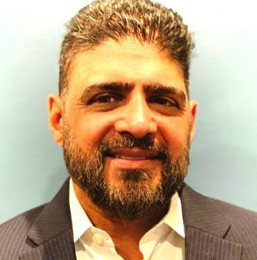


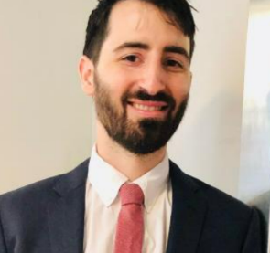




The CPB NGWS Team
Maciej Ochman
Senior Director, Media Technology and Service Strategies
Faisal Khan
Kyle Cromer
Executive Director
Director, Budget and Compliance
Kevin Maloof
Meirah Shedlo Eidelman
Kamanzi Kalisa
Alexandra Dade
Katelyn Mecca
Project Manager
Project Manager
Project Manager
Project Manager
Project Coordinator
www.cpb.org
Next Generation Warning System Grant Program

Slide 3
Mandate
Implementing ATSC 3.0 (TV) and digital broadcast (radio) technology to deliver alerts
of the Notice of Funding Opportunity (NOFO)
CPB will award subgrants to eligible, high priority stations to fund equipment purchases, installation, and training that advance the mission of the NGWSGP.
Training for technology and resilience
Supporting the acquisition of
resilience-related equipment
www.cpb.org
Next Generation Warning System Grant Program

Slide 4
Training objectives
Provide working knowledge of ATSC 3.0 (commercially known as NextGen TV) and HD Radio
Explore the cost/benefits and value of upgrading to ATSC 3.0 and HD radio technology for consumers and emergency alerting
Technology transition and implementation
www.cpb.org
Next Generation Warning System Grant Program

Slide 5

Today’s training agenda
  Module 1: Introduction to FEMA’s Integrated Public Alert and Warning System (IPAWS)
  Module 2: Introduction to the Next Generation Warning System Grant Program (NGWSGP)
  Module 3: Introduction to NEXTGEN TV
  Module 4: NEXTGEN TV Features and Opportunities
  Module 5: Upgrading from ATSC 1.0 to
  ATSC 3.0
  Module 6: Support for Emergency Alerts in
  ATSC 3.0
  Module 7: Fiscal Responsibility
  Q&A and Next Steps
www.cpb.org
Next Generation Warning System Grant Program

Slide 6
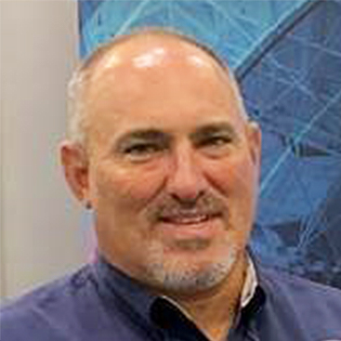

The FEMA IPAWS Team
Wade Witmer
Deputy Director, FEMA IPAWS
John B. Casey
FEMA IPAWS Contractor Broadcast Engineer

Slide 7
Introduction to FEMA’s Integrated Public Alert and Warning System (IPAWS)
Module 1: Introduction to IPAWS
Agenda:
What is IPAWS
IPAWS Architecture
Emergency Alert System (EAS)
Alerting Authorities
Continuity of Broadcast Operations
Relationship between Alerting Authorities and Broadcasters
Consider:
What are your policies and procedures for redistributing emergency alerts sent by local public safety officials in your community?
Notes:
We really appreciate you as a key part of IPAWS. I am going to talk a little bit about what IPAWS is, what it looks like, and how it works. Then, I will talk about the Emergency Alert System. Broadcast TV is a key resource that supports and makes up the EAS across our nation. I will talk about our key customers, the alerting authorities who use IPAWS and the Emergency Alert System. I will share some thoughts about making broadcast resilient through continuity of broadcast operations and why that is important to us and you. And then, I will discuss the relationship between alerting authorities and broadcasters that makes EAS work.

Slide 8
What is IPAWS?
Module 1: Introduction to IPAWS
IPAWS is a program and system built to ensure that the President, Federal, State, Tribal, Territorial, and Local authorities can alert and warn the civilian population in areas endangered by natural and man-made threats to public safety
IPAWS enables public safety officials to send emergency alerts, warnings and information to the public through:
  Radio and Television as Emergency Alert System (EAS) broadcasts
  Cellular phones as Wireless Emergency Alerts (WEA)
  NOAA Weather Radio (NWR)
  Other private sector systems
Mission: Provide integrated services and capabilities to Federal, State, Local, Tribal, and Territorial authorities that enable them to effectively alert and warn their respective communities via multiple communications methods.
Vision: To provide trusted timely alert and warning to people affected by threats to public safety in the preservation of life and property.
Notes:
IPAWS is end-to-end and we consider ourselves to be in the middle. On one side are the people who are the authorities. Those are public safety officials across the country who need to get critical, timely emergency information to the people in our communities. And on the other side are people that receive emergency alerts, the people in your community that those public safety officials are trying to assist and protect. IPAWS, end-to-end, is a program that not only has these systems, but is there to meet a FEMA mission requirement to ensure that people receive timely warnings. Those warnings can come from Federal, State, Local, Tribal, and Territorial authorities, all of which we count as users of the IPAWS that are eligible to activate and send alerts through IPAWS to get information out through your station via the Emergency Alert System activation. We are key in providing training to ensure that those alerting authorities understand how to use the system and provide technical assistance with getting messages out the door that are effective to warn the public in their communities.

Slide 9
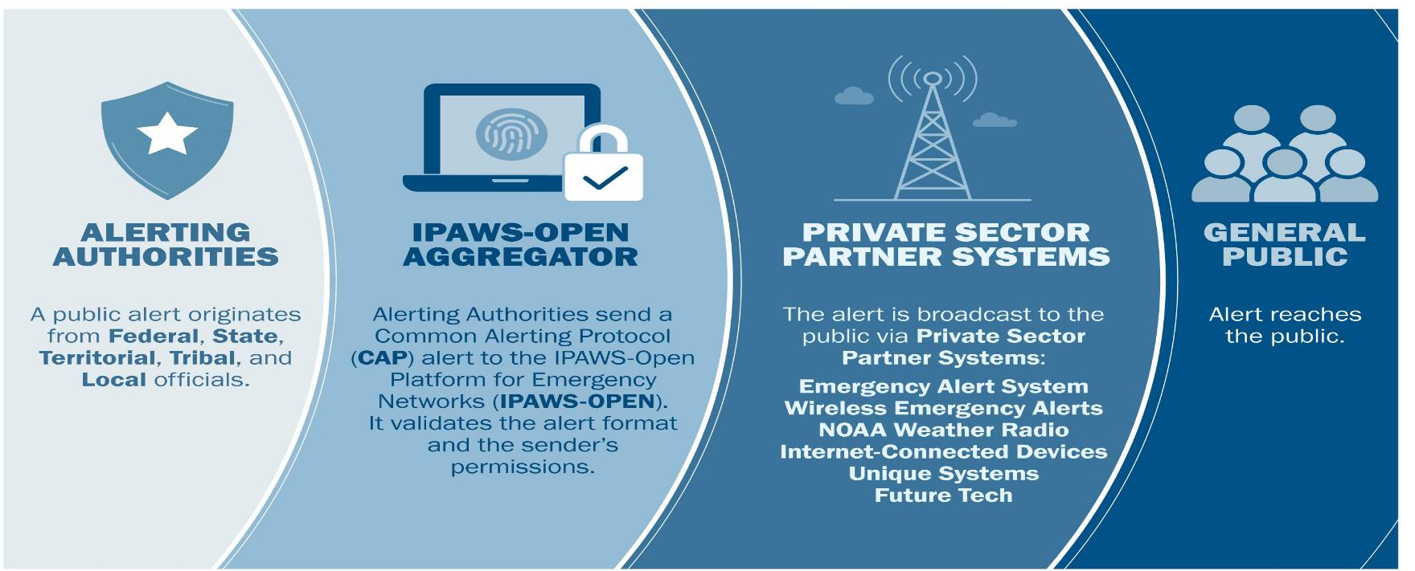
IPAWS Architecture
Module 1: Introduction to IPAWS
Notes:
This is a broad scope picture of IPAWS. You will see in the middle, we have the IPAWS-OPEN Aggregator and Private Sector Systems, that being you, that are able to deliver messages and emergency information to our end goal: people. On the far left, we have alerting authorities, which we will talk about in the next few slides. Again, a key aspect of our IPAWS program is that we take on end-to-end responsibility from ensuring and providing a system that makes those alerting authorities on the far end of that diagram ready and able to send effective warnings that come through the various pieces that IPAWS is connected to, to getting alerts and warnings to people in a timely fashion and that can effectively help the public take protective actions to save themselves and the people in the communities around them.

Slide 10



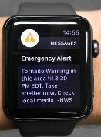




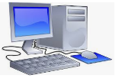
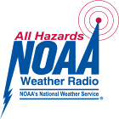

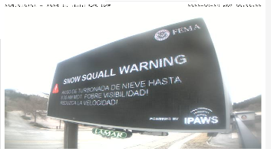
IPAWS Architecture
Module 1: Introduction to IPAWS
Alerting Authorities IPAWS Gateways Private Sector Systems People
Emergency Alert System
FCC 47 C.F.R. Part 11
Radio and TV stations, cable & wireline providers
Emergency
Wireless Emergency Alerts
FCC 47 C.F.R. Part 10
Wireless Providers participate in accordance with regulations
Local authorities
IPAWS OPEN
NOAA Weather Radio Network
1,800 public safety agencies use IPAWS compatible alert origination tools to send alerts
NOAA Weather Radio transmitters
Internet Applications
apps, websites, messaging services, voluntarily participating in distributing alerts
Notes:
The Emergency Alert System is probably the largest system, which includes all radio and television providers who participate in the Emergency Alert System. There is a set of rules that is published by the Federal Communications Commission, published in 47 CFR Part 11, that guides the stations’ participation. This includes what their requirements are to be an effective part of the Emergency Alert System. The other systems that are also able to be sent alerts from alerting authorities are cell phones via the Wireless Emergency Alert system, which includes participation from mobile providers or cellular companies. They participate on a voluntary basis but most of them do. If they choose to participate, the FCC sets rules to participate. We are also connected to the NOAA Weather Radio system which allows an alerting authority to send an alert through IPAWS that will go to the NOAA systems and then be broadcast out over NOAA Weather Radio transmitters for people who have NOAA Weather Radios. We also have a growing number of internet applications that are also able to be targeted and distribute alerts to people in a community that is geographically specified by the person who wrote that message.

Slide 11
Emergency Alert System (EAS)
Module 1: Introduction to IPAWS
FCC rules require all radio, television, cable, wireline, and satellite providers to participate in the EAS. Participants must maintain EAS equipment able to receive and re-transmit a national alert. Participants are encouraged to support broadcast of emergency information sent from state and local authorities.
EAS participants must monitor the FEMA IPAWS EAS Feed and other audio sources in accordance with State EAS Plans
  State Emergency Communications Committees (SECCs) develop the State EAS Plans that describe state and local EAS operations and contain guidelines that define local alerting authorities and EAS participants roles and responsibilities for use and activation of the EAS
All EAS participants must:
  Immediately broadcast a national emergency message
  Receive and broadcast state initiated monthly EAS tests
  Initiate EAS Required Weekly Test
Notes:
Every TV and radio provider, however it gets into a TV or radio, is a participant in the Emergency Alert System today. Those rules generally detail that you have a piece of equipment in your infrastructure that is listening for and receiving alerts that are appropriate for your audience. Then, that equipment can insert that into your program material and get the alert out to people in a timely fashion. The sources for those alerts include the IPAWS system, which is a connection via the Internet that comes into the EAS device as well as monitoring requirements to listen to other stations that are within earshot of your device. This monitoring is another way for those alerts to come in should the Internet not work or if that is the way the alerts were distributed. That monitoring is defined typically in a state issued book or plan called an EAS State Plan. Some states do local EAS Plans and territories have plans as well. That document is coordinated and published by a State Emergency Communications Committee, which is typically chaired by someone from the State Broadcast Association. With monitoring assignments, there may be a State Relay Network that may be via a wired connection, ethernet or cable, as well as over the air.
For EAS, the minimum set of requirements are that participants must be ready to broadcast a National Emergency Message that is issued through FEMA at the request of a national authority. The only national messages in the entire history of the Emergency Alert System have been test messages and we just did one on October 4. We distributed that national message through the IPAWS, not over the air relay and it was a very successful test. Details are still being collected, and results will come out soon. In addition to being ready to distribute a national emergency message, there are required weekly test messages. Those weekly tests can validate and allow downstream participants to hear your station broadcast and validate that you are hearing the identified monitoring sources according to your EAS State Plan. You are also required to be able to receive and rebroadcast a Monthly Test, which is typically initiated by the state.

Slide 12
Emergency Alert System (EAS)
Module 1: Introduction to IPAWS
EAS participants must monitor IPAWS and other sources in accordance with State EAS Plans for emergency alert messages applicable to their audience.
State Emergency Communications Committees (SECCs) develop the State EAS Plans that describe state and local EAS operations and contain guidelines that define local alerting authorities and EAS participants roles and responsibilities for use and activation of the EAS
State plans identify monitoring assignments for each EAS participant in a state
State plans identify how a national emergency message will be disseminated to all stations if the IPAWS is not available to disseminate emergency alerts
FEMA maintains the National Public Warning System (NPWS) – a network of selected radio stations that also perform as Primary Entry Point (PEP) Stations for dissemination of a national emergency message.
PEP station transmitter facilities are enhanced to be highly resilient in all hazard scenarios and expected to be on the air ready to broadcast a national emergency message at all times
In the event of disruption to the IPAWS, the NPWS serves as an independent and resilient source to initiate broadcast of a national warning or emergency message
77 PEP stations provide direct coverage for 90% of the US population
12
Notes:
We really appreciate when stations, and mostly all do, support EAS activation from the state authorities or local authorities in your area that are trying to communicate emergency information to communities. The state plans detail how your station is supposed to listen or receive those alerts. There are also details in the plan about the authorities that may use the Emergency Alert System in your area, as well as the types of messages that they will be sending. We really encourage that you are familiar with those authorities that are in your area that would use your station to get emergency information out to your community. We would like that relationship to be maybe a personal relationship or at least a meeting occasionally, so that alerting authorities understand where you are, who you are, how you are getting those messages, and which messages you will relay for them. If the internet is not functioning, FEMA has relationships with 77 radio stations across the country which IPAWS would use to be able to distribute a national message. This happens via the Emergency Alert System so that initial message may come out of those PEP stations. The State Plan details how you would receive a message that came out of a FEMA Primary Entry Point station and rebroadcast it.

Slide 13
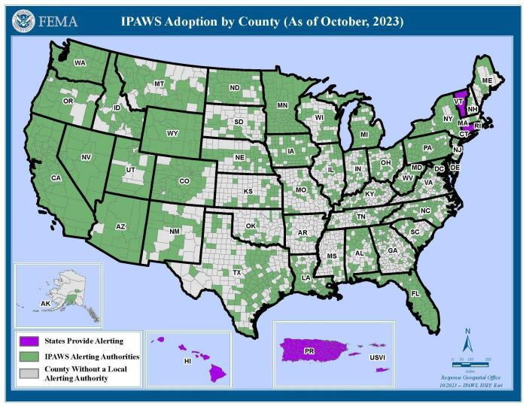
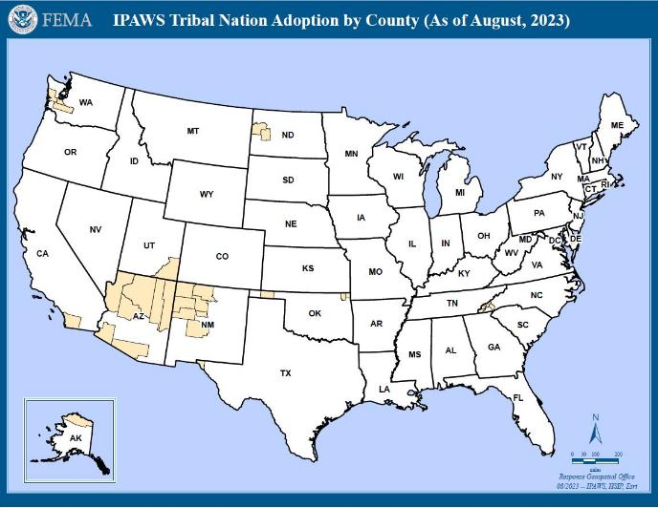
IPAWS Alerting Authorities
Module 1: Introduction to IPAWS
1,836 Total IPAWS Alerting Authorities sending an average of 21,965 per month
1,712 Local
86 State-wide
21 Military
4 Territory
11 Tribal
3 Federal
*All 50 States, Washington DC, Puerto Rico, and the U.S. Virgin Islands have a State level (or equivalent) authorized Alerting Authority.
Notes:
Our key customers include more than 1,800 agencies across the United States today that use IPAWS to distribute alerts to their communities. About 1,700 of them are local authorities. Every state has at least one authority that use the system. There are 11 Tribal Nations today that distribute alerts through IPAWS, as well as three Federal agencies. The number one user sending alerts across the country is the National Weather Service. They send warnings to be broadcast over television, radio, and cell phones. The four territories that we count are Puerto Rico, the Virgin Islands, the District of Columbia, and American Samoa, who is newly online as an alerting authority.

Slide 14
Continuity of Broadcast Operations
Module 1: Introduction to IPAWS
Though each situation is unique, any station can be better prepared if it plans carefully, puts emergency procedures in place, and practices for all kinds of emergencies.
Broadcast stations can provide a resilient and reliable source for emergency information to their community before, during, and after emergencies.
Stations should plan to continue broadcast operations through out the wide spectrum of disaster threat scenarios.
Develop a Continuity of Broadcast Operations (COBO) Plan to be prepared for major disasters
Risk Assessments provide valuable information needed to craft plans to harden physical plants and operations for broadcast continuity
Consider:
What emergency policies and procedures does your station have in place?
Notes:
Our responsibility is to ensure that people can receive alerts. To do that, we want those broadcast stations on the air and operating through the full spectrum of disasters, meaning before, during, and after as much as possible. To do that, we encourage and have some sources to assist your operations and your equipment to determine what the best way is to maintain that continuity of broadcast operations so that you can receive and rebroadcast emergency information to the public in your community. We really encourage contacting us, and we can provide some resources that can help you look through your current operations and systems and look at making them more resilient. A part of this grant program is assisting with the resiliency. We want your station to be able to receive alerts in a better, more integrated fashion from the IPAWS system. We want your station to be on the air and providing that critical public safety information through all phases of a disaster, particularly after disasters when other types of communications infrastructure are sometimes challenged.

Slide 15
Public Broadcasters Collaboration with Alerting Authorities
Module 1: Introduction to IPAWS
The relationship between Public Broadcasters and Alerting Authorities is essential to effectively communicating alert, warning, and emergency information to the people in your community.
Radio and television stations provide a resilient capability for local alerting authorities to disseminate emergency alerts, warnings and information to the public before, during and after disasters.
EAS equipment properly configured to retrieve emergency messages from the IPAWS is critical for supporting local alerting authorities.
Tips
Know Your Alerting Authorities and emergency managers
Be familiar with the State EAS Plans
Review you EAS device settings to ensure readiness to retrieve and broadcast emergency messages from local alerting authorities
Encourage local emergency managers in your area to use IPAWS for emergency alerting
Consider:
Do you know your State and Local Alerting Authorities?
Notes:
We strongly encourage that you reach out to your alerting authorities. We can give you a list or some hints on who the local authorities in your area are that are sending alerts through the IPAWS system. We really encourage you to be familiar with your State Plan and make an introduction to those alerting authorities to say, “I am an asset, I am a resource for you in an emergency to be able to inform the community, keep them safe, and point them in the right direction during an emergency.”

Slide 16
Introduction to IPAWS Key Takeaways
Module 1: Introduction to IPAWS
IPAWS is the program responsible for ensuring government authorities can effectively warn the public
IPAWS enables Federal, State, Local, Tribal, and Territorial officials to send geo-targeted emergency messages and lifesaving information to the public through IPAWS connections
  EAS = radio and television broadcasts
  WEA = alerts and warnings sent to cell phones
Local alerts and warnings cannot reach the public without active participation from radio and television broadcasters
The relationship between Public Broadcasters and Local Alerting Authorities is essential to effective emergency alerting
Discussion Questions:
Do you know your State and Local Emergency Managers?
What are your public broadcast entities’ policies and procedures for redistributing emergency alerts?
ASK: Share your EAS success stories with the Corporation for Public Broadcasting!
Notes:
Some of the key takeaways from this modules are: IPAWS is responsible for ensuring that government authorities can get warnings to the public. We feel that public broadcasters can really assist with more rural areas where there are less communications systems available to the people to provide emergency information. Our two regulated systems are EAS, which is you and all other broadcasters and cable companies, and WEA which go to cell phones. In addition, we are connected into NOAA Weather Radio, which can loop back into your EAS system as well. Without your participation, we cannot get our mission done. We are very excited about this grant, and we are really leaning and looking into making EAS even better at providing emergency information to the communities in your area.

Slide 17

Next Generation Warning System Grant Program Training
Module 2: Introduction to NGWSGP
Faisal Khan, Executive Director, NGWS
www.cpb.org
Next Generation Warning System Grant Program

Slide 18
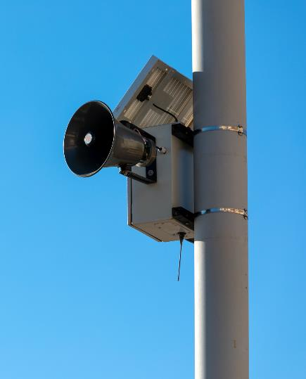

Objectives
Module 2: Introduction to NGWSGP
of the grant program
The program advances FEMA’s goal to promote “an effective system for warning and informing the American public of impending natural and man-made disasters is an essential part of America's emergency preparedness.”
www.cpb.org
Next Generation Warning System Grant Program

Slide 19




Objectives
Module 2: Introduction to NGWSGP
of the grant program
Enhance stations’ capacity
Upgrade to digital radio and ATSC 3.0
CPB will award subgrants to eligible, high priority stations to fund equipment purchases, installation, and training that advance the mission of the NGWSGP.
Improve technology infrastructure
Expand emergency alerting
www.cpb.org
Next Generation Warning System Grant Program

Slide 20
Prioritization Criteria
Module 2: Introduction to NGWSGP
Priority 1
Tribal, minority, and/or rural stations serving underserved communities
Priority 2
Small stations
Priority 3
Other television and radio stations - All public broadcasting entities as defined in 47 U.S.C. §397(11) are eligible to apply. Eligibility is not contingent upon whether a public broadcasting entity qualifies for CPB’s Community Service Grant (CSG) program.
www.cpb.org
Next Generation Warning System Grant Program

Slide 21
Prioritization Criteria
Module 2: Introduction to NGWSGP
Station characteristics
Project proposal
  Uniqueness of coverage
  Geographic special risk factors
  Public safety/alerting impact
  Nature of the equipment request
  Project management capability
  Partnerships with local/regional/state emergency management officials
www.cpb.org
Next Generation Warning System Grant Program

Slide 22
Project Funding Overview
Module 2: Introduction to NGWSGP
Funding
The FY22 funding round has closed, but there will be an additional round for FY23.
Contracting
Environmental and Historic Preservation Review (EHP)
CPB is administering; recipients are FEMA subrecipients and subject to
federal grant requirements
Applicants must submit a FEMA Environmental and Historic Preservation Review questionnaire
No funding match or cost share is required.
Funds will be granted as reimbursements.
www.cpb.org
Next Generation Warning System Grant Program

Slide 23
Introduction to NEXTGEN TV
Module 3: Introduction to NEXTGEN TV
Agenda:
What is NEXTGEN TV?
ATSC 3.0 / NEXTGEN TV as a global standard
Upgrading to NEXTGEN TV
Key features and capabilities of NEXTGEN TV
Enhanced audio / video quality and interactivity
Benefits of NEXTGEN TV for broadcasters and the public
Consider:
What are your stations’ goals?
How does NEXTGEN TV fit into your goals?
Notes:
My name is John Casey, and I’m a senior consultant with FEMA IPAWS and the CTO at Airwavz.tv. My background is in consumer devices and broadcast Television. I’ve been working with the IPAWS team to help develop and present this ATSC 3 leadership training.
For more that 30 years, I’ve been designing, developing and commercializing broadcast TV receivers, video encoders, and other electronics systems. Since 2015, I’ve been working closely with broadcasters who are deploying NEXTGEN TV. My goal here today is to share my knowledge about the strategy and planning required when upgrading to ATSC 3.
In this module we are going to cover:
The impact of NEXTGEN TV
The benefits and features of NEXTGEN TV, including advanced emergency alerting
And, in the later modules, we’ll share some strategic decisions to consider when planning your upgrade.

Slide 24
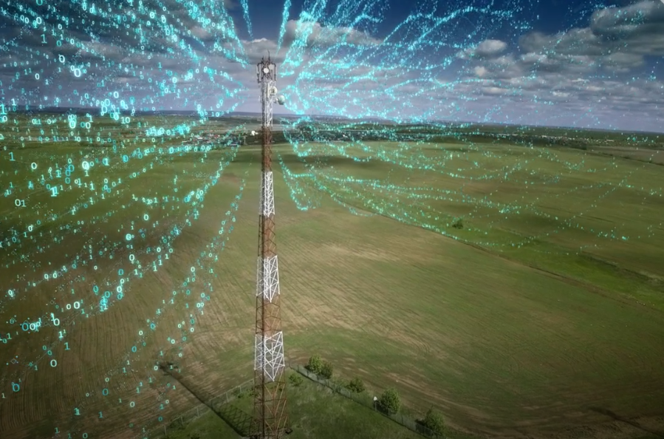
What is NEXTGEN TV?
Module 3: Introduction to NEXTGEN TV
A brand-new broadcast television standard for UHF and VHF
Actively being deployed in the USA and a growing list of other countries
Extended broadcast TV station coverage
Better quality video and audio
Data Broadcasting as a Service
Based on Internet Protocol (IP) just like the Internet
Interactive Broadcaster Application is a key feature
24
Notes:
NEXTGEN TV is the commercial name for a brand-new broadcast standard. The specification behind NEXTGEN TV was developed by the Advanced Television Systems Committee and its members and is called “ATSC 3.” During this webinar, we use the terms “ATSC 3” and “NEXTGEN TV” interchangeably, and we will introduce the host of new features and opportunities it offers.
Image from Creative Commons

Slide 25
NEXTGEN TV / ATSC 3.0 Becoming a Global Standard
Module 3: Introduction to NEXTGEN TV
373
Broadcast TV experts actively participate in ATSC 3.0 standards:
Daily
Weekly
Monthly
In-Person
Internationally
8.1%
Compound Annual Growth Rate (CAGR) of TV Antenna sales from 2023 – 2030
Source: Bezinga
150
Business organizations participating in ATSC 3.0:
TV Broadcasters
Consumer Electronics Manufacturers
Professional Equipment Manufacturers
R&D Laboratories
Universities
CTA
IEEE
SMPTE
Countries*
Canada
China
Europe (including DVB)
Jamaica
Japan (including NHK)
Mexico
South Korea
Trinidad & Tobago
United States
More coming…
Notes:
You might be delighted to know that hundreds of broadcast experts came together to create the ATSC 3 standards, and many continue to improve and expand these standards every day. Many thousands of professionals are working daily to deploy NEXTGEN TV. More than nine countries are involved in ATSC 3, with more waiting in the wings.

Slide 26
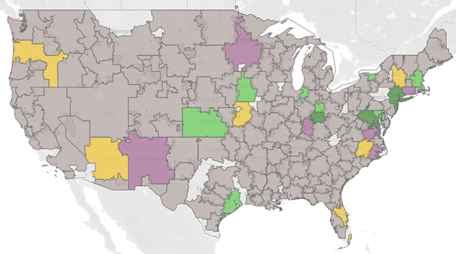



Current PBS Deployments
Module 3: Introduction to NEXTGEN TV
Source: Pearl TV
New York City & Chicago launched mid-October 2023
50+ stations plan to launch Hybrid Broadcast. majority are Public Broadcasters (46)
US cable operators plan to carry NEXTGEN TV features in 2024
120+ stations launching interactive broadcast applications
Notes:
Pearl TV is a consortium of U.S. broadcast companies with a shared interest in exploring forward-looking broadcasting opportunities. Pearl supplied this data, which shows PBS stations that are broadcasting NEXTGEN TV today. Many markets are creating partnerships among broadcasters to launch ATSC 3. Later in the discussion, we will talk more about the models used to launch ATSC 3.
The map key indicates how they launched:
The blank white areas in the map are areas without a PBS station.
“Self-Launch” indicates PBS stations that upgraded without a partner – in general, this was possible because they had 2 stations in a market
“1.0 Host” indicates the PBS station is a participant in an ATSC 3 launch, but their role is as an ATSC 1 host.
“3.0 Guest” is a station invited to participate on a ATSC 3 broadcast without having to host any additional content themselves.
“3.0 Host” indicates the PBS station is the ATSC 3 host in the market.
For instance, New York City’s WLIW21 Public TV station, part of The WNET Group, was the First Full Power ATSC 3 Station to launch in a Top Market, and they partnered with CBS, NBC and Telemundo. They launched in October of 2023, and viewers can now receive 6 primary TV services plus additional subchannels over the air on NEXTGEN TV compatible devices in NYC

Slide 27
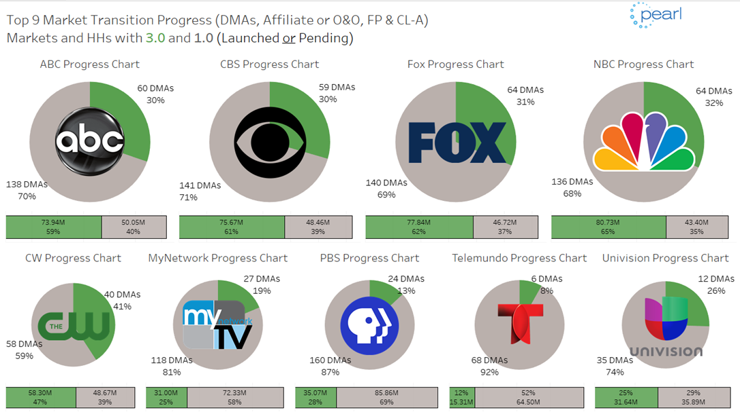
Source:
Notes:
This data, also from Pearl, shows the current state of the NEXTGEN TV transition. There are 210 Designated Market Areas, or DMAs, listed by Nielsen, with the top 3 markets being New York, Los Angeles and Chicago. The top row shows the Networks with the most progress in deploying NEXTGEN TV, as indicated by the green progress bars. The bottom row shows additional networks who are actively working to deploy NEXTGEN TV. On the center of the bottom row, we see that PBS has deployed NEXTGEN TV in 24 of the total 184 DMAs with PBS stations.

Slide 28
NEXTGEN TV Impacts
Module 3: Introduction to NEXTGEN TV
ATSC 3.0 is not backwards compatible with ATSC 1.0. This means viewers will need a new TV, or device to access the new features.
The FCC has not mandated broadcasters upgrade to ATSC 3.0, and there is no subsidy for consumer NEXTGEN Televisions.
NEXTGEN TV compatible TVs and low-cost converter boxes have been shipping since 2020 and more are coming to market every month.
Notes:
ATSC 3 is not backwards compatible with ATSC 1. The good news is NEXTGEN TV is a modern Internet Protocol or IP based system that can be expanded and enhanced to meet our future needs. Even though its not backwards compatible, the FCC simulcast requirements assure that viewers will continue to receive primary channels on ATSC 1. As NEXTGEN TV is deployed, viewers who want the new enhanced experience will need to buy converter boxes or new Televisions.

Slide 29
Forecast TV Shipments with NEXTGEN TV
Module 3: Introduction to NEXTGEN TV
U.S. Market – Millions of Units
January 2023 Update
Introduction
Inflection Point
Maturation
% Unit Growth (YoY) | 1438 | 8 | 54 | 140 | 67 | 35 | 4
% of Total TV | 6 | 8 | 12 | 30 | 50 | 67 | 71
Source: CTA, U.S. Consumer Technology Five-Year Industry Forecast, Jan 2023
Notes:
In fact, projections from The Consumer Technology Association show that by 2027 there will be over 98 million NEXTGEN TV capable sets deployed
and 71% of all TV’s sold will include ATSC 3. A survey by ATSC indicates that NEXTGEN TV viewers in Boston watching WGBH have overwhelmingly positive feedback on NEXTGEN TV.

Slide 30







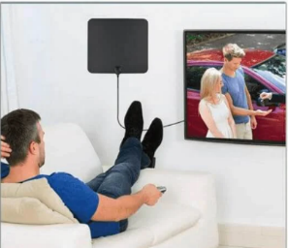

Why Upgrade to NEXTGEN TV?
Superior Audio & Video Quality
New Business Opportunities
Ultra HD
Immersive Audio
Interactivity
Geo-Targeting
Datacasting
Extended and Enhanced Reach
Mobile
Transportation
Indoor
Advanced Alerts
Notes:
NEXTGEN TV brings an important suite of new features and capabilities to broadcast television including superior audio and video and new business opportunities. It also extends the reach of TV to mobile and automotive and improves indoor reception. Next, we will look at some of these features and capabilities, along with the improvements in alerting. Images from Creative Commons

Slide 31



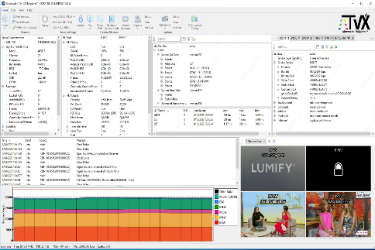

Superior Audio & Video Quality
Superior Video Quality
4K Ultra High-Definition High Dynamic Range Wide Color Gamut
More efficient = Lower bitrates
Immersive Audio
More channels (7.1.4)
Dialog Enhancement
More efficient = Lower bitrates
Higher Throughput, and More Capacity
35% more bitrate capacity will carry many more TV channels, more pixels and more colors
Notes:
On the video front, NEXTGEN TV provides state of the art features including 4K Ultra High Definition or UHD. The High Dynamic Range and Wide Color Gamut features provide video with much better contrast, brightness, and a richer range of color for a more lifelike experience.
For example, did you know that the standard green color used on road signs can’t be accurately reproduced on an ATSC 1 TV?
We get the superior video quality of NEXTGEN TV at bitrates much lower than traditional ATSC 1 bitrates. On the audio front, NEXTGEN TV is based on Dolby's AC4 codec which is part of the Dolby ATMOS suite. It gives us higher quality audio at lower bitrates as well, but it also brings along other important improvements. One of the significant benefits is dialog enhancement, which allows the viewer to control the relative volume of dialog compared to the soundtrack. If you have ever had trouble following the dialog in a movie with lots of background noise, you will quickly fall in love with dialog enhancement.
The advanced RF level coding of ATSC 3 provides up to 35% higher bitrates in your existing 6MHz channel. When this is combined with the lower bitrate audio and video streams from the new CODECs, ATSC 3 brings the capacity for many more services or Diginets.
Images from Creative Commons

Slide 32

Business Opportunities
Additional Diginet’s (subchannels)
Interactive broadcast application
Targeting (Geographic & Demographic)
Datacasting
Measuring, Analyzing, Reporting TV Viewership
Notes:
NEXTGEN TV brings a myriad of new business opportunities. As previously mentioned, the additional capacity of ATSC 3 provides an opportunity to add more services to your broadcast.
In addition, by blending broadcast TV and Internet streaming, NEXTGEN TV can further expand the number of channels and services available in your broadcast.
You can also add interactive content that can provide more viewer engagement, more fundraising opportunities, and new types of sponsorships. The interactive content can target viewers by geographic location or by demographics.
What else can you do with the additional capacity enabled by NEXTGEN TV you ask? Those bits are valuable and there are a variety of datacasting business models that can be leveraged with this extra capacity.
In Module 4 will be talking about interesting use cases that are live today.
Image from Creative Commons

Slide 33
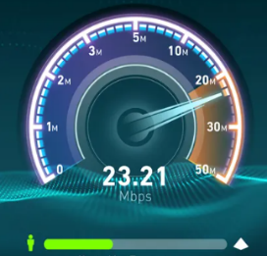

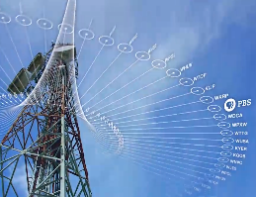
Extending the Reach of TV with ATSC 3
More Capacity & Higher Throughput
Hybrid & Virtual Channel support
Robustness
Better Indoor Reception
Mobile Reception
Advanced Emergency Information (AEI)
26 Mbps
Notes:
Let’s looks a little deeper at some of the other features available with NEXTGEN TV. At the RF level, NEXTGEN TV provides additional capacity in the same 6MHz channel.
Capacity: Not only can you add more channels by leveraging the improved channel capacity and CODEC efficiency of ATSC 3, but it is also possible to add channels to your lineup beyond what fits in your 6MHz channel
Hybrid Virtual: NEXTGEN TV provides Virtual or Hybrid channels that allow adding streamed channels to your lineup that are indistinguishable from your broadcast channels.
These channels appear to the viewer just like any other channel, but they are delivered over the internet expanding your overall programming capacity.
Robustness: ATSC 3 offers the capability to spilt the broadcast into multiple pipes.
Often, it makes sense to offer both a robust pipe for alerting and a less robust but higher bitrate pipe for video.
Indoor & Mobile: ATSC 3 pipes can be configured to penetrate indoors and target mobile or handheld devices.
In Motion: Some of us remember using NTSC analog TV in cars. Well, after a 20-year hiatus, NEXTGEN TV is bringing back live TV in moving vehicles.
All this adds up to more Over the Air TV viewers. Later in the presentation, we will talk about the critical Advanced Emergency Information capability of NEXTGEN TV.
Image from Creative Commons

Slide 34

ATSC 3 Make Content More Accessible
Module 3: Introduction to NEXTGEN TV
Emergency Alerts & Messaging
Emergency Crawls & Audio Tracks
Visually Impaired
Video Description
Hearing Impaired
Closed Caption
Closed Signing
Dialog Enhancement
Source: ATSC 3.0
Notes:
NEXTGEN TV alerts are no longer limited to simple audio messages and video crawls.
NEXTGEN TV adds the ability to add rich Advanced Emergency Information to the broadcast.
AC-4 Audio encourages the inclusion of descriptive audio tracks, which add a description of the action portrayed in the video. Like closed captions, this track can be switched on and off by the viewer so it’s audible only to those who want it.
Closed captions can now be made available in multiple languages simultaneously, including languages which require more than the basic Latin alphabet.
Signing for the hearing impaired, referred to as Closed Signing, can now be added to the broadcast. This is implemented as a viewer-controlled pop-up signing window that can be turned on and off just like closed captions and descriptive audio.
Dialog enhancement is a great NEXTGEN TV feature that allows the viewer to control the volume of the dialog relative to the soundtrack or background audio.
Image from Creative Commons

Slide 35
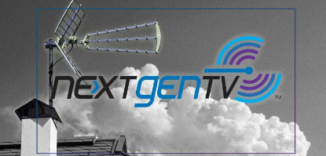

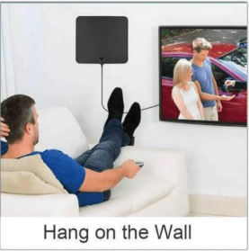


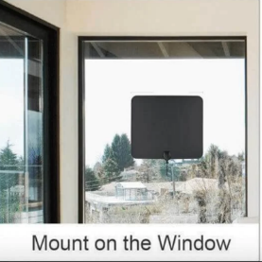

Consumers Are Buying Antennas
Module 3: Introduction to NEXTGEN TV
NEXTGEN TV is growing the antenna TV market by improving indoor reception and providing viewers with High Definition free Over The Air programming
New antennas are flat, thin, inexpensive and are easily setup indoors
Hyperlocal 60% of viewers want an antenna to get local news, weather and sports
Satisfied 62% of antenna users surveyed were happy with picture reliability and channel quantity
(Source: FreeTVProject.org)
Notes:
Over The Air TV provides the highest quality, most engaging viewing experience. Nothing from any cable operator or streaming service offers the same quality. The Over the Air TV experience of NEXTGEN TV will continue to fuel the surge in antenna TV driven by cord cutters. Most people recognize TV antennas as the traditional method of getting free Over The Air TV, but TV antennas have evolved, and many are suitable for indoor use – both in attractiveness and reliability. Though it can be useful to have an antenna on your roof, indoor antennas work well in many situations, and ATSC 3 improves reception by indoor antennas.

Slide 36
Introduction to NEXTGEN TV Key Takeaways
NEXTGEN TV enhances video and audio quality and interactivity
NEXTGEN TV will reach ~82% of U.S. households in 2024
Viewers need new TVs or converter boxes to get the NEXTGEN TV experience
NEXTGEN TV is future proof by tying together OTA broadcast, internet streaming, and interactivity
NEXTGEN TV makes content more accessible
Discussion Questions:
What are your stations’ goals?
How does ATSC 3.0 fit with these goals?
Notes:
NEXTGEN TV will soon reach 82% of U.S. households. Viewers who want this experience will need to buy a new television. ATSC 3 is designed from the ground up to be future proof. As a platform, it will continue to grow, eventually adopting 8k video and new compression technologies along with other technological advances.
What are your station goals?
How does ATSC 3 fit with these goals?

Slide 37
NEXTGEN TV Features and Opportunities
Module 4: NEXTGEN TV Features and Opportunities
Agenda:
ATSC 3.0 Business Models
Personalized content delivery
Interactive and data-driven services (Data As A Service DAAS)
Partnerships and collaborations
AM/FM Radio Distribution using ATSC 3.0
Case studies highlighting successful ATSC 3.0 technology
Consider:
What is the potential of ATSC 3.0?
Which opportunism pique your interest?
Notes:
In this module, we take a deeper look at some of the other features and opportunities made possible by NEXTGEN TV. We will touch on new business models, how it can make fundraising more effective, and how we can better engage viewers with personalized interactive content. We will also talk about collaborations and radio distribution, and then we will close with some case studies.

Slide 38





Potential of ATSC 3.0
Module 4: NEXTGEN TV Features and Opportunities
1
2
3
5
4
Personalization
Content
Local, State & National Emergencies
Localization
Applications
Notes:
The NEXTGEN TV Interactive Broadcast Application provides huge new capabilities and opportunities for broadcasters. We will look at some examples in this module and discuss how it lets viewers personalize their experience and discover additional content. We will also look at how content, including alerts, can be targeted based on location to the zip code level, providing life saving information to those who need it without disrupting the lives of others in unaffected areas. We also show how these same features can be used to target audiences by demographics, thus delivering customized premium content while watching live TV. These are just some of the ways NEXTGEN TV significantly expands the value proposition.
Images from Creative Commons

Slide 39


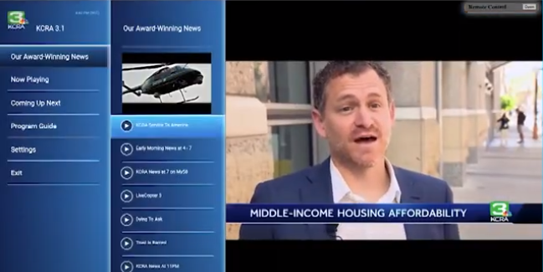
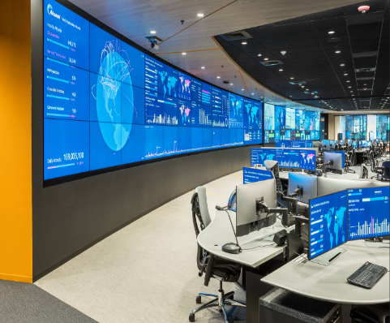
Interactive and Data Driven Services
Module 4: NEXTGEN TV Features and Opportunities
Broadcasters in Control
Interactive applications give broadcasters control of their content, service, and the direct viewing experience.
Data Driven Services
Broadcasters can use excess bandwidth to deliver data services like distance learning.
Interactive Apps
Broadcaster controlled Interactive web content overlays on video giving viewers unique personalized interactive content.
Analytics
Broadcasters can collect, and record their own viewer analytics.
Notes:
One of the key differentiators of NEXTGEN TV is the interactive broadcast application, which is also a key element of the advanced emergency alerting capabilities.
Its development environment lets you build and deliver a custom user experience for your viewers. Since the interactivity features of ATSC 3 are built on current web technologies (like HTML 5, and JavaScript), the broadcast application is easy to design, build, and deploy. There are both commercial and open-source frameworks to jumpstart this effort. Using the Interactive Broadcaster Application, you will be able to target viewers based on demographics and geolocation. When TVs are Internet connected, you will also be able to collect viewer analytics. Remember, your stations’ bits and bytes have significant value for datacasting applications, like distance learning, automotive firmware and map updates, and many others.
Images from Creative Commons

Slide 40



Personalization & Interactivity
Module 4: NEXTGEN TV Features and Opportunities
Burned in sponsor name
Pictures, Graphics and Sound are “burned in”
Same experience for entire audience
ATSC 1.0
Broadcast Applications are fundamental to the entire NextGen TV experience
Viewers can interact with TV
Like a web page, the branding, layout and menu list is completely customizable by the broadcaster
Collect analytics about viewer habits
Share
Feedback
Get Help
Director
Location
Genre
ATSC 3.0
Add to watchlist
Closed Captions
Audio Language
Notes:
The interactive broadcast application is an essential component of NEXTGEN TV. Interactivity implies the viewer can use their remote control to interact with the TV broadcast, just like they can with web sites and streaming services today. In this example, we see the difference between traditional TV on top and what viewers can expect when watching NextGen TV. All ATSC 1 TV viewers see the same picture with graphics “burned in” by the broadcaster. With NEXTGEN TV, viewers have a whole new experience. They can use the TV remote to interact with their TV and customize the content. Using menus added by the interactive broadcast application, viewers can turn on and off various features, enable and disable the graphic overlays, and browse additional related content. Applications can also support viewer language selection. The application can remain in the background and collect analytics, or it can serve up menu’s, QR codes, graphics, or any sort of web content.
Images from Creative Commons

Slide 41
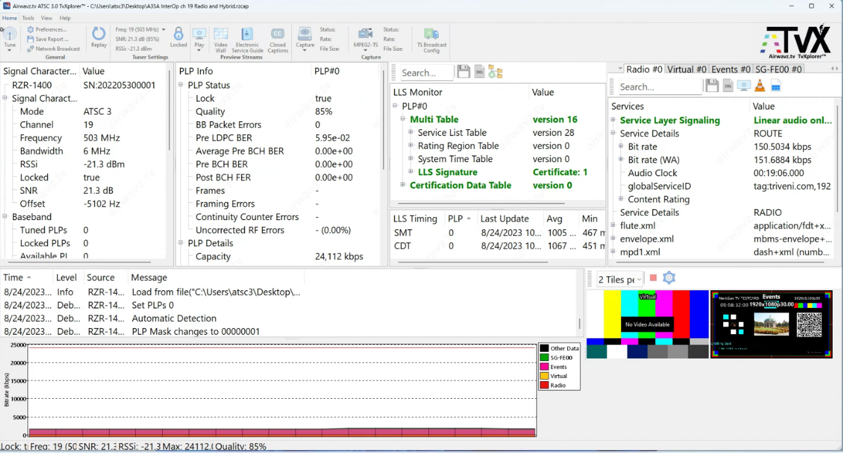

AM/FM Radio Distribution over NEXTGEN TV
Module 4: NEXTGEN TV Features and Opportunities
Radio as a TV “Service”
Listen to AM & FM radio over NEXTGEN TV
Radio bandwidth is minimal, and that’s good
Source: Airwavz.tv
Notes:
Another enormous benefit of ATSC 3 is the ability to add AM FM radio and other music services to a NEXTGEN TV broadcast. For those of you who are dual licensees, this is a very exciting opportunity. As NEXTGEN TV begins to appear in automobiles, having both radio and TV in the same receiver is a game-changer! Imagine having analytics from your viewers and listeners and directly measuring their engagement. OneMedia successfully demonstrated radio over NEXTGEN TV during NAB in April 2023.

Slide 42

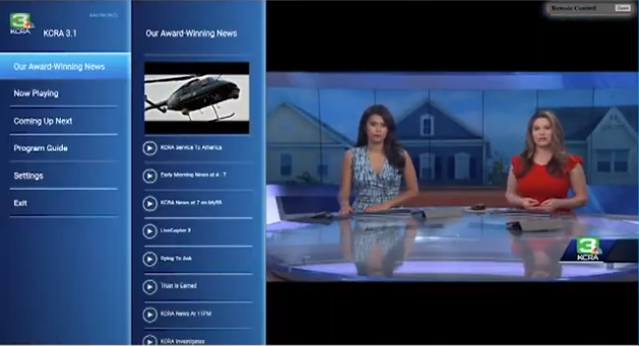
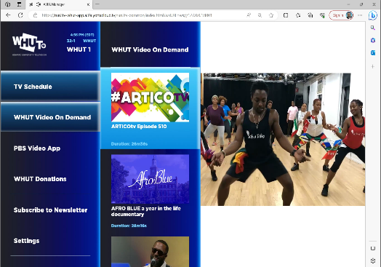
Highlighting Successful Uses of ATSC 3.0
Module 4: NEXTGEN TV Features and Opportunities
E.W. Scripps promotes “Caught in the Ropes” during live NEXTGEN TV viewing with an interactive ad. Viewers click on the overlay and can watch the episode immediately using streaming (OTT) delivery.
Hearst is using an interactive app on Sacramento KCRA to display advertising, animations and promotions that are integrated into the left sidebar.
WHUT in Washington, DC added videos of events with QR codes as part of there viewer engagement and fundraising efforts.
Notes:
Many organizations are exploring new business opportunities around NEXTGEN TV. Let's look at some real-world case studies.
Caught in the Ropes is a documentary about the hazards of abandoned ropes, cages, and hooks endangering ocean life. Scripps is promoting this content and making it directly available for streaming on viewers’ TVs utilizing their interactive broadcast application: https://vimeo.com/656706679?utm_campaign=5250933&utm_source=affiliate&utm_channel=affiliate&cjevent=03b1ecf4405c11ee81aa01cc0a1cb82a&clickid=03b1ecf4405c11ee81aa01cc0a1cb82a
Hearst is using the interactive broadcast application on KCRA for advertising and promotions.
WHUT at Howard University in Washington, D.C. is exploring ways to use the Interactive Broadcast Application to generate more viewer engagement.
There is a great deal of opportunities for future use cases as ATSC 3.0 continues to be deployed.

Slide 43
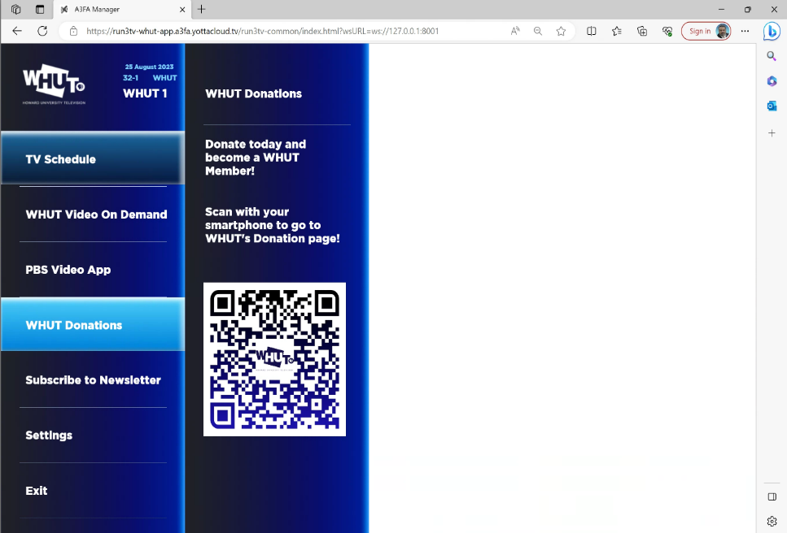

More Effective Viewer Engagement with NEXTGEN TV
Module 4: NEXTGEN TV Features and Opportunities
WHUT in Washington DC uses the Interactive Broadcast Application (BA) to generate more viewer engagement
Overlaying the Broadcast Application on top of television services gives viewers the ability to interact with TV – a great new experience!
Their BA adds streaming videos of events
They use QR codes to support fundraising and solicit signups to the WHUT newsletter
This white space can be used to show the current channel video or anything digital.
Interactive Broadcaster Application Overlay
Notes:
The WHUT interactive broadcast application contains a graphics overlay with a complete menu system and allows the viewer to browse the application with their remote. One interesting piece of this application is the ability to display a QR code. QR codes can be used in different ways. In this case study, WHUT used the QR code as a fundraising tool and a subscription link for their email newsletter. Most web developers can quickly and easily adapt and deploy this new feature.
Howard University has a state-of-the-art ATSC 3 lab and is educating students on NEXTGEN TV. Other Universities are following suit in both the U.S. and Canada.

Slide 44

NEXTGEN TV Keeps US Marine Marathon Runners Safe & Secure
Module 4: NEXTGEN TV Features and Opportunities
October 29, 2023, US Marine Marathon
NEXTGEN TV datacasting was used to transmit private DC Area camera feeds to law enforcement
The encrypted video was accessible only to law enforcement, and invisible to traditional TV sets
Proved that ATSC 3.0 datacasting can send big data, quickly and securely
Notes:
In October 2023, as part of the Emergency Preparedness for the U.S. Marine Corp marathon, NEXTGEN TV was used to stream Encrypted camera feeds available only to law enforcement monitoring agencies. The private camera video was transmitted along with the standard TV programming from WHUT using the Datacasting features of ATSC 3. The feeds were invisible to consumer televisions, but law enforcement seamlessly received, decrypted, and displayed the marathon camera content. An important feature of ATSC 3 is the ability to transmit large amounts of data over the air using TV signals to unlimited numbers of viewers, which is something cellular and Wi-Fi systems are unable to do.
Source: https://apts.org/news/press-releases/nextgen-broadcasting-successfully-used-keep-americans-safe-during-marine-corps-marathon

Slide 45
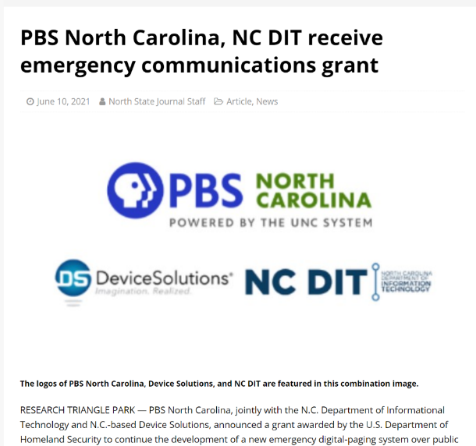
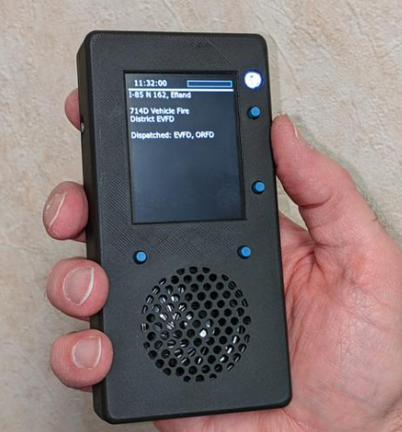
Partnerships and Collaborations
Module 4: NEXTGEN TV Features and Opportunities
Successful case study – PBS North Carolina / NC Department of Information Technology (DIT) in partnership with local public safety officials
ATSC 3.0 as a real-time public safety paging system
Direct to handheld devices
Funded by a DHS grant
Notes:
Another innovative datacasting use case is the paging system being tested by PBS North Carolina. This project was funded by a grant from the U.S. Department of Homeland Security. PBS North Carolina successfully demonstrated that extra ATSC 3 capacity can be used for digital paging. In this case, they replaced a slow, antiquated VHF based analog voice paging system for First Responders. This ATSC 3 paging system provides fast, secure, low latency messaging to the prototype handheld pagers. Messages can be encrypted and targeted to specific groups of first responders. The old system used audio messages that could take up to one minute to complete. The new system is text based and pages can arrive in less than one second. ATSC 3 paging systems can reduce costs while saving lives. This is one of the myriad of potential public safety uses of NEXTGEN TV.
Source: https://stanlyjournal.com/2021/06/10/pbs-north-carolina-nc-dit-receive-emergency-communications-grant/

Slide 46
NEXTGEN TV Features and Opportunities Key Takeaways
Module 4: NEXTGEN TV Features and Opportunities
“Interactive broadcast application” refers to broadcasters adding web content as an overlay on the video, even if users are not connected to the internet
Personalization and Interactivity can enable new business opportunities
A big advantage of NEXTGEN TV is the ability to target users geographically which support geotargeting alerts
Radio can be re-transmitted over NEXTGEN TV
Discussion Questions:
What are new ways you can leverage NEXTGEN TV?
Notes:
Key Takeaways from Module 4:
The interactive broadcast application is a powerful tool that broadcasters use to enhance the viewer experience and deliver vital information in times of crisis.
It can create many new business opportunities including geographic and demographic targeting.
NEXTGEN TV is not limited to traditional TV services and can carry Radio, music and data services as well.
Think about new ways you can leverage NEXTGEN TV?

Slide 47
Upgrading from ATSC 1.0 to ATSC 3.0
Module 5: Upgrading from ATSC 1.0 to ATSC 3.0
Agenda:
FCC Simulcasting Requirements
Practical Considerations Before the Upgrade
Strategy for Transitioning to ATSC 3.0
Equipment Requirements
Consider:
What does station leadership need to consider when transitioning to ATSC 3.0?
Notes:
In Module 5, we are going to focus on what leadership needs to know to plan a successful upgrade to ATSC 3. We will talk briefly about FCC requirements, the various models used for transitioning, and business strategies and challenges. We will also briefly talk about the equipment requirements.

Slide 48
Important FCC Rules for ATSC 3.0
Module 5: Upgrading from ATSC 1.0 to ATSC 3.0
Simulcast | Sunset ATSC 1.0 | 95% Coverage Rule | No Must Carry
Full Power & Class A stations must simulcast substantially similar content on both ATSC 1 and ATSC 3 until the sunset date. | ATSC 1.0 simulcast rule sunsets on July 17, 2027 (Source: FCC). This date is subject to FCC review. | FCC requires maintaining 95% coverage of the pre-existing ATSC 1.0 coverage. | There is NOT a mandate for ATSC 3.0 to be carried on cable (yet).
Notes:
The FCC has put in place rules for TV stations upgrading to ATSC 3. The most important thing you can take away from this slide is that FCC rules require broadcasters to continue to simulcast their main channel on ATSC 1 with 95% of the pre-upgrade coverage. The other important takeaway is that traditional must carry rules for broadcast content only apply to content broadcast on ATSC 1 and DO NOT currently apply to content broadcast only on ATSC 3.

Slide 49



Transition Models for Consideration
Module 5: Upgrading from ATSC 1.0 to ATSC 3.0
Flash-cutting is upgrading directly from ATSC 1 to ATSC 3
Requires FCC waiver of the simulcast rule
ATSC 3.0 devices required for consumers
Petition FCC for another RF channel if available
May be best for rural and underserved areas
Infrequent use-case
One ATSC 3 Host (Lighthouse)
One or more ATSC 1 Host(s)
All stations must be licensed in same market
Notes:
So, lets look at the models' stations are using to transition to ATSC 3 today.
Lighthouse: A lighthouse partnership is where one station is the ATSC 3.0 host and the other or others are the ATSC 1.0 hosts. The partnership enables NEXTGEN TV while assuring that the simulcast rules are met.
Flash-Cut: When there is no chance to create such a partnership, the only practical method may be a flash-cut directly from ATSC 1 to ATSC 3. In order to Flash-Cut from ATSC 1 directly to ATSC 3, you will need a waiver of the FCC simulcast rules that require that substantially similar content be simulcast on ATSC 1.0. The FCC states that they are open to such waivers should the broadcaster agree to make the necessary equipment to receive NEXTGEN TV available to its viewers.
Additional Channel: In rural and underserved communities where the TV spectrum is underutilized, there is a third alternative to consider. In these markets, broadcasters could apply for an additional broadcast license and build out an additional RF channel as ATSC 3, leaving the current ATSC 1 facility intact. In many cases, this could be done by adding another broadcast antenna to the existing broadcast tower.
----
See FCC GN Docket No. 16-142, Sec 17 pg. 9

Slide 50
What is “ Repack” and How Does it Impact ATSC 3.0
Incentive auction 2017
Repack 2018 - 2022
NextGen TV
Between 2017 and 2022 the FCC reclaimed some TV spectrum, reducing the number of TV channels 51 to 35 (2 – 36)
Stations on channels 37 through 52 where required to move channels (frequencies)
The FCC provided funding for equipment, to stations moving frequencies (being “repacked”)
“Repacked” stations now have updated ATSC 3 capable exciters and transmitters as well as improved antenna systems
Notes:
Some stations were forced to move channels as part of the recent FCC “repack”. These “repacked” stations updated key equipment and are fortunate that the most expensive parts of an ATSC 3 upgrade are already in place, making them good candidates to upgrade. Stations that have not updated their antenna and transmitters recently need to make some strategic decisions.

Slide 51
ATSC 3.0 Strategic Decisions
Indoor and mobile support is important in your market!
Antenna – Get better mobile and indoor reception by adding Vertical Polarization (VPOL)
Transmitter – Evaluate for ATSC 3.0 higher peak-to average ratio (PAR) requirement
– Adding VPOL will require additional transmitter power
Transmission Line – Evaluate transmission line and mask filter if transmitter power increases
Tower – Confirm the structural integrity of your tower before planning antenna upgrade
Notes:
Antenna: Indoor and mobile support is important in your market! You can generally upgrade to ATSC 3 while continuing to use your existing antenna, however if you agree that better indoor and mobile reception is an important goal of your upgrade to ATSC 3, you should consider modifying or replacing your antenna to add vertical polarization.
Transmitter: Adding a vertical polarization to your antenna will require roughly 30% more transmitter power, making it likely you will also need to upgrade or replace your transmitter. Even if you do not modify the antenna, your transmitter will need to be evaluated to assure it meets the requirements of ATSC 3. In many cases, the old transmitter can be used and only a new exciter is necessary. Most Exciters purchased in the last 5 years or so are software upgradable to ATSC 3.
Transmission Line: If the transmitter is upgraded or replaced to provide additional power, the transmission line and mask filter must be evaluated to determine if they can handle the increased power.
Tower: If antenna or transmission line work is to be done, the structural integrity of the tower should be evaluated. In most cases, your existing tower will handle the new antenna and transmission line without any issues.

Slide 52
Other Equipment Considerations for ATSC 3.0 Host
Module 5: Upgrading from ATSC 1.0 to ATSC 3.0
Dedicated Secure Link – fiber optic, microwave, or public internet link between partner stations (not needed when flash-cutting)
EAS Encoder / Decoder – upgrade to facilitate Advanced Emergency Information
Audio and Video Encoders – HEVC and Dolby AC -4
Program Guide – More functionality to support multi-languages, etc.
Scheduler/ Gateway – Assigns the streams to a specific Physical Layer Pipes (PLPs)
Studio to Transmitter Link – Upgrade STL to IP compatible
Interactive Broadcast Application – Framework & Application Development
Monitoring – remote and local monitoring of the live TV signal
TCP-IP networking gear
HVAC – Evaluate if transmitter power is increased
Single Frequency Networks (SFN) – To replace translators and repeaters
Notes:
For stations moving to ATSC 3, this slide lists the key equipment required or suggested as part of the transition beyond the exciter, transmitter and antenna that we have already discussed. A comprehensive list of approved equipment can be found on the CPB web site. The key elements here are new audio video encoders, program guide generator, and a Scheduler or Gateway which is new to ATSC 3 and is the device that drives the Studio to Transmitter Link or STL. In an ATSC 3 system, the STL must be upgraded to support an IP based connection.

Slide 53
Equipment Considerations for ATSC 1.0 Hosts in an ATSC 3.0 Partnership
Module 5: Upgrading from ATSC 1.0 to ATSC 3.0
Partner Links – Dedicated fiber, microwave links, or public internet link between partner stations Video Encoder – New more efficient Video Encoders (MPEG-2) to accommodate hosting ATSC 1.0 Statistical Multiplexing (Stat Mux) – Statistical Multiplexing capability to get the most efficient use of the ATSC 1.0 19.3 Mbps Program Service Information Processor (PSIP) – Update PSIP to accommodate metadata from other stations i.e. assigning virtual channels and merging EPGs
Notes:
As part of a Lighthouse Partnership, some stations will end up as a ATSC 1 host. These stations will continue to broadcast their own ATSC 1 content, as well as adding some partner's content to their ATSC 1 broadcast. This will let all the partners meet the FCC simulcast requirement. In the role of an ATSC 1 host, you may need to upgrade older equipment to squeeze as much content as possible into your existing ATSC 1 broadcast. This will likely include high speed links to your partners to exchange content and newer, more efficient encoders with stat muxing to reduce video bitrates. You may also need to upgrade your PSIP to aggregate the program guide data from several partners.
The partner who becomes the ATSC 3 host will add your content to their ATSC 3 broadcast to assure all content is available on both ATSC 1 and ATSC 3.

Slide 54
Upgrading from ATSC 1.0 to ATSC 3.0 Key Takeaways
Module 5: Upgrading from ATSC 1.0 to ATSC 3.0
Commit early to support indoor antennas, mobile devices, and automotive applications
Antenna and Transmitter upgrades are the costliest part of an ATSC 3.0 upgrade, unless they were replaced during “repack”
Lighthouse partnerships may be difficult for Public Media stations
Flash cutting is the method of upgrading from ATSC 1.0 to ATSC 3.0 without the need for partner stations in your market
Discussion Questions:
1. Have you developed a strategy for indoor and mobile reception?
2. Are you able to create a lighthouse partnership for ATSC 3.0?
Notes:
Indoor and mobile reception are key drivers for antenna and transmitter upgrades. Think about them early on, as they are the cost drivers.
Stations who participated in repack may have done these upgrades already and are ahead of the game.
Lighthouse partnerships may be the easiest path to an upgrade but may not always be possible.
Flash cutting is the primary alternative but requires a waiver of the FCC simulcasting requirements.
1. Have you developed a strategy for indoor and mobile reception?
2. Are you able to create a lighthouse partnership for ATSC 3?

Slide 55
Support for Emergency Alerts in ATSC 3.0
Module 6: Support for Emergency Alerts in ATSC 3.0
Agenda:
Emergency Alerting is the driver behind NGWS grant funding
Review of NEXTGEN TV Alerting
Advanced Emergency Information (AEI) as a supplement to EAS
Robustness and Reach matters especially for alerting!
Broadcast Equipment used in EAS
Consider:
How does ATSC 3.0 help to expand emergency alerting?
Notes:
In this module, we explore the requirements for ATSC 3 Emergency Alerting as well as how to leverage the new features of ATSC 3 to greatly improve messaging to viewers in times of crisis.

Slide 56
ATSC 3.0 Emergency Alerting
Module 6: Support for Emergency Alerts in ATSC 3.0
EAS requirements for ATSC 1 remain unchanged for ATSC 3.0
Optional Advanced Emergency Information (AEI) supplements EAS
Broadcasters are strongly encouraged to support NEXTGEN TV’s Advance Emergency Information (AEI) capability
Your branded interactive broadcast application will include support for Advanced Emergency Information
Advanced Emergency Information supports text, graphics and audio in multiple languages customizable by the viewer
Notes:
Currently, ATSC 3 does not carry any new requirements for EAS, however it provides the ability to supplement EAS with additional Advanced Emergency Information or AEI. AEI leverages your branded Interactive Broadcast Application to display the additional rich Advanced Emergency Information.

Slide 57
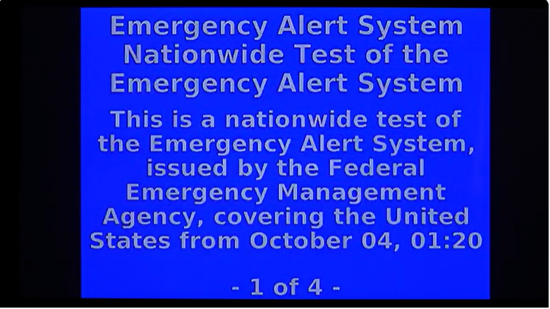
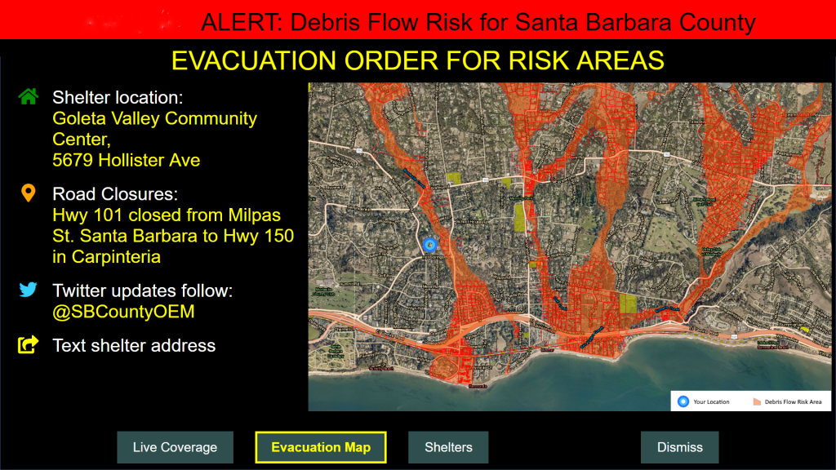
NEXTGEN TV Expands Emergency Alerting
Module 6: Support for Emergency Alerts in ATSC 3.0
EAS
AEI
Notes:
At the heart of the ATSC 3 NGWS grant is the desire to enable broadcasters to deliver Emergency Alerts and rich Emergency Information to the public.
On the left, we see a TV screen with the recent October 2023 EAS national test message. This EAS messaging has changed very little since it was introduced on NTSC analog TV. However,
ATSC 3 introduces “Advanced Emergency Information,” which substantially enhances your ability to bring additional, critical life saving information to viewers.
On the right, we see an example of ATSC 3 Advanced Emergency Information which supplements an EAS alert.
EAS image: https://www.youtube.com/watch?v=TtEZC99YCkE
AEI Image: https://awarn.org/about-awarn/

Slide 58
Advanced Emergency Information (AEI) Example
Module 6: Support for Emergency Alerts in ATSC 3.0
This is an example of Advanced Emergency Information received on NEXTGEN TV
Viewers can use their remote control to interact with the AEI and choose:
  Live Coverage
  Evacuation Map
  Shelters
  Text the shelter address to their mobile
  Follow @SBCountyOEM
Broadcasters are encouraged to display addition information using an AEI in conjunction with EAS crawl
EAS / CAP
Notes:
This screen capture is a good example of rich, interactive AEI. The interactive broadcaster application is displaying rich interactive Advanced Emergency Information. There is textual information along with an image showing local flood zones. The user can use the remote to navigate using the menus or buttons at the bottom of the screen. The menus provide access to Live News Coverage, Evacuation Maps, and Shelter information. This interactivity, along with the capability to geo-target viewers, delivers enormous benefits and will save lives.

Slide 59
NEXTGEN TV Robust Emergency Alerting
Module 6: Support for Emergency Alerts in ATSC 3.0
ATSC 3 can improve the coverage, particularly for EAS and alerting
ATSC 3 allows broadcasters to split signals into multiple “pipes”
Robust low-bitrate pipes improve coverage and indoor penetration
High-bitrate pipes deliver linear high-quality Audio and Video channels
Notes:
ATSC 3 offers the capability to split the broadcast into multiple pipes. Generally, it makes sense to offer a robust pipe for alerting and a less robust but higher bitrate pipe for things like UHD video. Doing so will assure that alerts and emergency information reaches as many people as possible by expanding coverage and indoor penetration.

Slide 60

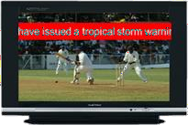


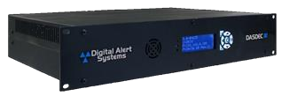
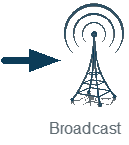

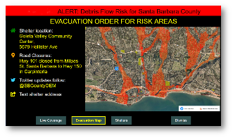
EAS and AEI Architecture
Module 6: Support for Emergency Alerts in ATSC 3.0
EAS Insertion
Programming
Content Sources
EAS
ATSC 3.0
Gateway
EAS Display
Local News
CAP
EAS
Emergency Message Authentication, Filtering, Processing and Routing
ATSC
3.0 AEI
AEI Insertion
AEI message received on NEXTGEN TV
EAS / CAP
Notes:
You might ask, how does my broadcast equipment change when I move to ATSC 3? Remember that you're existing ATSC 1 stations have EAS encoder / decoders that control the insertion of EAS audio and video into your audio and video feeds.
You will be happy to know that in the ATSC 3 world, this stays the same. However, modern EAS encoders can be software upgraded to provide an additional output that generates ATSC 3 Advance Emergency Information. The AEI supports rich media, including audio, video, images, and maps. This includes support for multiple languages with virtually any character set. While the basic EAS + AEI flow is shown in this diagram, your local news team will also have the option to supplement the AEI with pictures, maps, and links to additional detail.

Slide 61
Support for Emergency Alerts in ATSC 3.0 Key Takeaways
Module 6: Support for Emergency Alerts in ATSC 3.0
The grant funding is focused on Emergency Alerting and the addition of NEXTGEN TV Advanced Emergency Information
ATSC 3.0 provides better robustness and reach making alerts available to more people
Advanced Emergency Information (AEI) delivers video, maps and escape routes to geotargeted areas
The Broadcast App is essential for branding and deploying Advanced Emergency Information
Discussion Questions:
What excites you most about NEXTGEN TV?
Notes:
In this module, we saw:
How ATSC 3 NEXTGEN TV takes us from simple video crawls and audio messages to robust, geotargeted interactive alerts.
The reach of this emergency information is improved by better signal robustness, user driven multilingual support, interactivity, and geotargeting.
What excites you the most about the transition to ATSC 3 NEXTGEN TV?
For us, its about the lives we can save.

Slide 62
Fiscal Responsibility
Module 7: Fiscal Responsibility
Kyle Cromer, Budget & Compliance, NGWS
www.cpb.org
Next Generation Warning System Grant Program

Slide 63




Project Scope
and Eligible Equipment
Module 7: Fiscal Responsibility
Eligible equipment scope/allowable costs can include:
Advanced technology to enable IPAWS alerting capability
Applications should focus on transmission equipment that would improve a station’s air-chain infrastructure or resiliency to establish or enhance emergency alerting.
Common Alert Protocol (CAP) compliant
EAS boxes
Generators and other equipment enabling operation during disasters
www.cpb.org
Next Generation Warning System Grant Program

Slide 64






Project Scope and Eligible Equipment
Module 7: Fiscal Responsibility
Non-allowable costs will include, but are not limited to:
Project Scope
and Eligible Equipment
Vehicles
Funding of staff positions
General cosmetic and structural station upgrades and maintenance
Any cost incurred prior to award, and prior to CPB approval
Covered equipment
www.cpb.org
Next Generation Warning System Grant Program

Slide 65
Question and Answer

Slide 66



Contact Information
Contact us for more information!
ngws@cpb.org
Info + Helpful Links:
https://www.cpb.org/Next-Generation-Warning-System-Grant-Program
Complete brief survey about your experience today
Next Generation Warning System Grant Program

Slide 67
Appendix A
References

Slide 68
Reference Material
ATSC 3.0 and Public Broadcasting, a Case for Flash Cut
ATSC 3.0 File Delivery to Multiple Markets
Current Post Incentive Auction Television Transition Data Files
Host Station Manual, Phoenix Model Market v12
Next Gen TV Considerations for Public Media
Your Guide to NEXTGEN TV Powered by ATSC 3.0
Public Media Serving Public Safety 2020 White Paper
ATSC 3.0 Automotive Opportunity
ATSC 3.0 Deployment Map
A Report To The Corporation for Public Broadcasting Regarding ATSC 3.0 Digital Television Implementation for Public Television
FCC SECOND REPORT AND ORDER AND ORDER ON RECONSIDERATION
FCC Rule for ATSC 1.0 Sunset

Slide 69
Appendix B
CPB Existing Training

Slide 70
Additional CPB Training Material
CPB Grant Related Training
CPB NEXTGEN TV Related Training
Next Generation Warning System Grant Program
All Upcoming Training Events
Ready to Learn Initiative
CSG Requirement & Resources
ATSC 3.0 - Next Steps in Next Generation Television
ATSC 3 and What It Means for Your Station
Information Equity Initiative
20 million homes do not have adequate access to broadband internet
Requires a waiver of the simulcast rule, which FCC states they are open to if low or no cost consumer devices are made available to viewers: FCC GN Docket No. 16-142, Sec 17 pg. 9

